Slide 1
Site Regulatory Readiness
Mickie Speers

Slide 2
ICECAP
Influence of Cooling duration on Efficacy in Cardiac Arrest Patients
Site Regulatory Readiness
Mickie Speers
ICECAP Site Manager/Monitor
SIREN CCC, University of Michigan
Notes:
‹#›

Slide 3
Agenda
Important Websites
Documents & Tools
Being Released to Enroll
Ongoing Activities

Slide 4
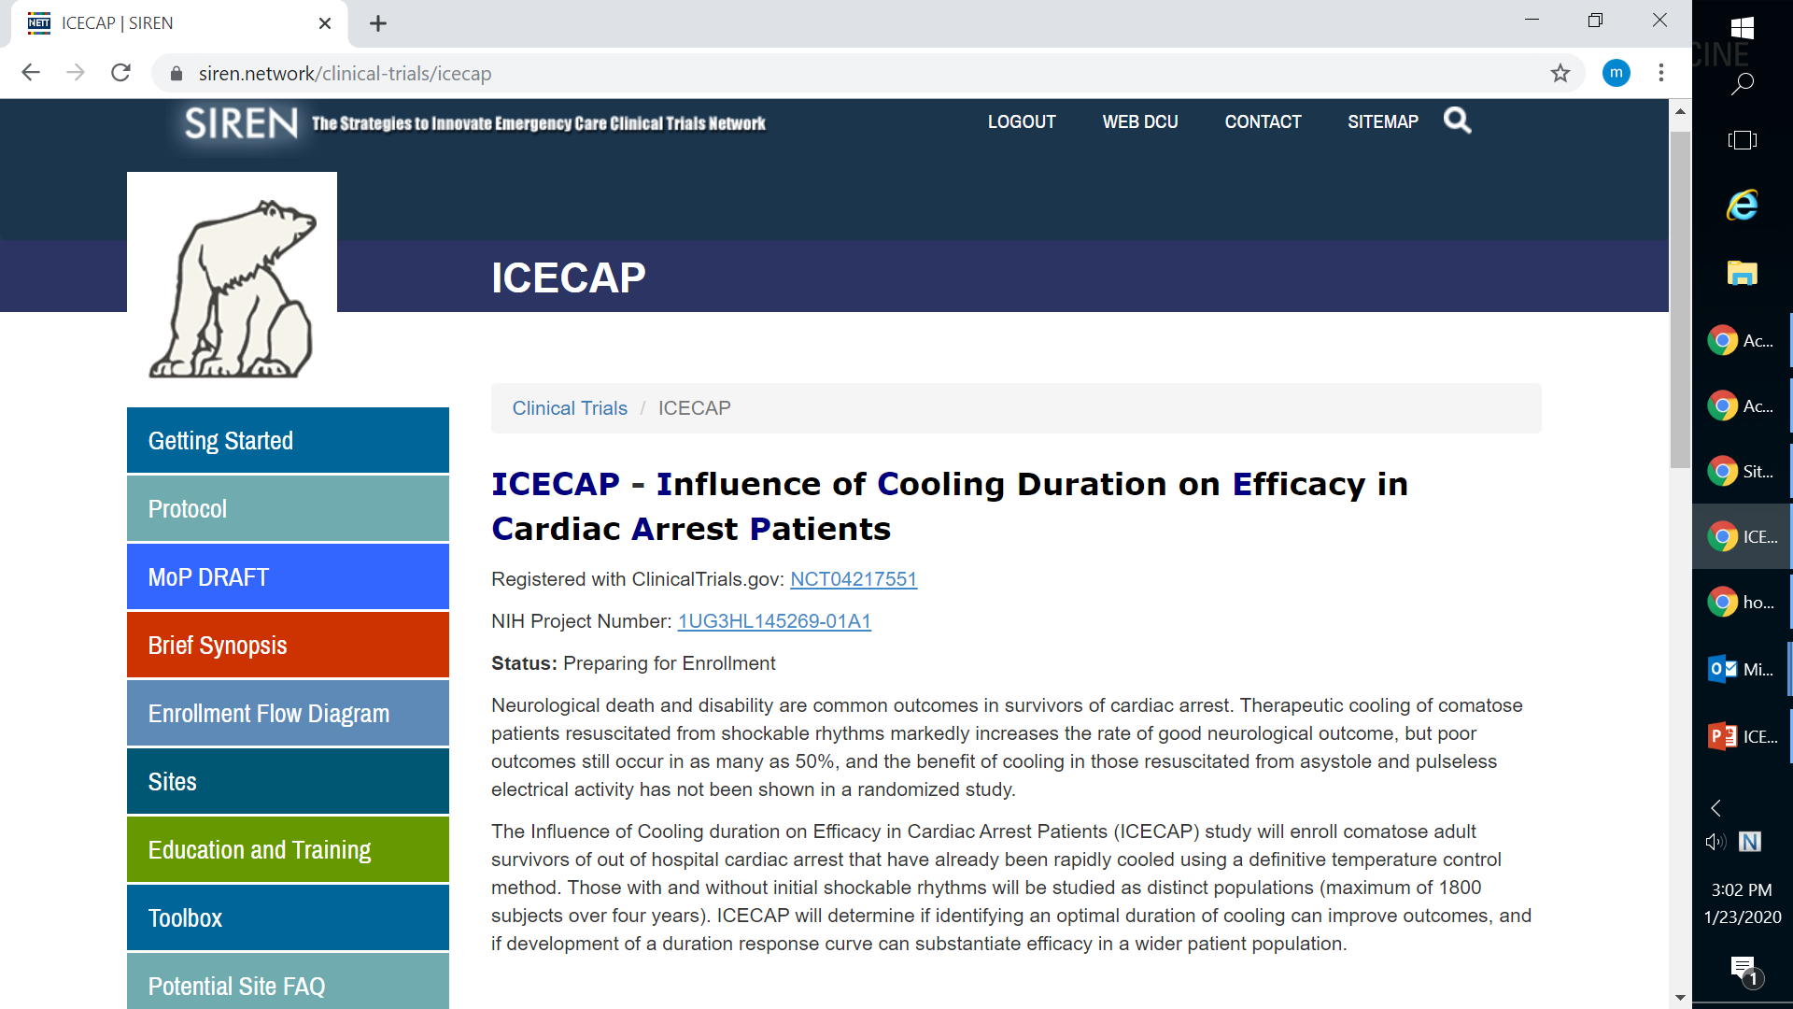
ICECAPtrial.org
Locate study materials: protocol, cIRB approved ICF, milestones, regulatory parameters document, MOP
Access training materials and FAQs
Notes:
‹#›

Slide 5
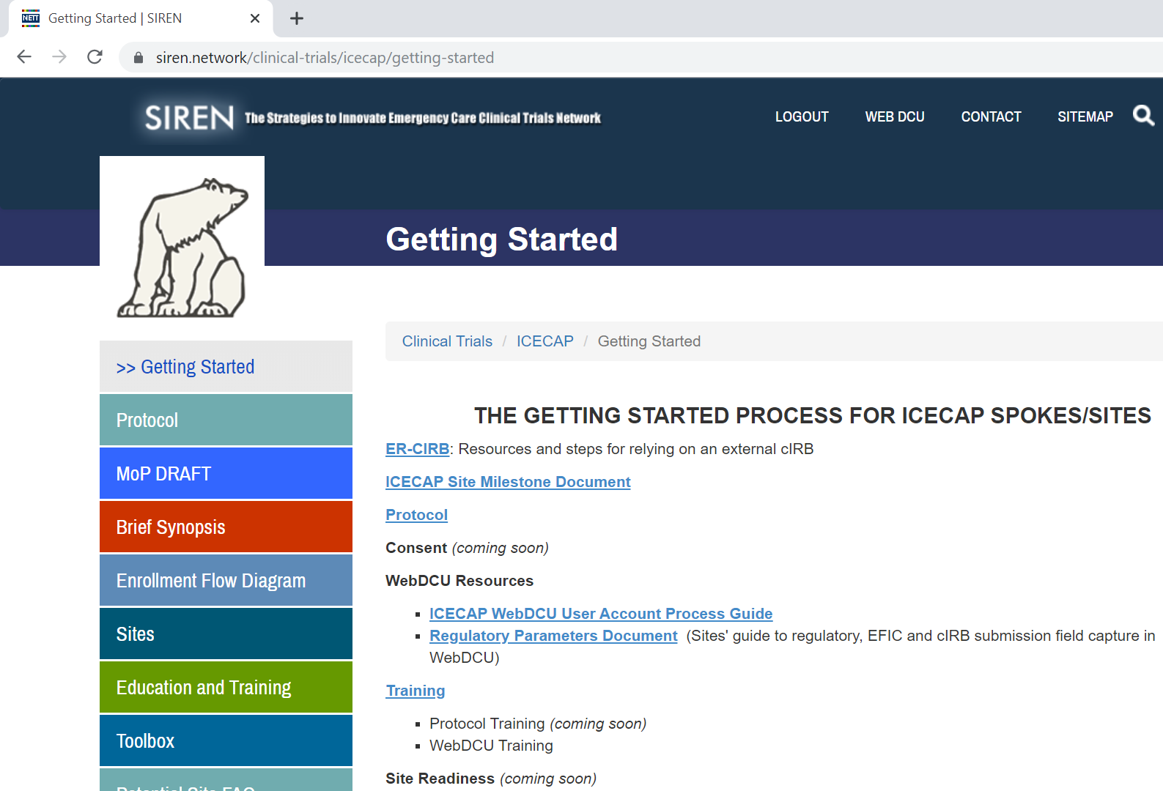
Getting Started
Important information and materials for preparing for ICECAP
Useful links to trial resources
Notes:
‹#›

Slide 6
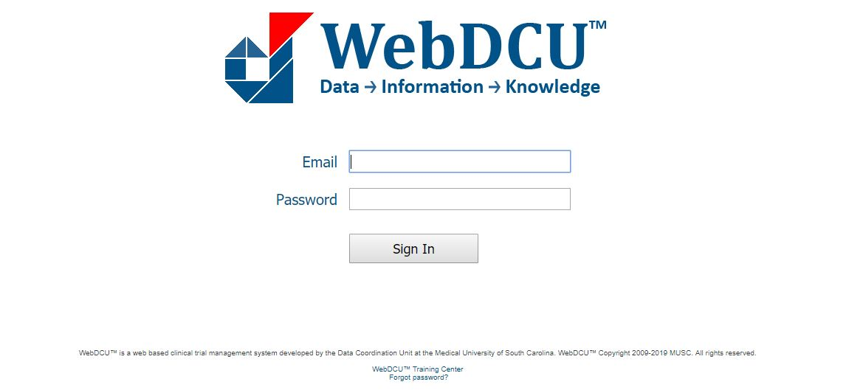
ICECAP Regulatory Database: WebDCUTM
Notes:
‹#›

Slide 7
ICECAP Regulatory Database: WebDCUTM
ICECAP regulatory database will serve as the central repository for all regulatory documents
IRB Approvals and other essential documents will be available via the database
Automated emails will be sent for expired, expiring, and missing documents
Notes:
‹#›

Slide 8
Regulatory Parameters Document
Outlines all regulatory and training requirements
People Document: Specific to an individual study team member

Slide 10
Regulatory Parameters Document
Outlines all regulatory and training requirements
Site Document: Applies to a site/Spoke

Slide 11
Regulatory Site Documents Needed for Startup
IRB Approved Informed Consent (Advarra)
cIRB Tables
Site Overview (SIREN)
Site Regulatory Inspection (SIREN)
Initial Site Submission (ICECAP)
FWA for your Institution
CLIA Certification
Attestation of Study Team Education and Training
Ceding Request to Local IRB
Ceding Acknowledgment from Local IRB
HSP Requirements
IRB Approval (Advarra)
Reminder: Please upload all documents as pdfs in WebDCU

Slide 12
Regulatory People Documents Needed for Startup
Applicable Team Members
Medical License
BOOST Data Training
Regulatory Document Training
Blinded Outcomes Assessment Training
All Team Members
CV
HSP
GCP
Protocol Training
Reminder: Please upload all documents as pdfs in WebDCU

Slide 13
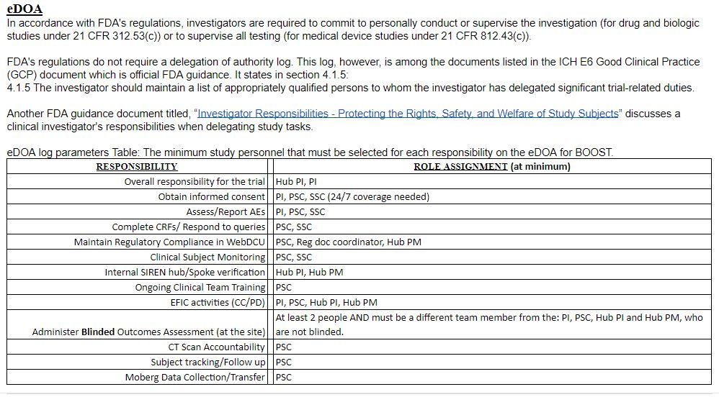
.

Slide 14
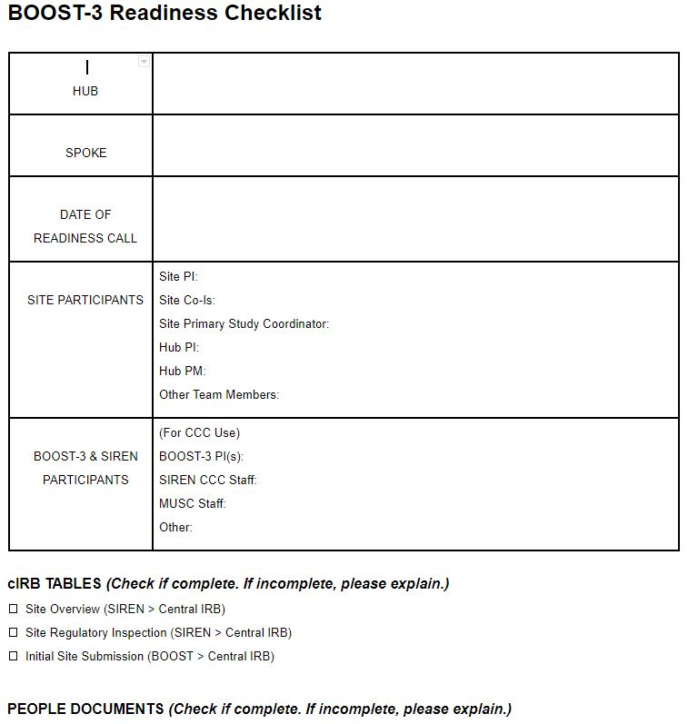
Readiness Checklist
Sites will complete to confirm regulatory and logistical readiness
List names of site participants who will be in attendance
Respond to all questions in logistics section
Email completed checklist prior to the call (ICECAP-contact @umich.edu)

Slide 15
Final Checks to be Released to Enroll in ICECAP
eDOA Complete
All documents in WebDCU
Complete Readiness Checklist
Send completed readiness checklist to ICECAP-contact@umich.edu and request a readiness call

Slide 16
Readiness Call
A readiness call is the study initiation meeting
Site Personnel: Hub PI and PM, Trial PI, Primary SC. Other team members are welcome to attend!
ICECAP PI, Site Manager, MUSC personnel and other team members
Conducted via phone conference
Q&A with trial leadership and CCC
Evaluate and confirm site readiness for study activation

Slide 17
Post Call – Site Activation
If action items remain after the readiness call, site personnel will resolve prior to activation
If no action items, site will be activated and released to enroll (assuming site has been approved by Advarra)
ICECAP study team will be notified via email

Slide 18
Ongoing Site Management
It is the responsibility of each Hub/Site to maintain regulatory compliance, inclusive of site documents and people documents, throughout the duration of the trial
Documents approaching expiration should be reconciled prior to the expiration date
Study team personnel who are out of regulatory compliance should not participate in any trial related activities

Slide 19
Study Team Changes
Documented in ICECAP Database
Update eDOA
Upload all team personnel documents, trainings and certifications (eg., CV, medical license)
Study team members cannot begin research related activities until all of the above have been reconciled.

Slide 20
Who to Contact?
For immediate emergency assistance (enrollment, clinical, protocol, adverse events, etc.), please use the 24/7 ICECAP Principal Investigator Hotline: 1-833-442-3227 (833-4ICECAP)
Clinical questions for ICECAP trial PIs: ICECAP-PIs@umich.edu
For non-urgent data entry/WebDCU questions call: 1-866-450-2016
For all other non-urgent questions: ICECAP-contact@umich.edu
For all email communications, please include ICECAP at the beginning of the subject line. Or #ICECAP

Slide 21
Questions?
Mickie Speers
734-232-3474
lraes@med.umich.edu

