Slide 1
Clinical Standardization
Romer Geocadin, Robert Silbergleit
Investigator Kick-off Meeting
January 30-31, Clearwater, Florida

Slide 2
Investigators Meeting
Clearwater, FL.
Jan 30 and 31, 2020

Slide 3
Difference Between:
Study
Protocol
Clinical
Standardization
Evidence
Based
Practices that we can agree on

Slide 4
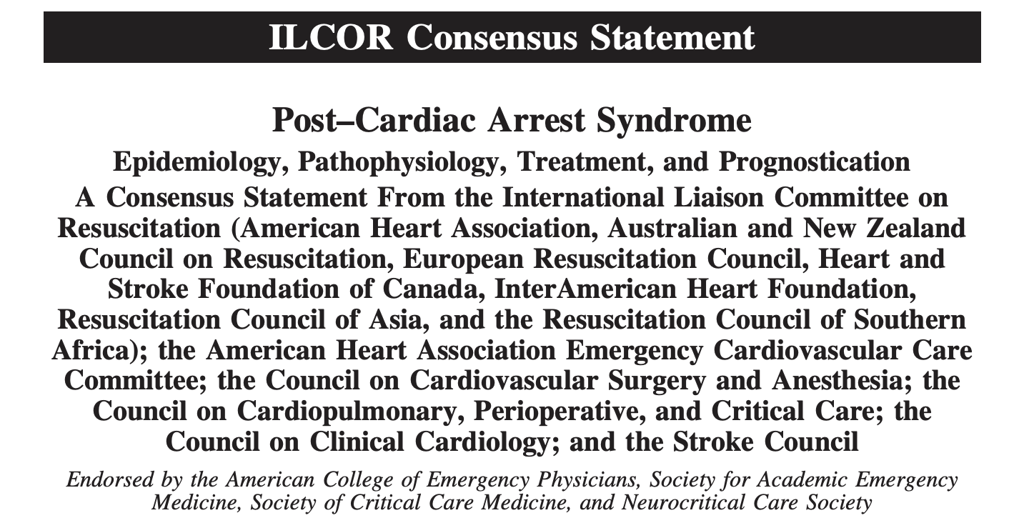

Slide 5
Circulation. 2015;132(suppl 2):S465–S482

Slide 6
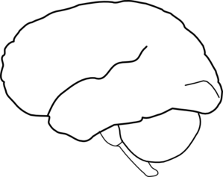
Post-Cardiac Arrest Syndrome – Intensive Care Management Consensus Conference October 15, 2019 17th Neurocritical Care Society Meeting Vancouver , BC, CANADA

Slide 9
Clinical Standardization Team Multi-disciplinary – Multi-professional
Romer Geocadin, MD - Neuro-ICU
Will Meurer, MD - EM
Robert Silbergleit, MD - EM
Brian O’Neil, MD - EM
Stephan Mayer, MD - Neuro - ICU
Lori Madden, RN, PhD – Nurse-Scientist
William A. Knight IV, MD -- EM / Neuro-ICU
Kelly Sawyer, MD – EM
Mimi Peberdy, MD - Cardiology – ICU
Mike Donnino, MD - EM - Med ICU
Teresa May, MD - Pulm-Med and NICU

Slide 10
Emergency
Department
Critical Care Unit
D/C
Hospital Unit
TH Induction
TH Maintenance
TH Rewarming
Normothermia
Shivering
Shivering
Critical care
Med – ICU
Cardiac Tx
Neuro
- EEG/SZ
Critical care
Cardiac Tx
Med – ICU
- BP
- O2/Vent
- Glucose
- DVT
- Infection
Neuro
- EEG/SZ
- Myoclonus
- Brain Edema
Goal of
Care
Brain Death
Medical Futility
Neurologic Prognosis
WLST

Slide 11
Temperature Management
Core Temperature Monitoring
Two Sources:
Preferred: Esophageal, Endovascular, Bladder*
Less Preferred: Rectal
*note: may be less reliable in anuric patients

Slide 12
Target Temperature of the Study
Target: 33 degrees Celsius
Deviation from target: 1 degree Celsius (Range 32-34 degree C)
Duration at target temperature: Based on randomization

Slide 13
Rewarming Parameters
Target Temperature at end of rewarming: 36 degrees C
Controlled rewarming at 0.15 degree per hour for those 24hr or more
Controlled rewarming equal to duration of hypothermia for those < 24 hour arms (e.g. 6 hours rewarming for those cooled for 6 hours)
Use cooling/rewarming device

Slide 14
Controlled Normothermia
After rewarming, keep core temperature within 36.5∘C to 37.5∘C
Period of controlled normothermia: 48 hours
Use definitive devise is preferred

Slide 15
Emergency
Department
Critical Care Unit
D/C
Hospital Unit
TH Induction
TH Maintenance
TH Rewarming
Normothermia
Shivering
Shivering
Critical care
Med – ICU
Cardiac Tx
Neuro
- EEG/SZ
Critical care
Cardiac Tx
Med – ICU
- BP
- O2/Vent
- Glucose
- DVT
- Infection
Neuro
- EEG/SZ
- Myoclonus
- Brain Edema
Goal of
Care
Brain Death
Medical Futility
Neurologic Prognosis
WLST

Slide 16
Shivering Management
Assess hourly using Bedside Shivering Assessment Scale (BSAS)
Target BSAS Score < 1
0 | None: no shivering noted on palpation of the masseter, neck or chest wall
1 | Mild: shivering localized to the neck and/or thorax only
2 | Moderate: shivering involves gross movements of the upper extremities (in addition to neck and thorax)
3 | Severe: shivering involves gross movements of the trunk and upper and lower extremities

Slide 17
Management of Shivering: Local Practice
Suggested Management
Targeted Temperature Management (TTM) for Cardiac Arrest Shivering, Sedation and Neuromuscular Blockade Pathway (modified from May et al.)
Stage of Cooling | Sedation for Shivering | Neuromuscular Blockade (NMB) | Other Shivering Therapy
INDUCTION | fentanyl 25-50 mcg/hr and propofol 20-40 mcg/kg/min Monitor BSAS hourly Titrate sedation to BSAS of <1 | vecuronium 0.1mg/kg Never use NMB in lieu of adequate sedation (ie BIS < 50); If BSAS ≥1 titrate to train of 4 (TOF) = 0

Slide 18
MAINTENANCE | Monitor BSAS hourly Titrate sedation to BSAS of <1 If BSAS=0 then titrate to RASS target | Continue only as needed for BSAS >1 despite titration of sedation cEEG monitoring indicated during extended NMB | acetaminophen 1g IV q6 (adjust dose or avoid for liver dysfunction) Counter-warming: warm air blanket to neck, torso and extremities
REWARMING | fentanyl 50-200 mcg/hr Decrease propofol prn Consider adding dexmedetomidine Once rewarmed, rapidly wean sedation to allow evaluation | Discontinue all NMB | acetaminophen Counter-warming Replace magnesium to ≥4

Slide 19
Emergency
Department
Critical Care Unit
D/C
Hospital Unit
TH Induction
TH Maintenance
TH Rewarming
Normothermia
Shivering
Shivering
Critical care
Med – ICU
Cardiac Tx
Neuro
- EEG/SZ
Critical care
Cardiac Tx
Med – ICU
- BP
- O2/Vent
- Glucose
- DVT
- Infection
Neuro
- EEG/SZ
- Myoclonus
- Brain Edema
Goal of
Care
Brain Death
Medical Futility
Neurologic Prognosis
WLST

Slide 20
Blood Pressure Management
BP Monitoring: Invasive (A-line) or Non-invasive Means (Cuff)
Preferred BP: Lower limit MAP 65 mmHg, optimal cerebral perfusion may require higher MAP.
Higher MAP is encouraged as clinical situation allows
Management of MAP < 65 mmHg: Local practice
Fluids, vasopressors, inotropes and mechanical support may be used depending on clinical need
Sequence and combination at the discretion of clinicians

Slide 21
Oxygenation
Continuous pulse oximetry is required
Arterial blood gases as needed per local standard
Preferred O2 saturation 94% to 98%
Wean oxygen ASAP to keep within preferred range
Use of other interventions (mechanical ventilator and manipulation of respiratory support) per local practice

Slide 22
Ventilation
Normocapnea is preferred
P_{ET}CO₂ preference is 35-40 mmHg
Titrate tidal volume (initially 6-10 mL/kg) and ventilatory rate to maintain target P_{a/ET}CO₂ (AHA Class IIb, LOE C).

Slide 23
Glucose control
Treatment of hypoglycemia or hyperglycemia will be dependent on local practice
Preferred target: serum glucose is between 80 to 180 mg/dL.

Slide 24
Thrombotic Venous Complication
Prevention: DVT prophylaxis via SCDs, subcutaneous heparin, low molecular weight heparin or other recommended prophylaxis pharmacological agents shall be instituted within 24 hours of ROSC, unless a contraindication exists
No routine monitoring is required
Treatment with unfractionated or low-molecular weight heparin with transition to oral anticoagulation as appropriate

Slide 25
Management of Cardiac Complications
PCI to be performed at the discretion of the local care team in accordance with AHA guidelines for early treatment of post-cardiac arrest patients, based on clinical suspicion, EKG findings and cardiac biomarkers.
Placement of AICD will also be at the discretion of local clinical team.

Slide 26
Seizure Diagnosis
EEG is needed for seizure diagnosis
EEG interpretation promptly within first 24 hours after ROSC.
Continuous EEG (cEEG) is preferred, initiated as soon as possible and continued through rewarming.
If cEEG is not available, then a repeat EEG during the second 24 hours after ROSC should be performed. (AHA Class IIb, LOE C).

Slide 27
Seizure Management
Treatment is mandated for unequivocal overt clinical or electrographic seizures.
Electrographic seizures should be treated aggressively as the patient's clinical status may safely tolerate
Treatment of seizures per established guidelines or local practice
Other epileptiform activity is treated per local practice.

Slide 28
Status Epilepticus
Definitions of status epilepticus and refractory to treatment may differ across site. Suggested definition
Status epilepticus - electrographically as sequences (>10 sec) of repetitive epileptiform discharges with an amplitude >50μV and a medium frequency ≥1Hz, constituting >50% of a 30 minute period with or without clinical manifestations.
Treatment refractory - unresponsive to treatment with propofol, midazolam or pentothal to a slow suppression burst pattern for 24 h in combination with at least one intravenous antiepileptic medication in adequate doses for at least 24 h

Slide 29
Infections
Sensitive detection balanced with sufficiently specific diagnosis
Daily CXR and daily CBC ok
Culture only for cause, based on imaging, fever, clinical suspicion
Not required for any of these in isolation
CDC National Healthcare Safety Network (NHSN) reporting
Prophylactic abx for VAP permitted but not required
Abx choice, source control
Notes:
Monitoring / Diagnosis
Rationale: our goal is to encourage a consistent pattern of care that balances the need for sensitive detection of infectious complications with sufficiently specific diagnosis. The balance is important because high rates of false positives associated with daily or indiscriminate cultures make it more difficult to detect changes in the real rate of infections between treatments. As with the rest of the CST guideline, the goal is to optimize detection of signal from noise.
Daily chest x-ray and daily CBC if desired by the treating team are appropriate and may be used to screen for infection, especially during the period of intubation and cooling. Cultures should not be performed just for monitoring or surveillance in the absence of clinical indications.
Cultures of blood, urine or sputum, and urinalysis should be performed based on specific indications. Indications for obtaining cultures include:
Imaging: a new infiltrate on chest X ray is a reasonable indication for blood and sputum cultures.
Fever: either a direct elevation of core temperature (despite or after TTM) or a drop in water bath temperature of cooling device as determined by local practice, if indicative of fever is a reasonable indication for obtaining cultures.
Clinical suspicion: cultures may be obtained if infection is suspected clinically based on observations such as increasing oxygen requirement, hemodynamic evidence of sepsis like direct or indirect evidence of decreased systemic vascular resistance, evident pyuria or skin or soft tissue infection on exam, or progression of leukocytosis or shift.
None of these observations or indications in isolation require cultures or other accelerated monitoring, but are more suggestive when observed together. In particular, the presence of leukocytosis alone is insufficient to generate clinical suspicion and cultures.
When cultures are indicated, the site of cultures should be appropriate to the suspected source.
Treatment
Prophylactic antibiotics to avoid ventilator associated pneumonia are permitted but not required as clinical trial data did not show an impact on ventilator-free days or outcome. Prophylactic antibiotics are not otherwise indicated.
When there is sufficient suspicion of infection, use and choice of antibiotics should be given consistent with institutional or clinical team preferences and local antibiotic susceptibilities. Source control is always indicated whenever possible. In cases of suspected infection of endovascular cooling catheter, pulling the catheter is recommended if (1) the cooling catheter is the likely source of CLABSI and (2) the patient is worsening.

Slide 30
Transgressions
Hypoxia
Hypotension
Hypoglycemia
Shivering
Administratively support quality improvement during trial
Characterize standardization achieved after the trial
Notes:
Monitoring / Diagnosis
Rationale: our goal is to encourage a consistent pattern of care that balances the need for sensitive detection of infectious complications with sufficiently specific diagnosis. The balance is important because high rates of false positives associated with daily or indiscriminate cultures make it more difficult to detect changes in the real rate of infections between treatments. As with the rest of the CST guideline, the goal is to optimize detection of signal from noise.
Daily chest x-ray and daily CBC if desired by the treating team are appropriate and may be used to screen for infection, especially during the period of intubation and cooling. Cultures should not be performed just for monitoring or surveillance in the absence of clinical indications.
Cultures of blood, urine or sputum, and urinalysis should be performed based on specific indications. Indications for obtaining cultures include:
Imaging: a new infiltrate on chest X ray is a reasonable indication for blood and sputum cultures.
Fever: either a direct elevation of core temperature (despite or after TTM) or a drop in water bath temperature of cooling device as determined by local practice, if indicative of fever is a reasonable indication for obtaining cultures.
Clinical suspicion: cultures may be obtained if infection is suspected clinically based on observations such as increasing oxygen requirement, hemodynamic evidence of sepsis like direct or indirect evidence of decreased systemic vascular resistance, evident pyuria or skin or soft tissue infection on exam, or progression of leukocytosis or shift.
None of these observations or indications in isolation require cultures or other accelerated monitoring, but are more suggestive when observed together. In particular, the presence of leukocytosis alone is insufficient to generate clinical suspicion and cultures.
When cultures are indicated, the site of cultures should be appropriate to the suspected source.
Treatment
Prophylactic antibiotics to avoid ventilator associated pneumonia are permitted but not required as clinical trial data did not show an impact on ventilator-free days or outcome. Prophylactic antibiotics are not otherwise indicated.
When there is sufficient suspicion of infection, use and choice of antibiotics should be given consistent with institutional or clinical team preferences and local antibiotic susceptibilities. Source control is always indicated whenever possible. In cases of suspected infection of endovascular cooling catheter, pulling the catheter is recommended if (1) the cooling catheter is the likely source of CLABSI and (2) the patient is worsening.

Slide 31
Emergency
Department
Critical Care Unit
D/C
Hospital Unit
TH Induction
TH Maintenance
TH Rewarming
Normothermia
Shivering
Shivering
Critical care
Med – ICU
Cardiac Tx
Neuro
- EEG/SZ
Critical care
Cardiac Tx
Med – ICU
- BP
- O2/Vent
- Glucose
- DVT
- Infection
Neuro
- EEG/SZ
- Myoclonus
- Brain Edema
Goal of
Care
Brain Death
Medical Futility
Neurologic Prognosis
WLST

Slide 32
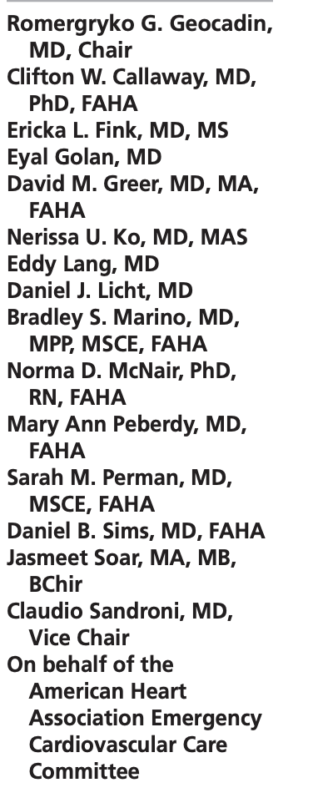
Circulation. 2019;140:e517–e542.
“Accurate prognostication is important to avoid pursuing futile treatments when poor outcome is inevitable but also to avoid an inappropriate withdrawal of life-sustaining treatment in patients who may otherwise have a chance of achieving meaningful neurological recovery.”
“Inaccurate neurological prognostication leading to withdrawal of life-sustaining treatment and deaths may significantly bias clinical studies, leading to failure in detecting the true study outcomes.”
The writing group determined that the overall quality of existing neurological prognostication studies is low.
As a consequence, the degree of confidence in the predictors and the subsequent outcomes is also low.

Slide 33
Goals of Care
Prospectively collected the mode of death in 4265 OHCA
one-third had WLST in <72 hours after admission because of perceived poor neurological prognosis.
Estimated: WLST for neurological reasons within 72 hours mortality in ≈2300 Americans each year, of whom nearly 1500 (65%) might have had a functional recovery if allowed to live longer. Elmer, et al Resus 2016

Slide 34
Goals of Care
Goals of Care
Crit Care Med 2014; 42:2493–2499
N=154
10% (8 of 78) patients (10%) who died qualified as brain dead
81% of all patients (63 of 78) died due to WLST
32% (20/56 comatose survivors had TH and awoke after 72 hours with good neurologic outcomes.

Slide 35
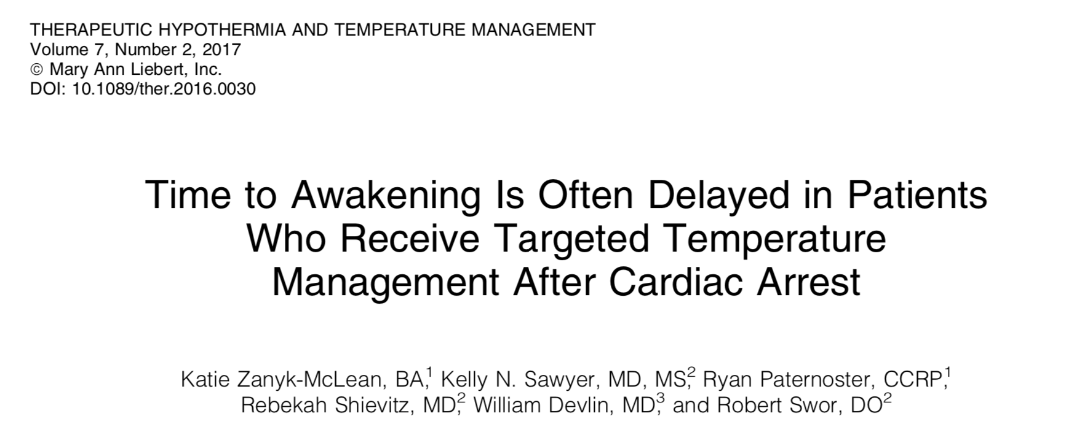
Goals of Care
Awakening >72 hours after ROSC was common with 31 patients surviving to discharge, with 16 as good neurological outcome on hospital discharge. Died before discharge, 54 (29.5%) had care withdrawn less than 72 hours after ROSC.

Slide 36
Withdrawal of Life Sustaining Therapies
Exclusion: if an early WLST (<96 hrs) is consistent with the goals of care
All participants in the trial are expected to receive active intensive care as needed for at least 96 hours after cardiac arrest (i.e. after rewarming from the longest possible duration of cooling to which participants may be allocated in the trial).
An evaluation of neurologic prognosis will be performed on hospital day 5 for participants not regaining consciousness.

Slide 37
Withdrawal of Life Sustaining Therapies Prior to Completion of Study Protocol: Brain Death Diagnosis
Participants in the trial may undergo brain death testing and diagnosis as defined by institutional standards (or as defined by guidelines by the American Academy of Neurology).
Patients need to be rewarmed, sedation and paralytics stopped and neurologic testing and apnea test undertaken.
Ancillary testing per local practice
AAN Protocol Provided Later

Slide 38
Withdrawal of Life Sustaining Therapies Prior to Completion of Study Protocol: Medical Futility
Life sustaining therapies may be withdrawn earlier than 96 hours because of medical futility or otherwise poor prognosis based on non-neurological problems (e.g. previously unknown disseminated end-stage cancer or multisystem organ failure, medically refractory shock, or repeated recurrent cardiac arrest).

Slide 39
Withdrawal of life sustaining therapies: >96 hours and therapeutic hypothermia
2015 AHA Post Cardiac Arrest Management (Callaway et al 2015) guidelines recommend that the earliest time for prognostication using clinical examination in patients treated with TTM, where sedation or paralysis could be a confounder, may be 72 hours after return to normothermia (Class IIb, LOE C-EO)
Neurologic prognostication of unfavorable outcome preceded withdrawal of life sustaining therapies

Slide 40
Neurologic Prognosis after TH
Neurologic prognostication should always be performed by an experienced and objective clinician.
To minimize bias, it is also encouraged that neurologic prognostication be undertaken by someone blinded from the duration of the cooling therapy.
Adequate time is given for clearance of sedative and paralytics

Slide 41
Multi-modal Neuro-prognostication
Neurologic Examination (Preferred) > 96 hr
Persistent GCS motor score 1 or 2
Persistent absence of bilateral pupillary light reflex
automated pupillometer is preferred
Persistent absence of corneal reflex
Neurophysiologic Testing (Preferred) > 96
Absence of bilateral N20 on SSEP testing hr
Absence of EEG reactivity to external stimuli
Additional supportive parameters
Head CT with global brain (cortex and subcortex) edema
Brain MRI with extensive DWI abnormalities in cortex and brainstem

Slide 42
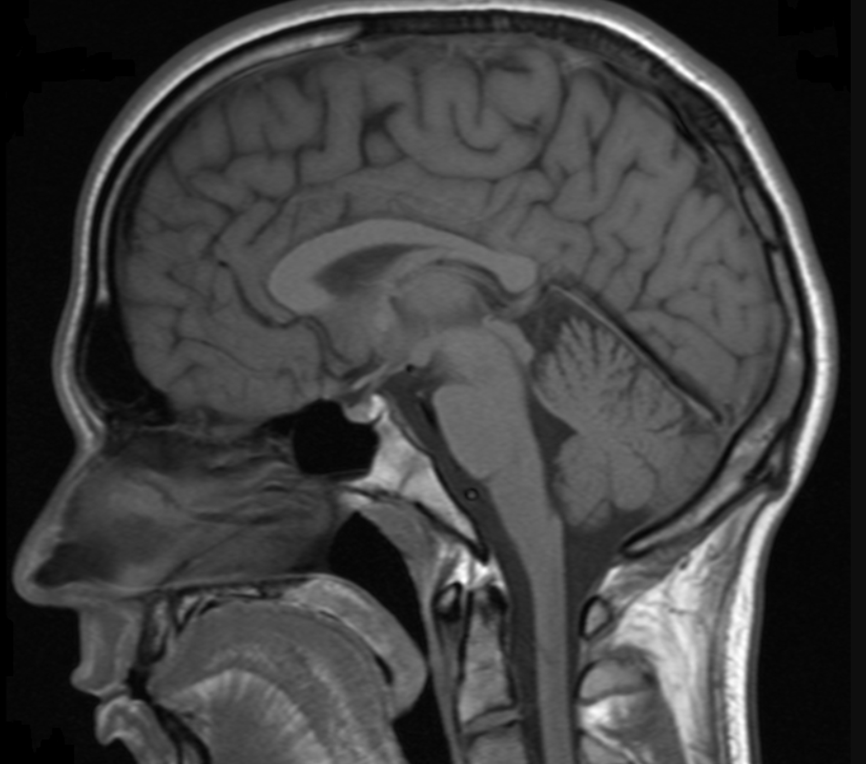

Slide 43
Less Reliable Parameters for Neuro-prognosis
Duration of Arrest Time and CPR time
Myoclonus
Serum Biomarkers
Seizures and Status Epilepticus (unless proven to be intractable to maximal medical therapies [i.e. use continuous IV anesthetics])

Slide 44
Brain Death Criteria (AAN)
Prerequisites
Coma, irreversible and cause known.
Neuroimaging explains coma.
CNS depressant drug effect absent (if indicated toxicology screen; if barbiturates given, serum level <10 μg/mL).
No evidence of residual paralytics (electrical stimulation if paralytics used).
Absence of severe acid-base, electrolyte, endocrine abnormality.
Normothermia or mild hypothermia (core temperature >36°C).
Systolic blood pressure ≥100 mm Hg.
No spontaneous respirations.

Slide 45
Brain Death Criteria (AAN)
(all must be checked)
Pupils nonreactive to bright light.
Corneal reflex absent.
Oculocephalic reflex absent (tested only if C-spine integrity ensured).
Oculovestibular reflex absent.
No facial movement to noxious stimuli at supraorbital nerve, temporomandibular joint.
Gag reflex absent.
Cough reflex absent to tracheal suctioning.
Absence of motor response to noxious stimuli in all four limbs (spinally mediated reflexes are permissible).

Slide 46
Apnea Testing (AAN)
Patient is hemodynamically stable.
Ventilator adjusted to provide normocarbia (PaCO2 35–45 mm Hg).
Patient preoxygenated with 100% FiO2 for >10 minutes to PaO2>200 mm Hg.
Patient well-oxygenated with a positive end-expiratory press (PEEP) of 5 cm H₂O
Provide oxygen via a suction catheter to the level of the carina at 6 L/min or attach T-piece with continuous positive airway pressure (CPAP) at 10 cm H2O.
Disconnect ventilator.
Spontaneous respirations absent.
Arterial blood gas drawn at 8–10 minutes, patient reconnected to ventilator.
PCO2 ≥60 mm Hg, or 20 mm Hg rise from normal baseline value.

Slide 48
This is our moonshot…
Thank you for joining us in this endeavor.
rgeocad1@jhmi.edu

