Slide 1
Adaptive Design
Will Meurer

Slide 2
Clinical Trials are Models with Tons of Guesses Assumptions
Dose from animal models is close
No heterogeneity of effect
Subgroups respond equally
Some subgroups excluded
DOSES ARE INDEPENDENT (terrible)
Effect size to create “reasonable” sample size
“Noise” in outcomes can be understood and overcome
Duration of treatment practical
LESSON: Make many compromises to reduce number of parameters to make model “solvable”

Slide 3
Comparison to an alternative scientific strategy
Trying to define a duration response curve by looking at only 3 time points is perilous…
Inability to explore complete range of interest
Likely to miss the inflection and the plateau
Ultimately unconvincing to the user community

Slide 4
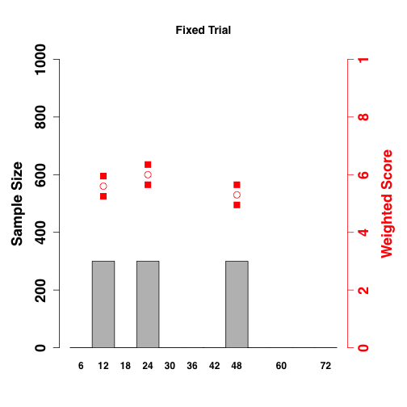
Middle Effect
Later Effect
This final trial result……
…Is consistent with any
of these scenarios of “truth”
Earlier Effect
Null
Harm
Open red dots are point estimates of efficacy. Grey bars are number of subjects in each arm.

Slide 5
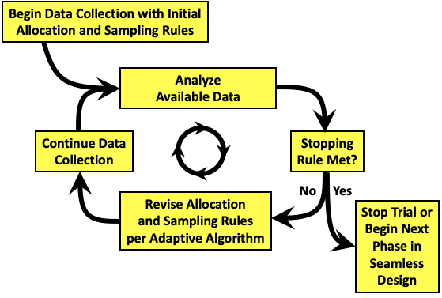
The Adaptive Process

Slide 6
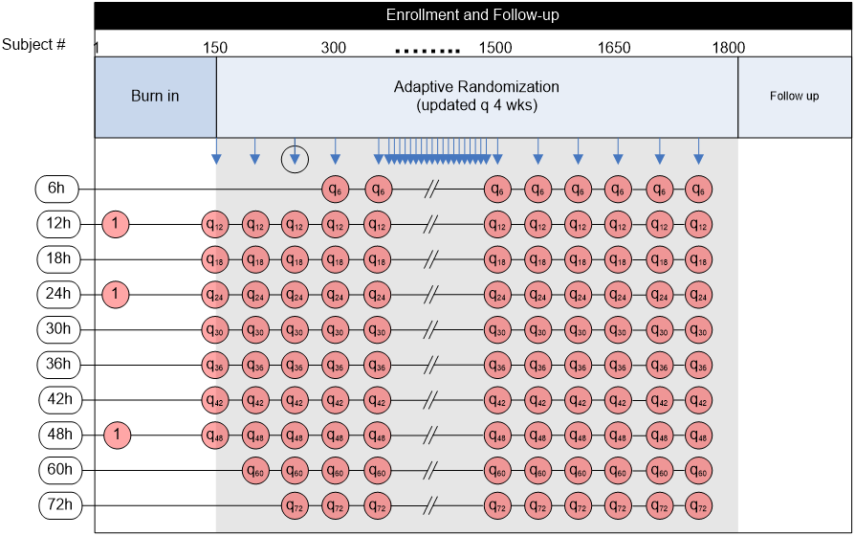
200
Notes:
Schematically the trial design looks like this. All of the possible durations that will be tested are shown in these white boxes over on the left side. They range from 6 to 72 hours. The sequential columns of red circles represent progressive time and accrual in the trial. You can see that there are 3 arms in the burn-in period each with 1:1:1 allocation (each arm equally likely at one third each), but that shorter, longer, and interspersed arms are potentially added incrementally. The blue arrows at the top indicate pre-planned interim analyses about every 4 weeks or 50 subjects. At each look, there is assignment of a new batch of randomization vectors. If the 6 hour window has opened, then there is the potential to stop for futility in that arm.

Slide 7
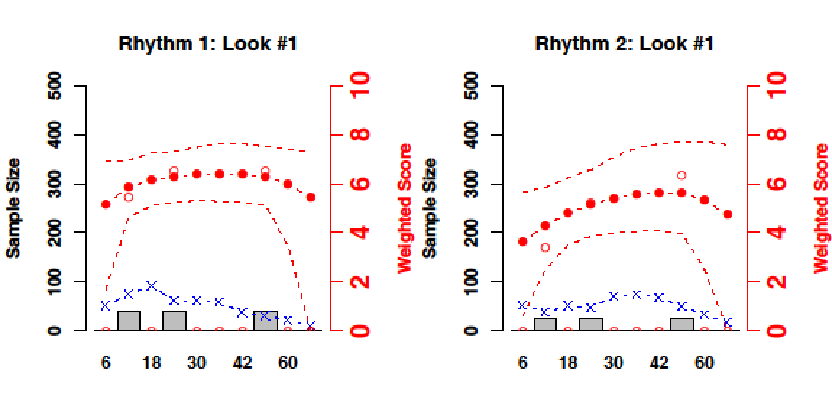
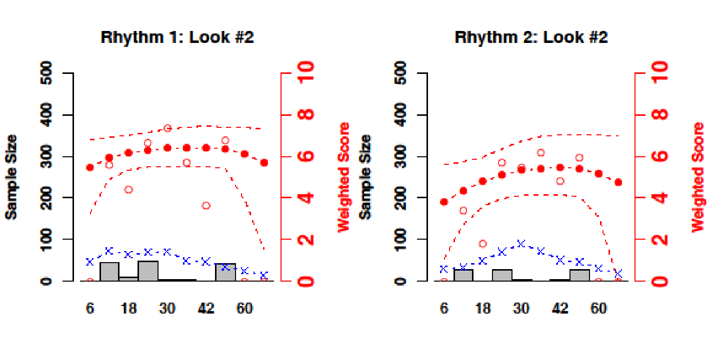
Example Simulation
Hollow dots are the observed responses so far
Shockable
Non-shockable
Solid dots represent the current model, dashes show CI
Blue x’s are randomization vectors for the next 50
Duration (hrs)
Duration (hrs)
Grey Bars are number of randomized subjects at each duration
Notes:
We simulated 47 scenarios 5000 times each. Each scenario represents one possible “truth” and for each simulation a random distribution of subjects probabilistically consistent with that truth is created. The simulation then shows how the study design and algorithm will perform for that set of conditions.
Walking through just one simulation of one scenario can be illustrative of how the trial works. These figures represent each look at the data. The graphs show the duration arms along the horizontal axis, the grey bar graph shows the number of subjects at each duration, The blue line shows how the next 50 subjects will be randomized. The open red circles are the accumulating observed outcomes, and the solid red circles and dotted red line show the emerging model of the duration response curve.
Here is look 1, and then look two.

Slide 8
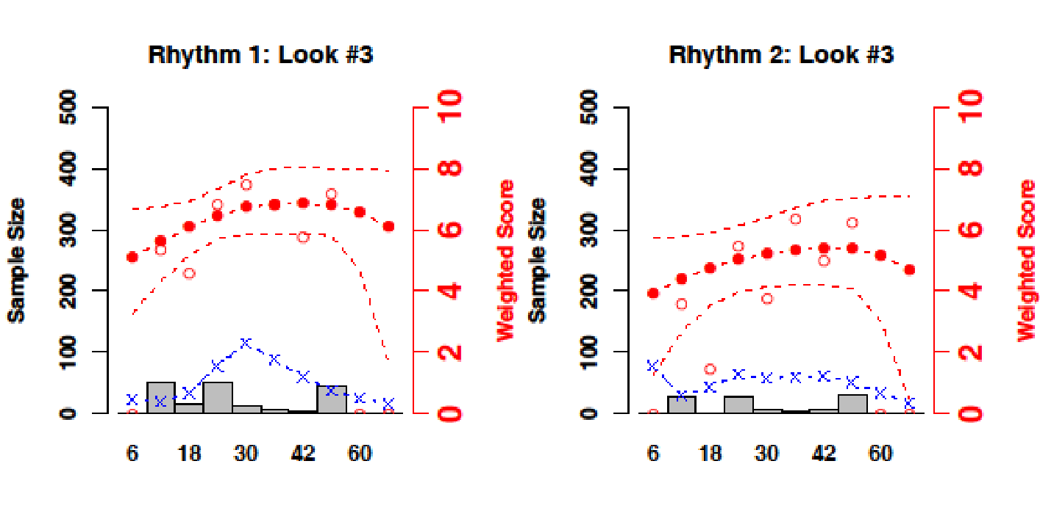
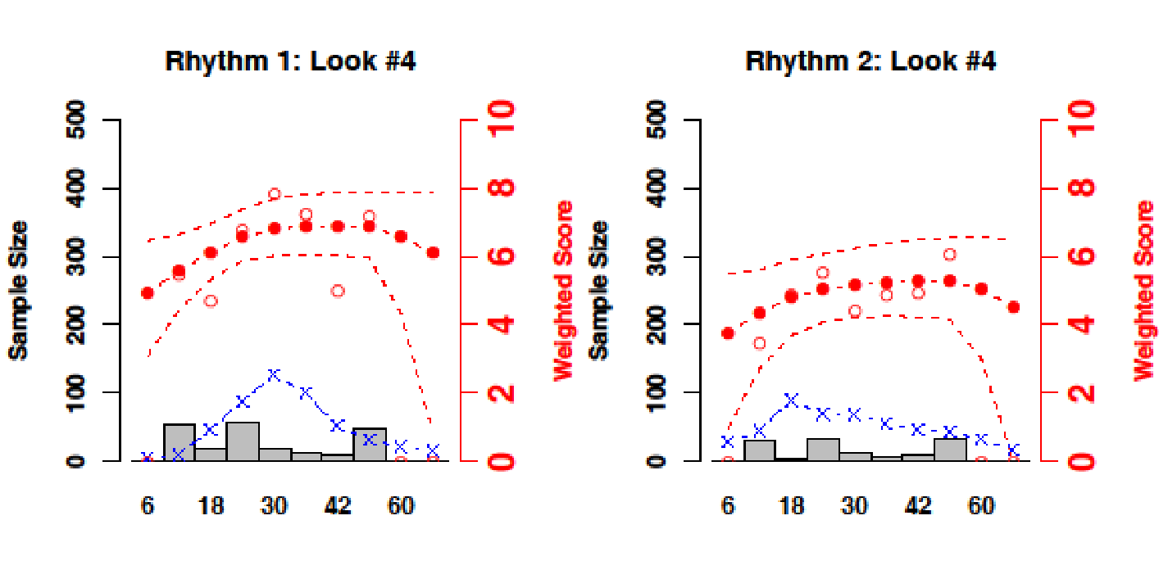
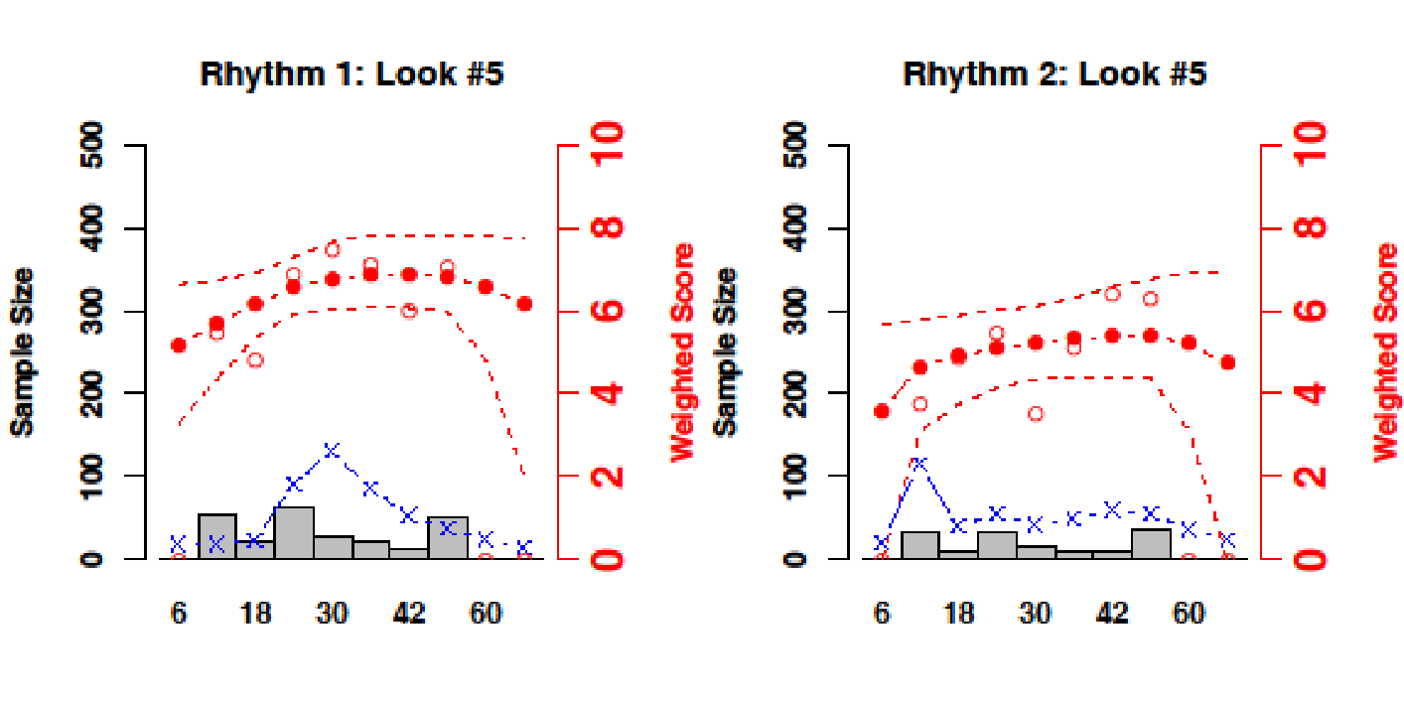
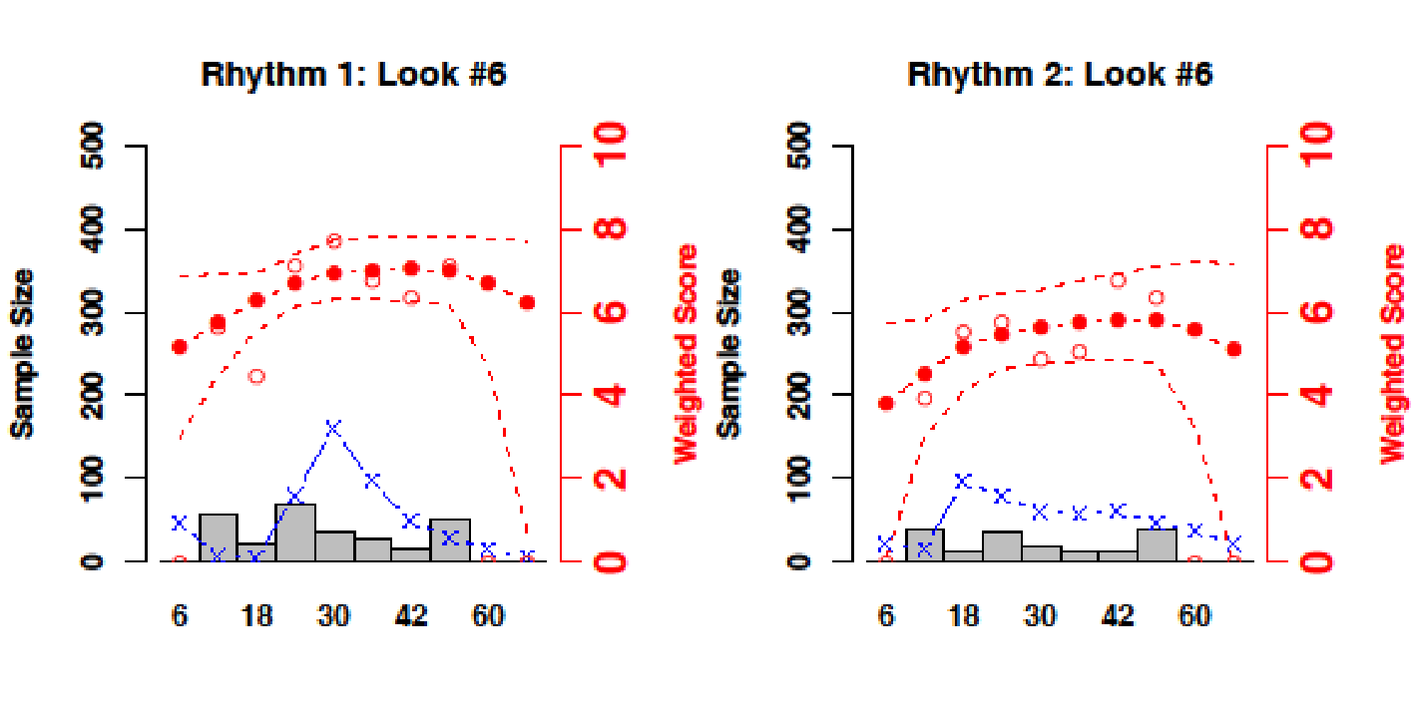
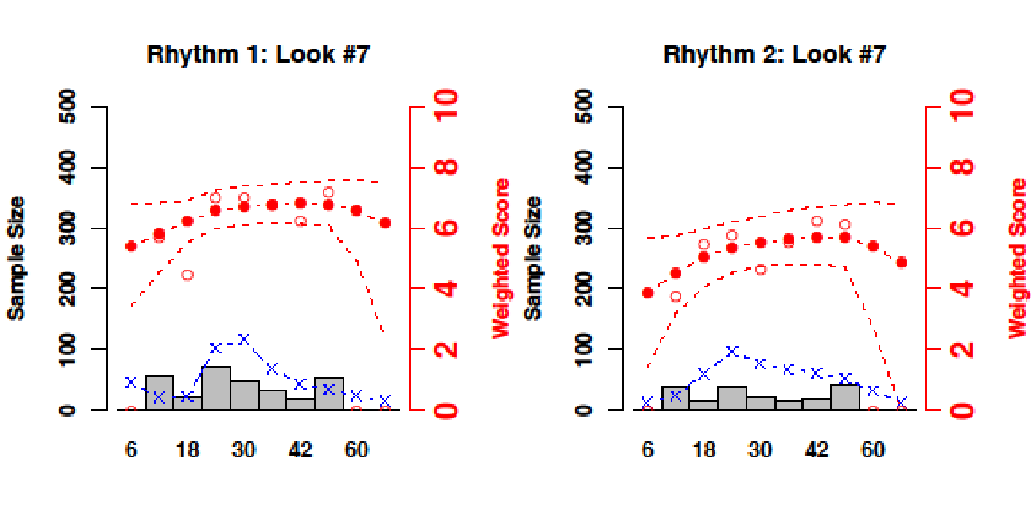
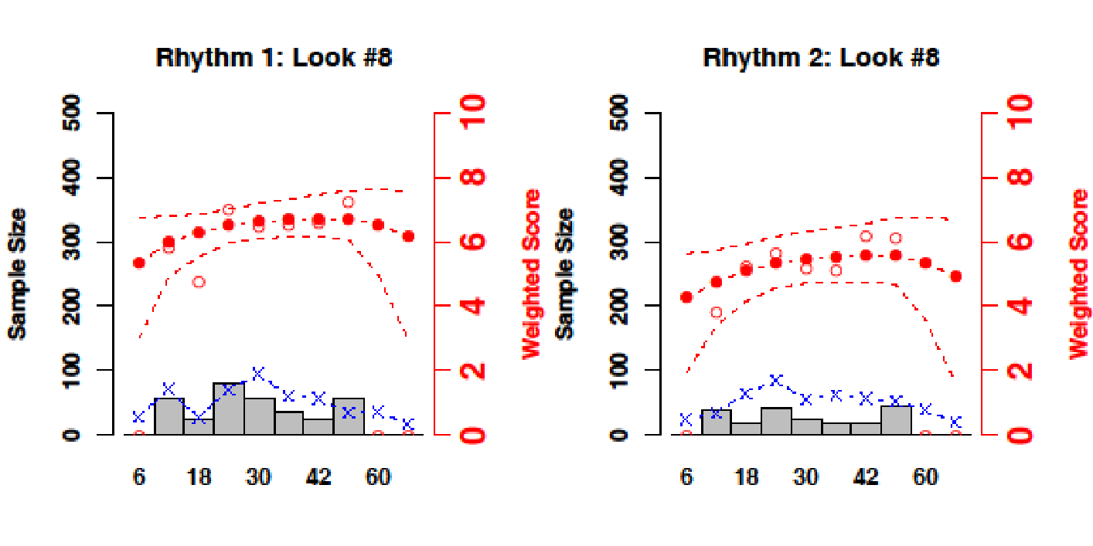
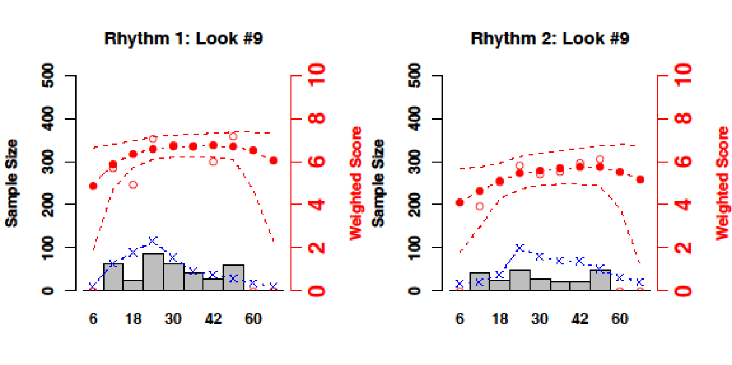
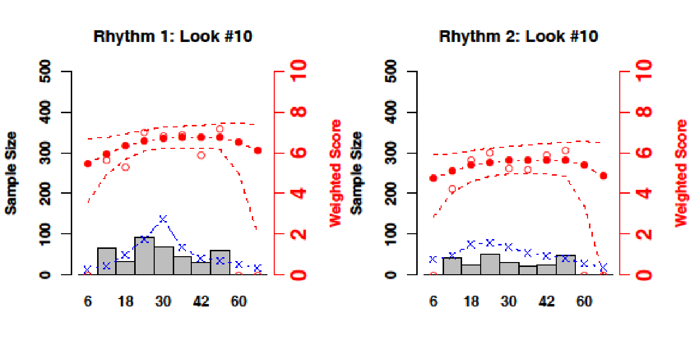
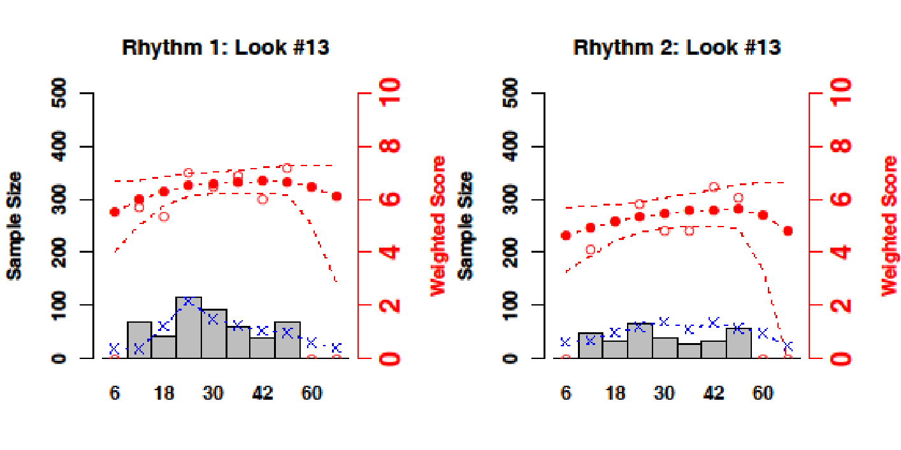
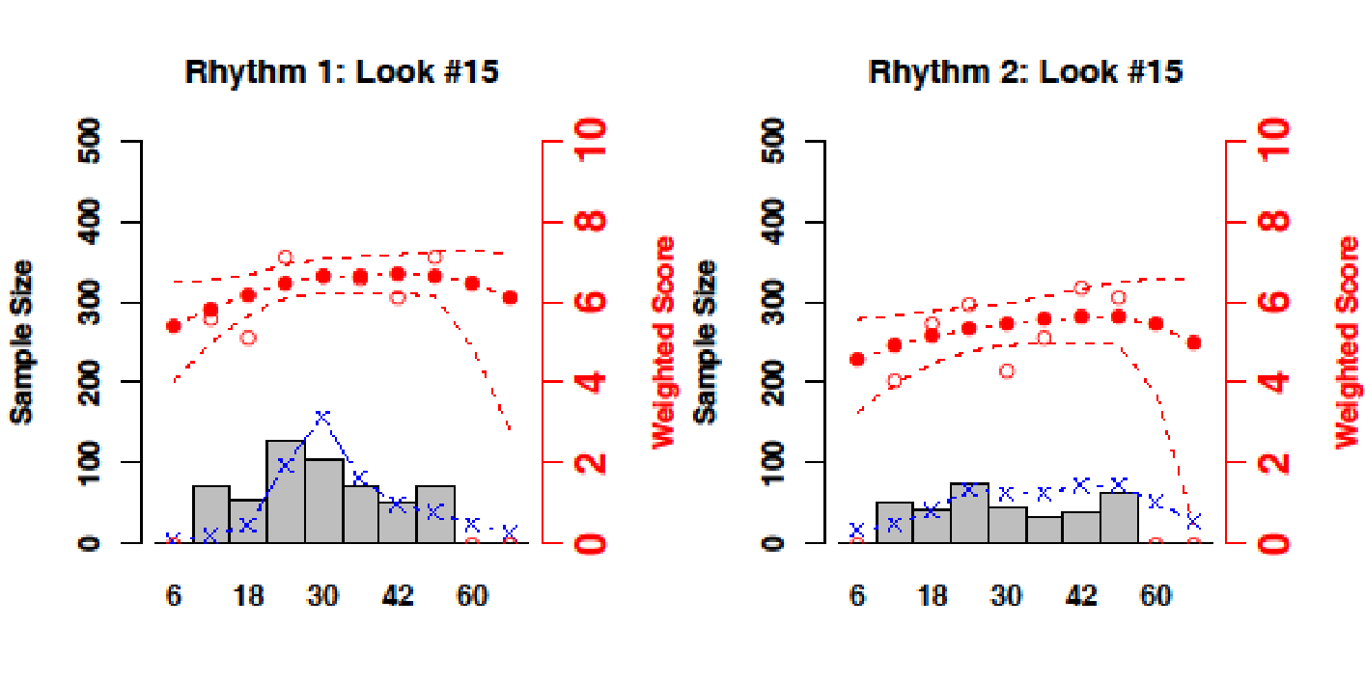
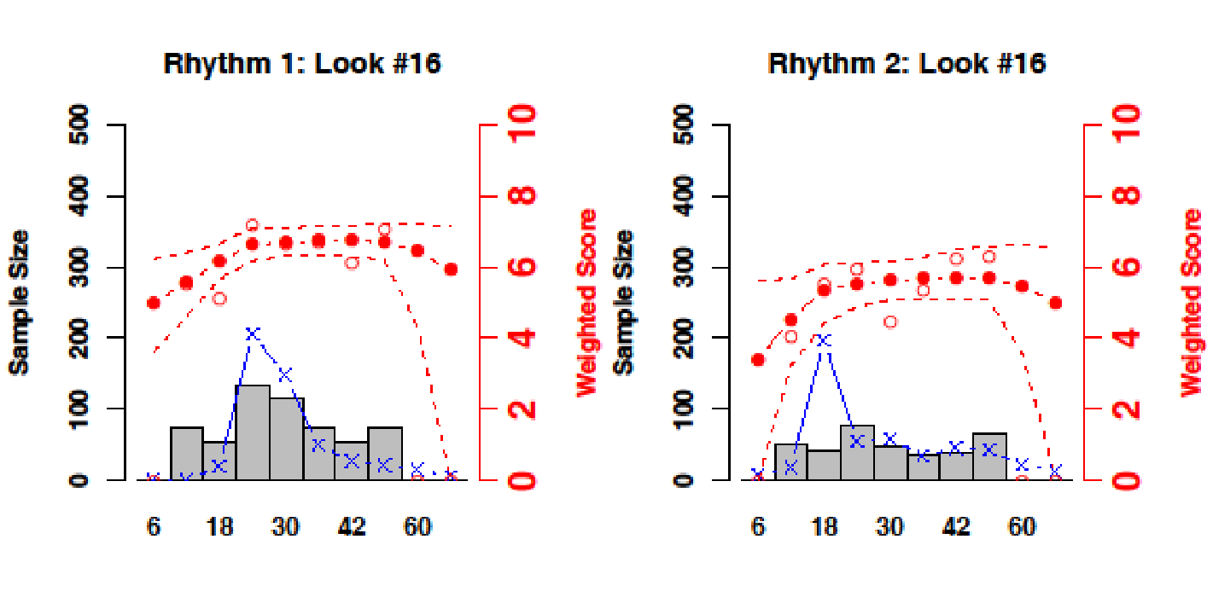
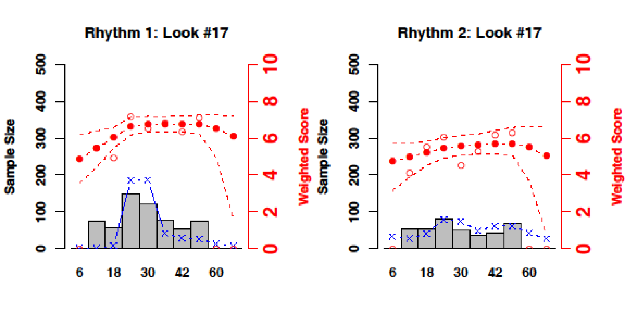
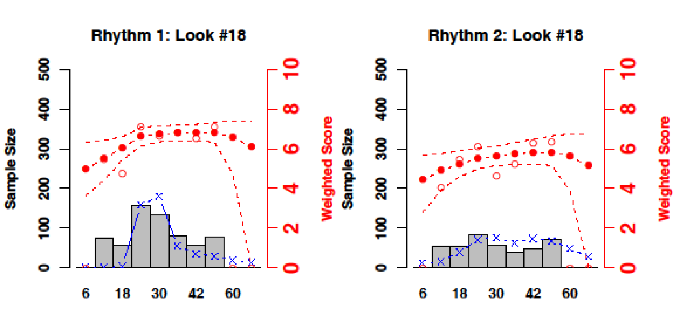
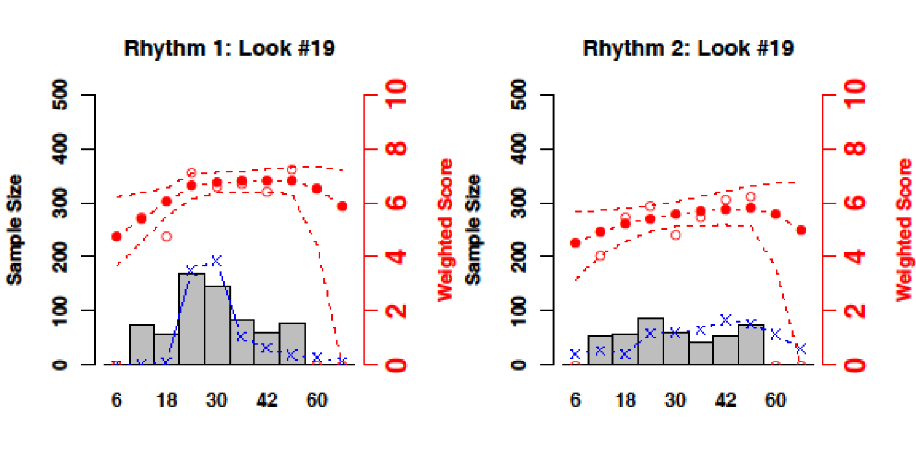
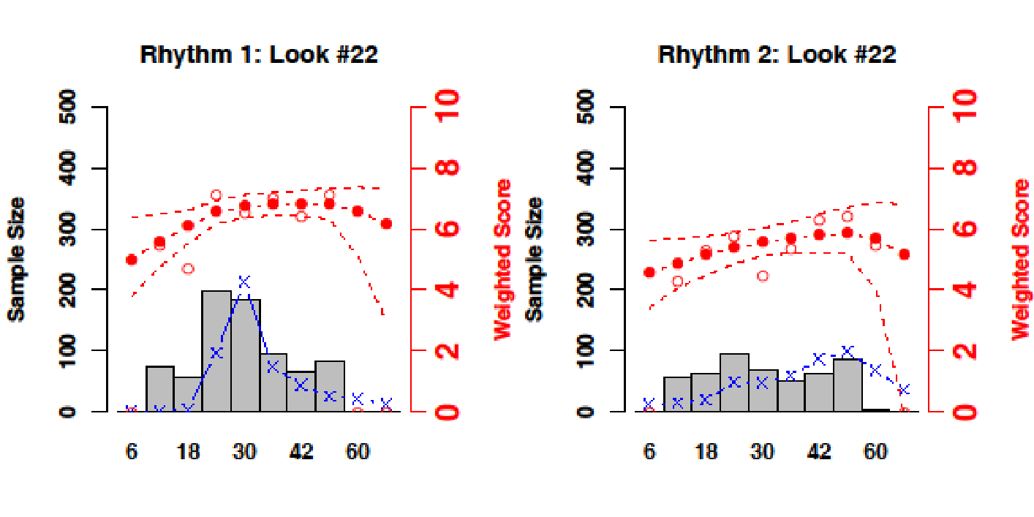
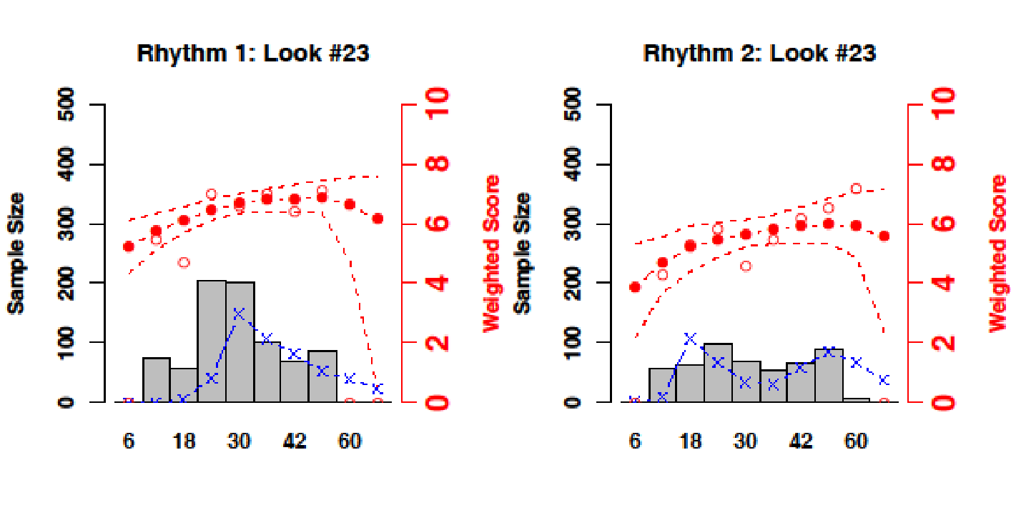
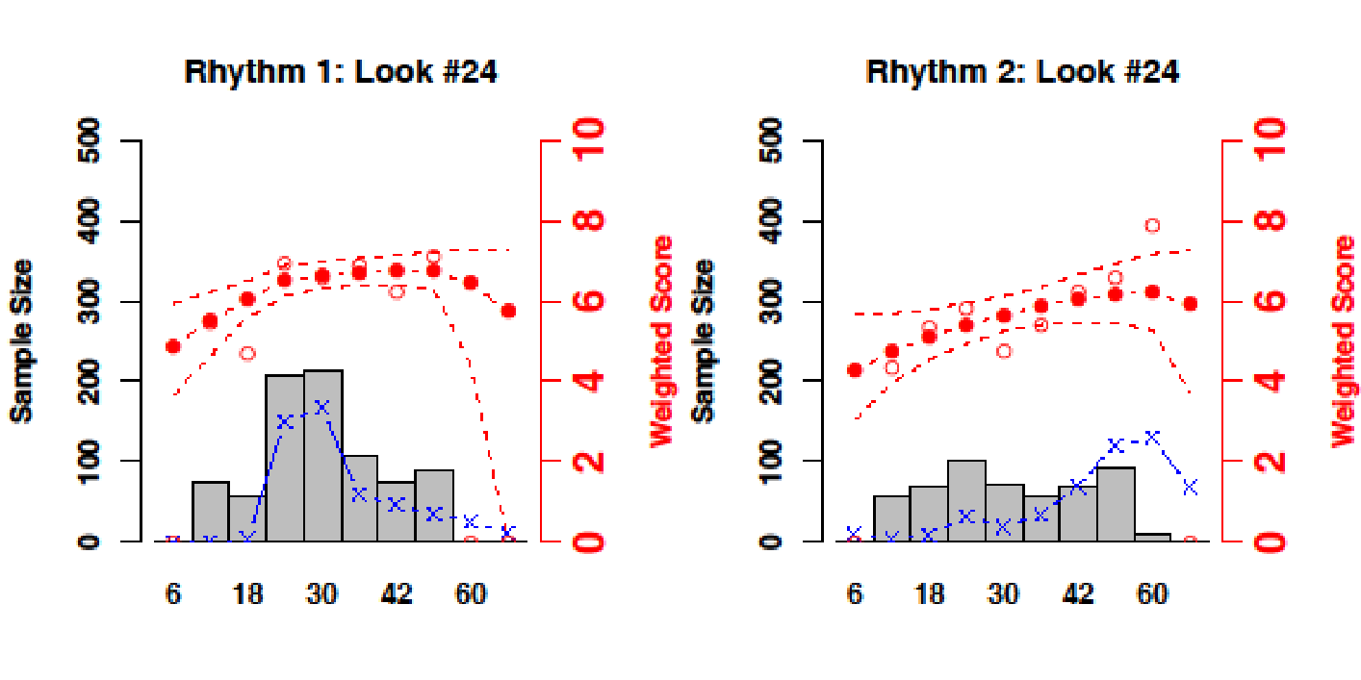
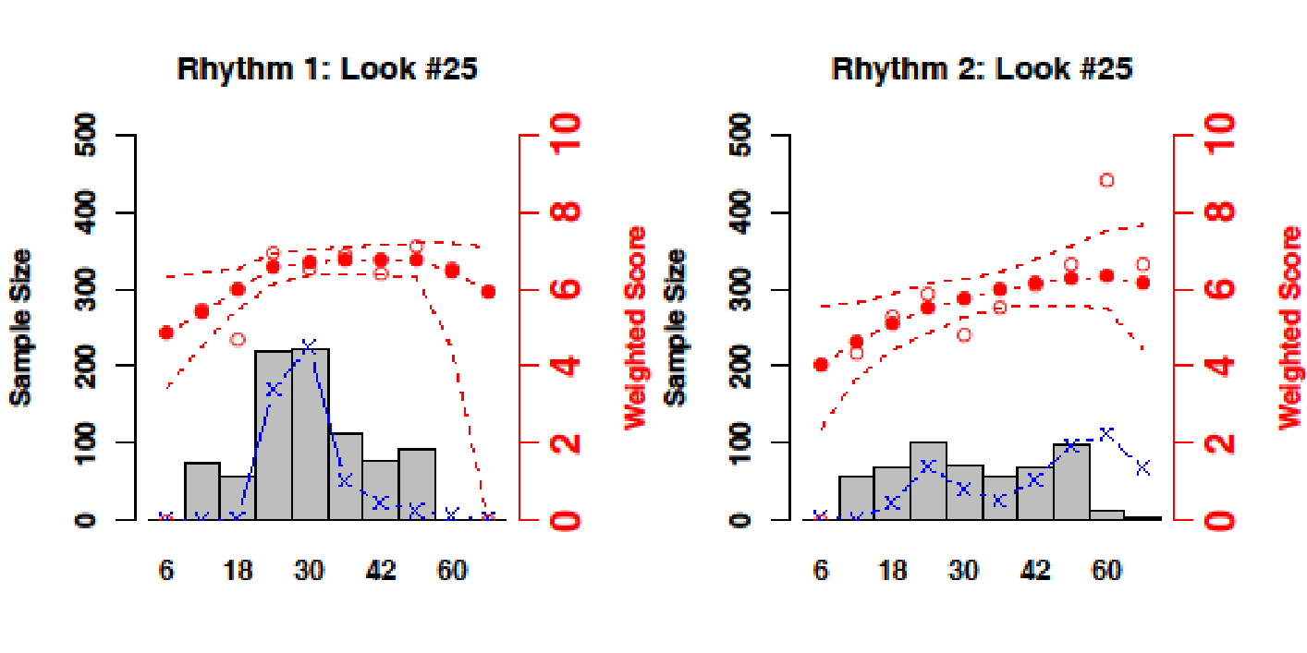
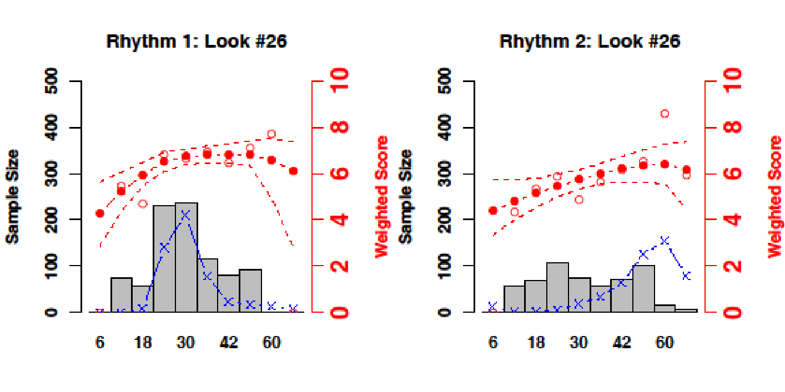
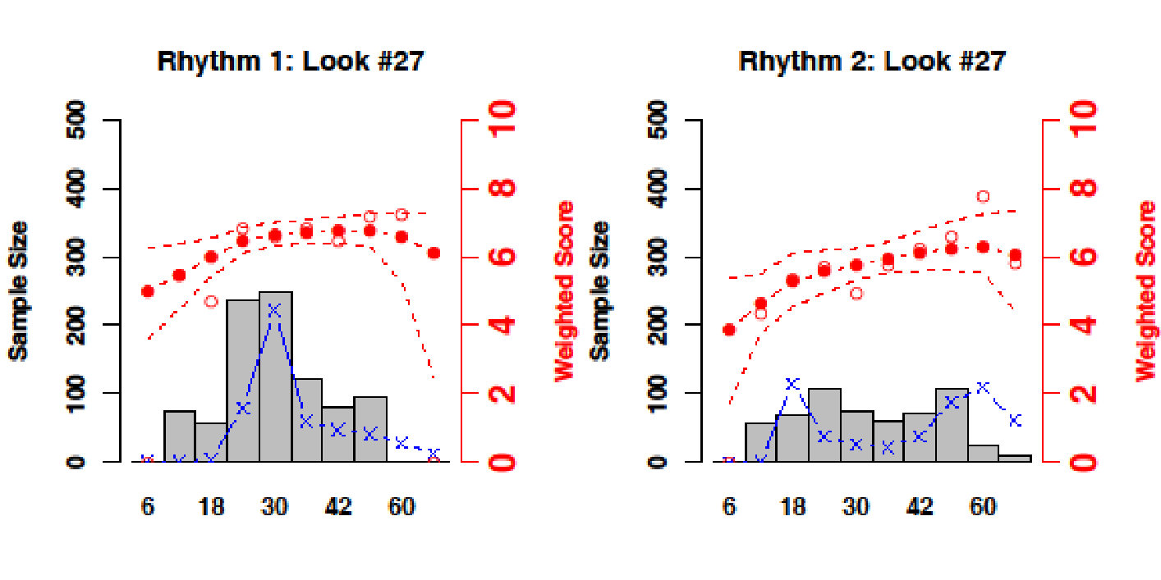
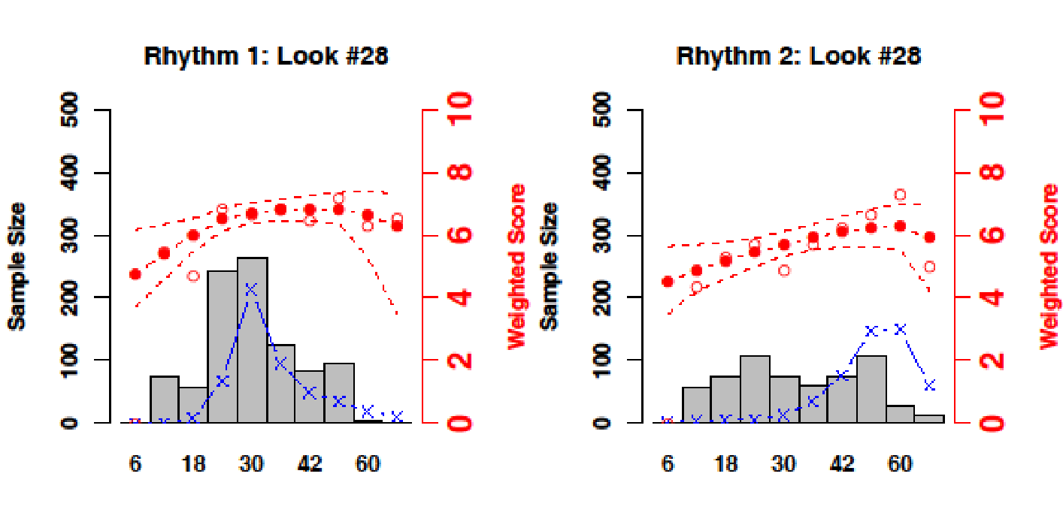
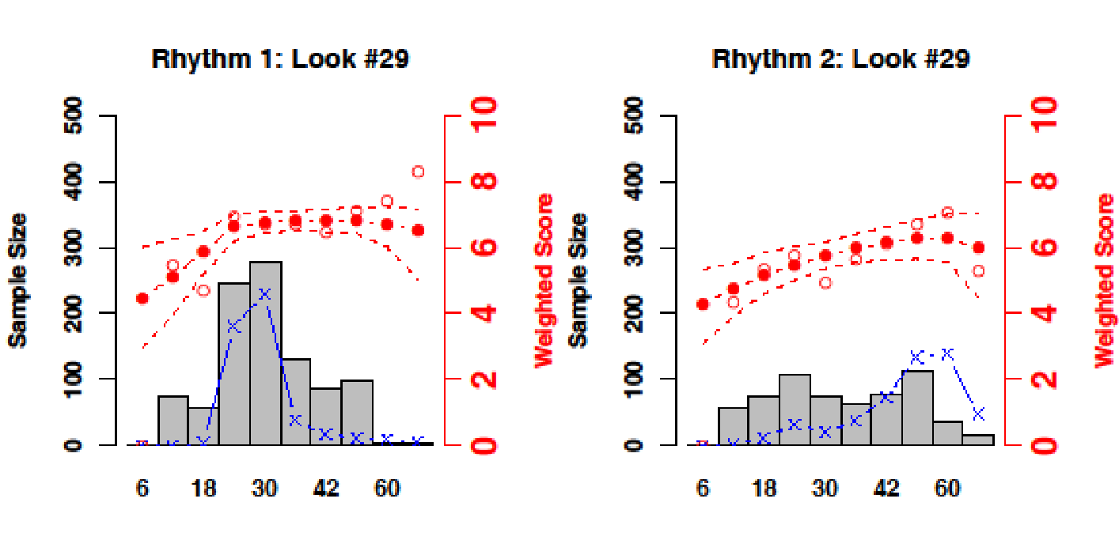
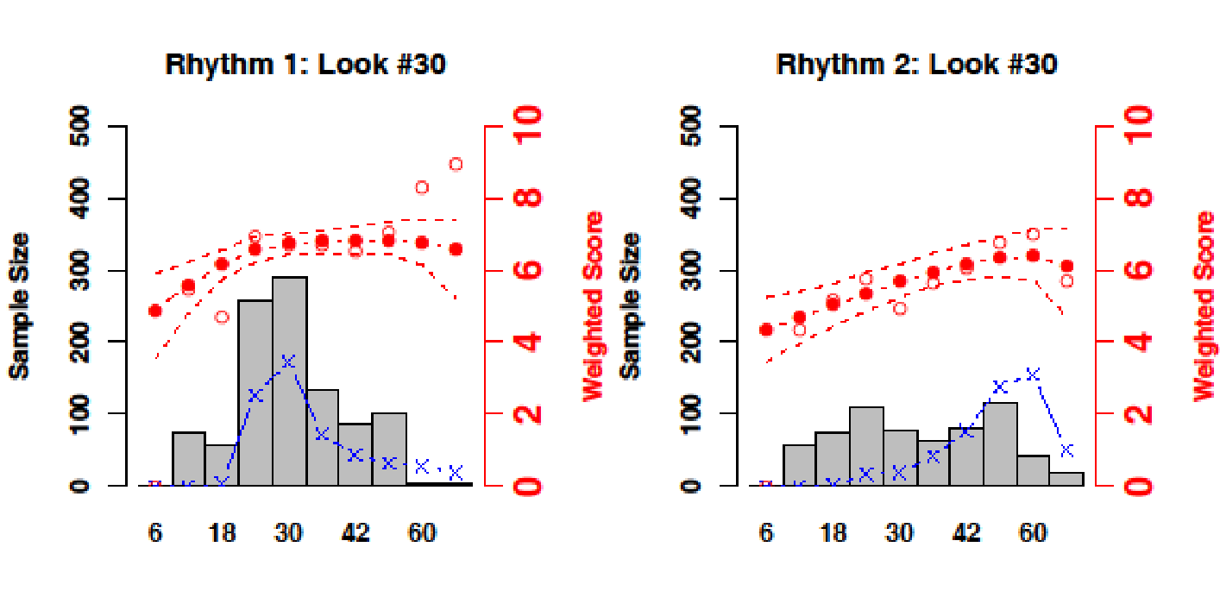
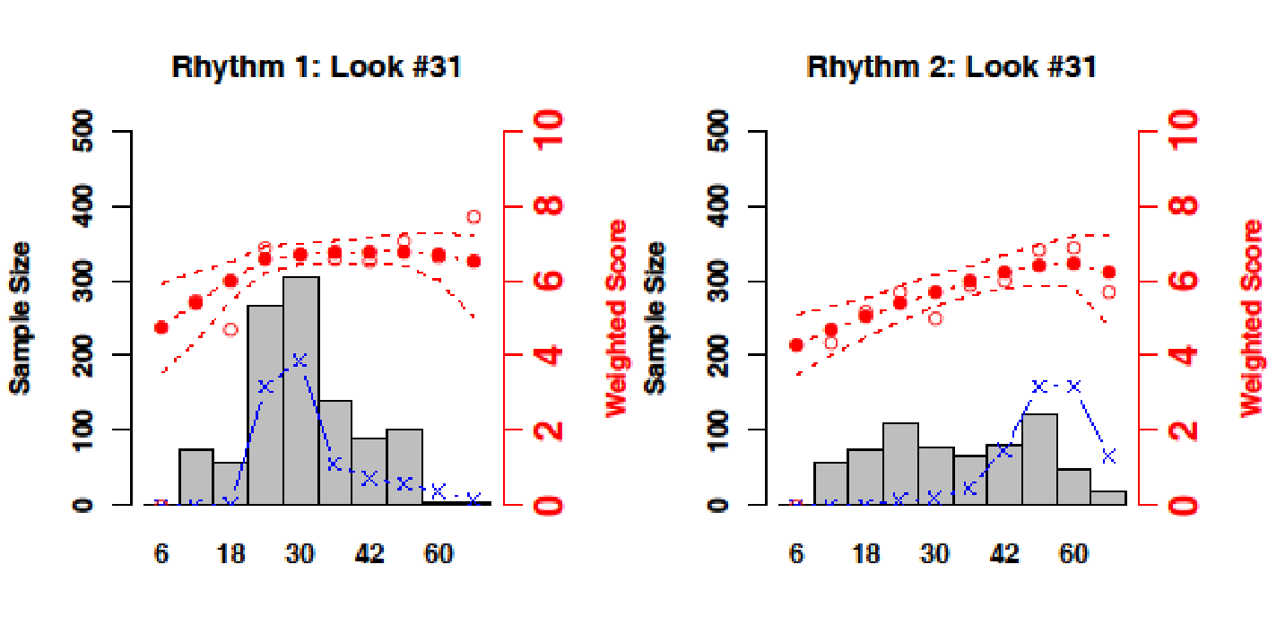
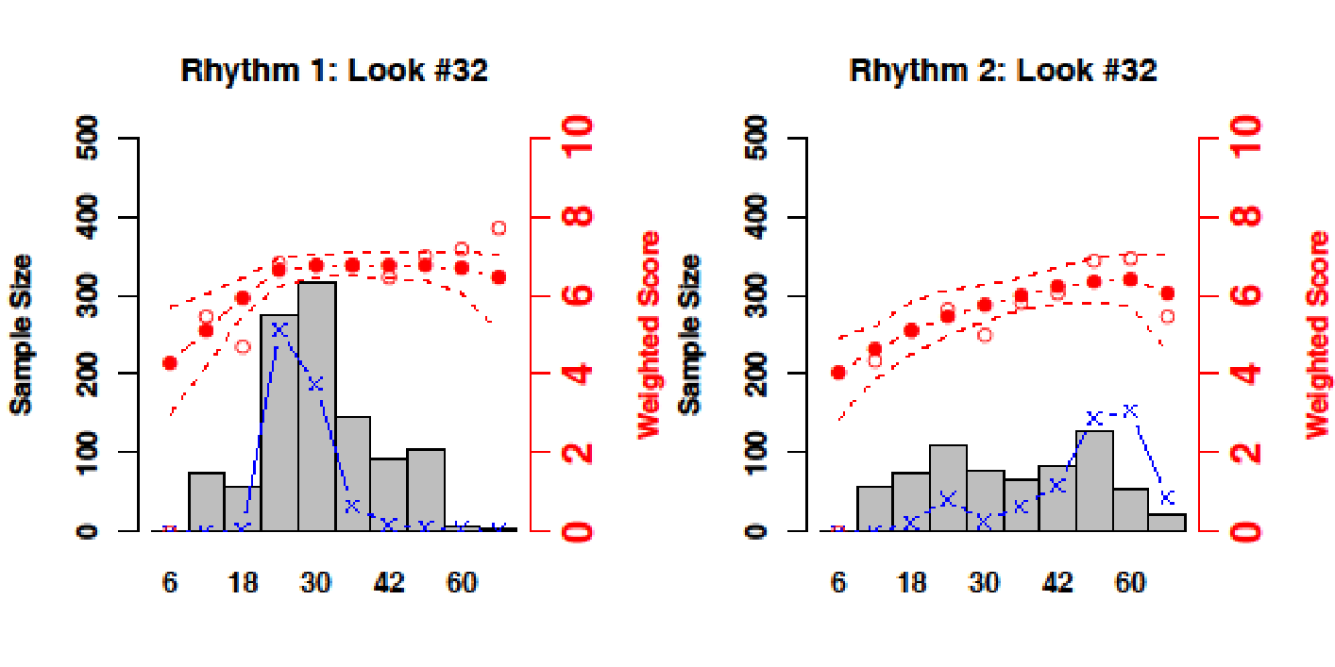
Example Simulation
The response model closely fits the observations with narrow confidence limits
Shockable
Non-shockable
Duration (hrs)
Adaptive randomization has put subjects where they are needed
Duration (hrs)
Notes:
Here you can see, how with each sequential look, subjects are distributed by the model to where they are needed and will be most informative. The modeled responsive curves and becoming more clear and the confidence intervals tighter.
After 32 looks, most subjects in the shockable group are near the start of what appears to be the plateau. They are more broadly distributed in the non-shockable group, but are mostly allocated to the longer durations where there appears to be more efficacy.
Now we reveal the “true” duration response curves assumed in this scenario.

Slide 9
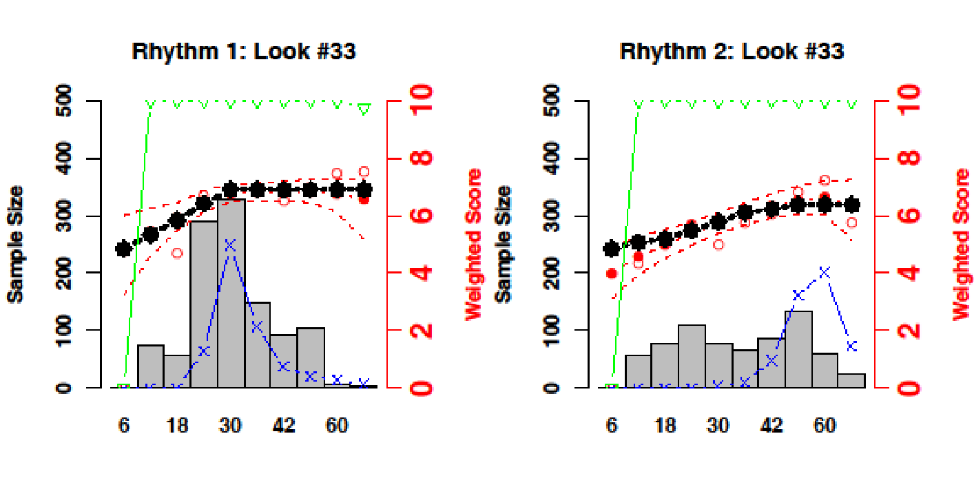
Example Simulation
Shockable
Non-shockable
Black lines show the “truth”, the scenario being simulated, which the model has estimated.
Duration (hrs)
Duration (hrs)
Notes:
The true duration response curves assumed for this scenario are shown here as solid black lines. You can see that in this scenario, the modeled duration response curve gives an excellent approximation of the true curves.
By design, we can look at the entire space of cooling durations of interest, and still have excellent operating characteristics. By examining the entire space of cooling durations, we eliminate the need to do repeated trials of various tweaks of pairwise comparisons. This will be the only trial of duration of hypothermia that you’ll ever need to do to answer this question.
Whether positive or negative, the results of this trial will be meaningful.

Slide 10
Operating Characteristics
37+11 Scenarios each simulated 5,000 times
Sample sizes of 1600-2300
Reference scenario at n=1800:
Modest effect, 18 hr plateau
Power p(duration selection) 80%
Power p(efficacy) 78%
Null scenarios at n=1800:
Type I error control <5% (two sided)
Notes:
From these we derive operating characteristics for our two main results.
We ask how often we select the right duration, which we define as the shortest duration that achieves the maximal effect of therapeutic hypothermia (analyzed separately for shockable rhythm and non-shockable rhythm groups)
We also ask how often we make the correct determination of efficacy, which we define as evidence of a duration response (for example 24 hours statistically better than 6 hours) that provides confirmatory evidence of overall efficacy using hierarchical modeling.
We used a reference scenario with a modest effect size and a plateau at 18 hours to select our sample size of 1800 which gave us about 80% power for both outcomes, and controlled type 1 error at less than 5%

Slide 11
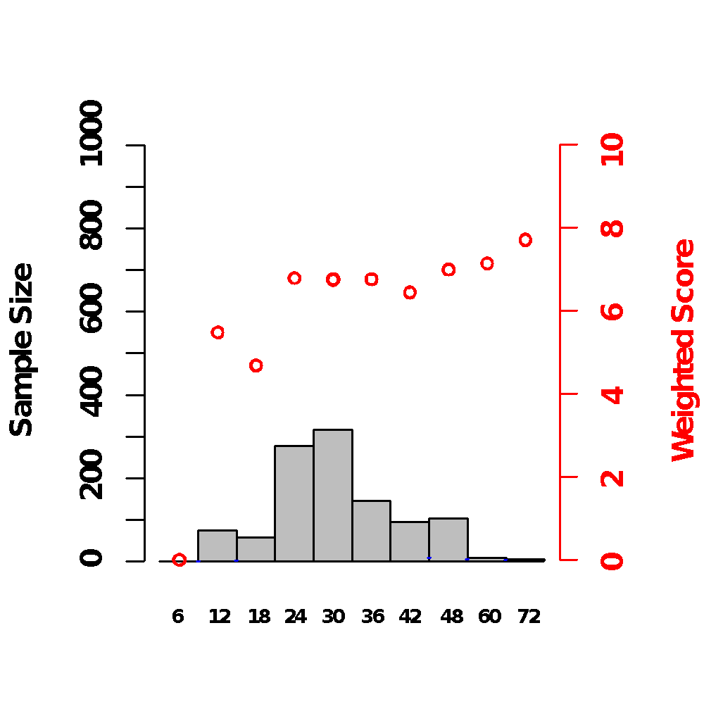
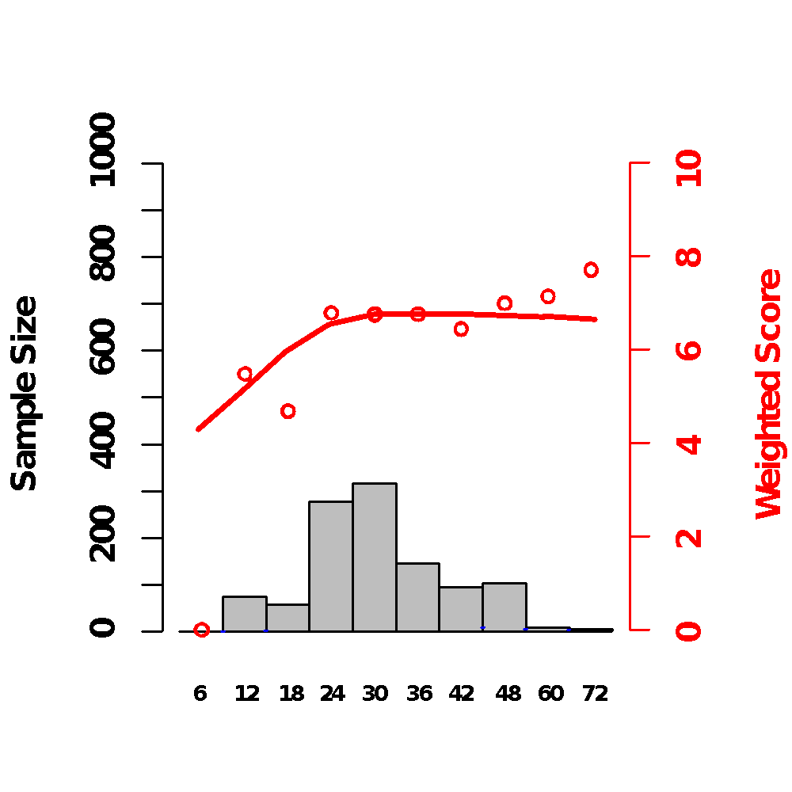
…Is not ambiguous.
…Allocates more subjects at the inflection, the time point of greatest interest
….Informs about a wider range of durations.
This final trial result……
Red dots are point estimates of efficacy. Grey bars are number of subjects in each arm.

Slide 12
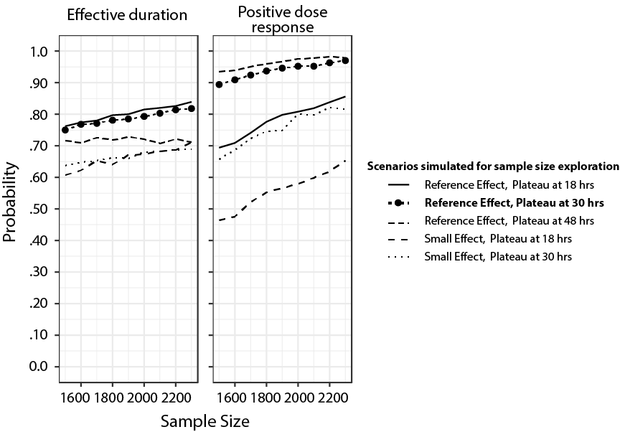

Slide 13
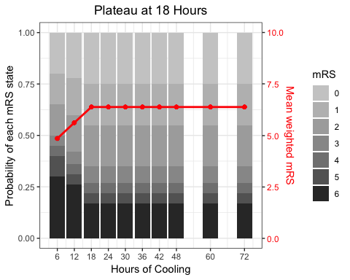

Slide 14
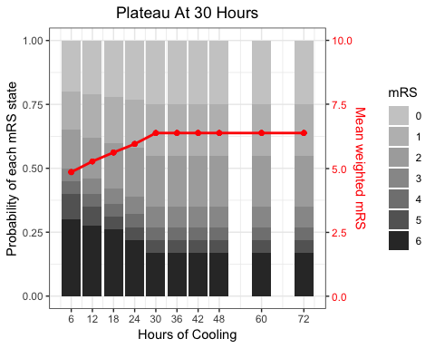

Slide 15
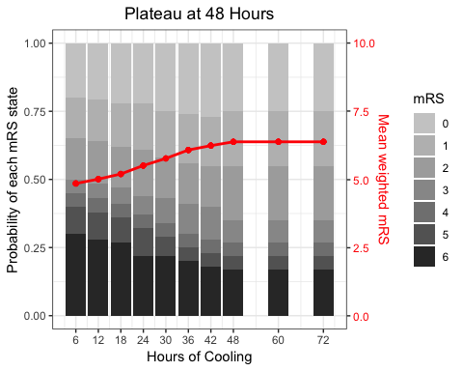

Slide 16
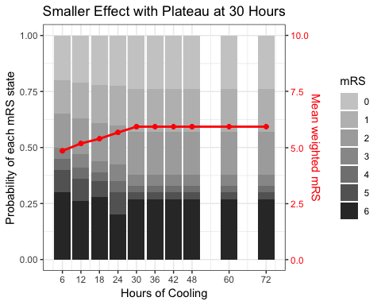

Slide 17
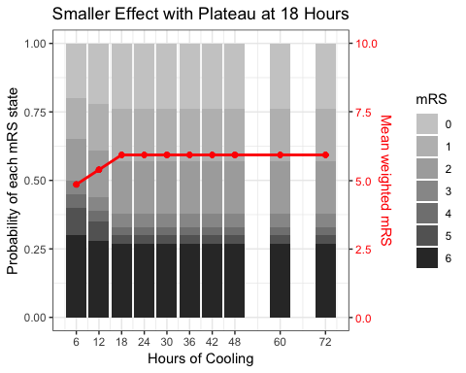

Slide 18
Proposed Timing / Structure of Interim Analyses
Monthly computation of randomization vectors
Presented in summary form via emailed reports
Will enact, but if issue identified by DSMB can revert and provide more details
After (if) 6 hour arm opens, possibility of futility stopping
Traditional full DSMB meetings
Timing at discretion of NIH/DSMB (every 6 months)
Set of safety data in addition to updated randomization vector

Slide 19
Stopping Rule
At least 50 patients have been randomized to the 6-hour duration arm for that rhythm
There is at least a 50% probability that the 6-hour duration treatment arm is the target duration

