Slide 1
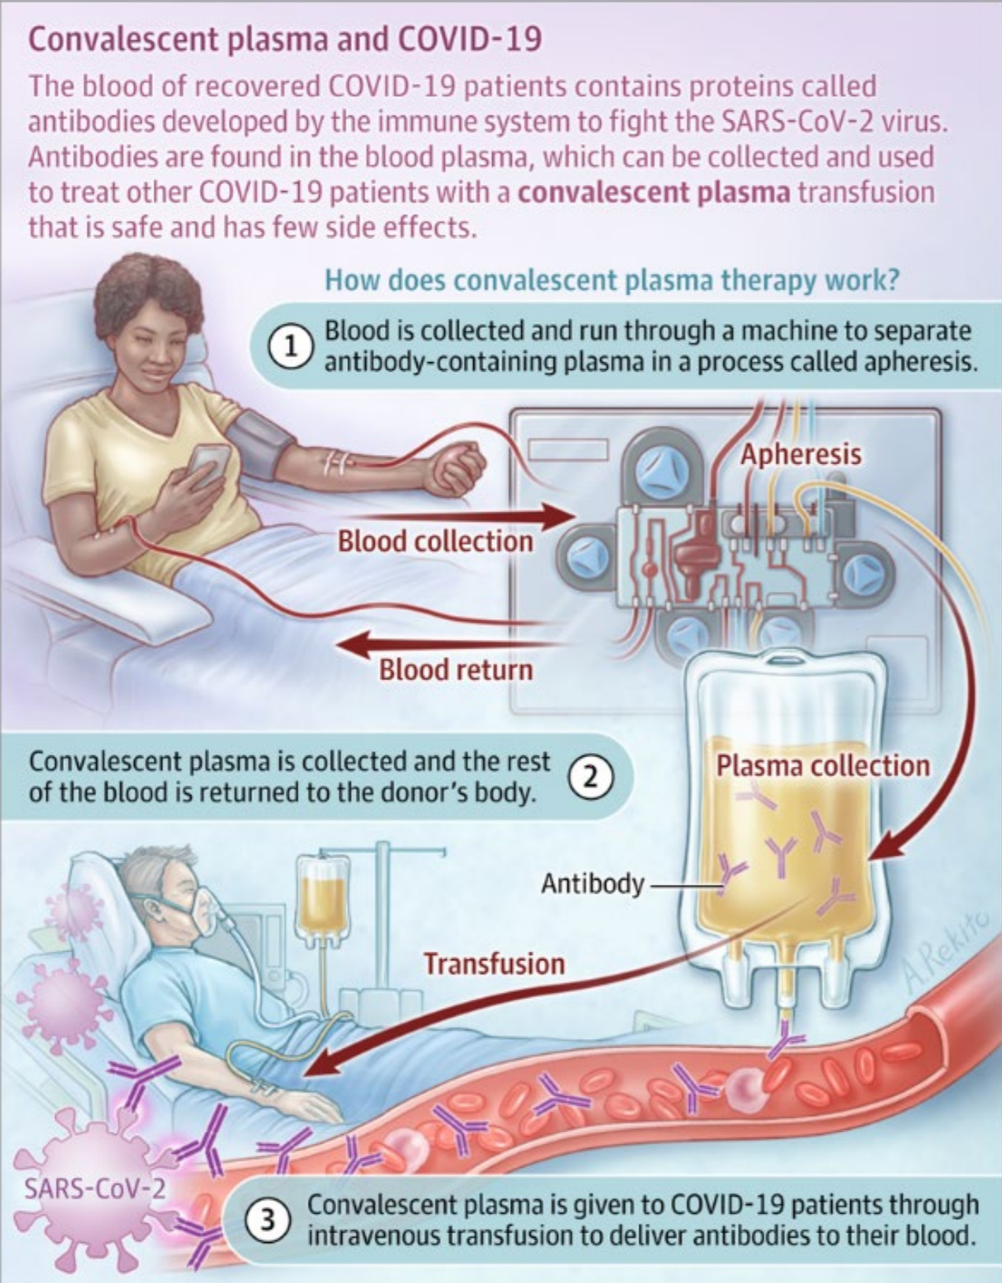
Clinical Trial of COVID-19 Convalescent Plasma in Outpatients (C3PO)
Principle Investigator: Bory Kea, MD MCR
Co-Investigator: Mohamud Daya, MD MS
Center for Policy and Research in Emergency Medicine (CPR-EM)
Objective: To determine the efficacy and safety of a single dose of convalescent plasma (CP) for preventing the progression of mild to severe COVID-19 illness in ED patients who are stable for outpatient management.
Inclusions:
≤7 days of symptoms,
≥1 symptoms of COVID-19
Lab-confirmed SARS-CoV-2 infection,
At least 1 risk factor
Clinically stable for outpatient management without O2
ABO-compatible CP available
Exclusions:
Cannot be <18yo, or a prisoner
Prior adverse reaction(s) from blood products
Other contradictions to receiving blood products
Receipt of any blood product within past 120d
Enrollment in another COVID-19 interventional trial
Inability to tolerate 250 ml of IV fluid.
C3PO Study Design
Trauma Research Group (TRG) screens and consents patients
RN collects blood sample pre-infusion
Patient is randomly assigned to CP or placebo study group.
RN collects blood sample 1 hour after infusion
Follow up with patient by phone every other day: 2-15, in person day: 15 & 30
QUESTIONS? STUDY COORDINATOR: JENNY COOK
EMAIL: COOKJEN@OHSU.EDU -- PHONE: (503) 494-1230

