Slide 1

Clinical-trial of COVID-19 Convalescent Plasma in Outpatients (C3PO)

Slide 2
The Team
MPI: Clifton Callaway, MD, PhD; Frederick Korley, MD, PhD; Valerie Durkalski-Mauldin, PhD
SIREN CCC: (University of Michigan): William Barsan, MD; Robert Silbergleit, MD; Clifton Callaway, MD, PhD
SIREN DCC: (Medical University of South Carolina): Valerie Durkalski-Mauldin, PhD; Sharon Yeatts,PhD
Transfusion Medicine Team: Alesia Kaplan, MD, Darrell Triulzi, MD, Rob Davenport, MD, Hua Shan, MD, PhD
Immunology: John McDyer, MD
Stanford University: Kevin Schulman, MD
NHLBI: Nahed El Kassar (Program Officer), Simone Glynn, Keith Hoots
BARDA: Mary Homer
The SIREN Investigators

Slide 3
Introduction
First contact—April 3
Formation of the team--April
Approval to move forward—June 2020
And here we are!

Slide 4
Thursday June 25th 2020, 10am till Noon EST
Start | End | Item | Presenter
10:00 | 10:05 | Welcome and SIREN Overview | William Barsan, MD
10:05 | 10:25 | Study Overview | Clifton Callaway, MD, PhD
10:25 | 10:35 | Biospecimen Collection, Processing, Storage and Shipment | Fred Korley, MD, PhD
10:35 | 10:45 | Outcome Assessment | Kevin Schulman, MD, MBA
10:45 | 10:55 | Protocol Violations/Deviations Adverse Event Reporting | Robert Silbergleit, MD
11:00 | 11:20 | Questions | Fred Korley, MD, PhD
11:20 | 11:35 | Site Regulatory Readiness | Carol VanHuysen
11:35 | 11:45 | cIRB and Electronic Consent Training | Deneil Harney
11:45 | 11:50 | Contracts, Payments and Milestones | Valerie Stevenson
11:50 | 11:55 | Data Monitoring and RSDV | Carol VanHuysen
11:55 | 12:00 | Closing Remarks | Clifton Callaway, MD, PhD

Slide 5
Study Overview

Slide 6
Clinical-trial of COVID-19 Convalescent Plasma in Outpatients (C3PO)
MPI: Clifton Callaway, MD, PhD; Frederick Korley, MD, PhD; Valerie Durkalski-Mauldin, PhD
SIREN CCC (University of Michigan): William Barsan, MD; Robert Silbergleit, MD; Clifton Callaway, MD, PhD
SIREN DCC (Medical University of South Carolina): Valerie Durkalski-Mauldin, PhD; Sharon Yeatts,PhD
University of Pittsburgh: Alesia Kaplan, MD; John McDyer, MD; Darrell Triulzi, MD
Stanford University: Kevin Schulman, MD; Siddartha Jaisal, MD; Hua Shan, MD, PhD

Slide 7
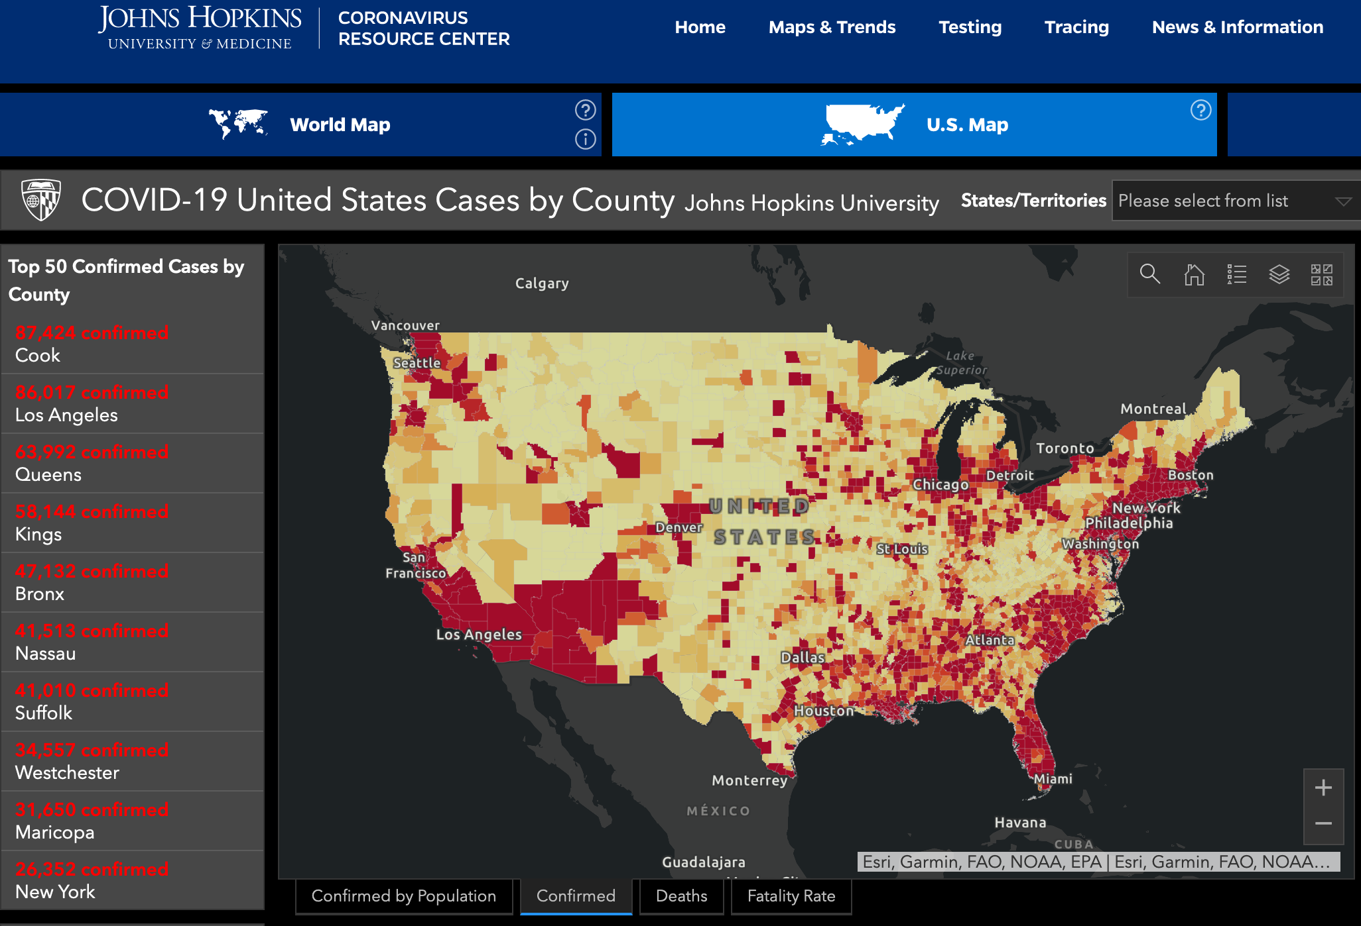
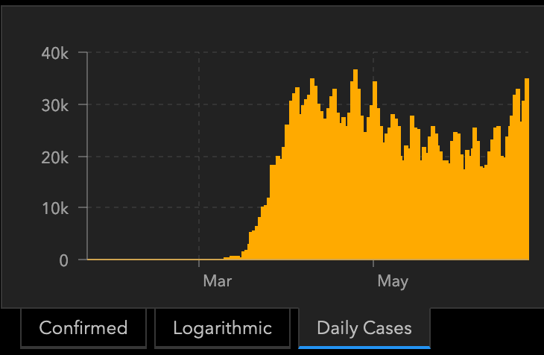

Slide 8
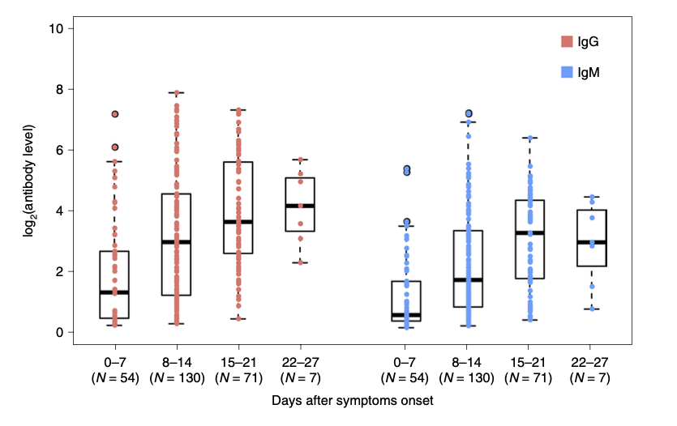
Patients recovering from COVID-19 develop antibodies against SARS-CoV-2
Levels in blood increase from week 1 to week 3.
Antibodies can neutralize infectious viral particles in vitro and levels correlate with clinical improvement in patients.
Long 2020; Nature Med, Apr 29; PMID: 32350462

Slide 9
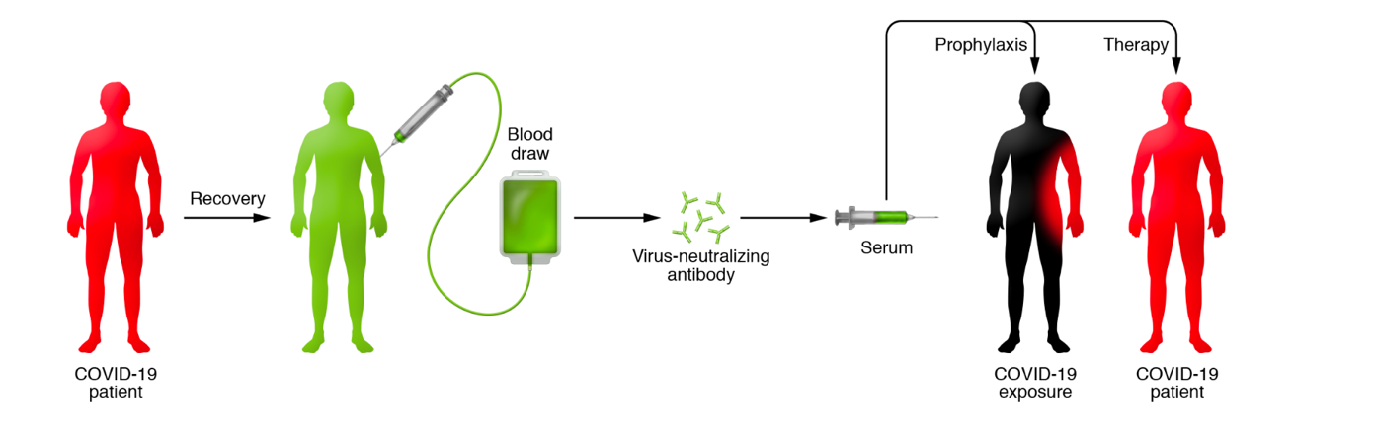
Passive immunization with convalescent plasma (CP) could prevent progression or treat COVID-19 illness in patients without antibodies
Used since 1890’s; Influenza, Ebola, SARS, MERS
Casadevall 2020 J Clin Invest. 130(4):1545–1548.

Slide 10
Convalescent Plasma Expanded Access Program
Preliminary safety results
From the Expanded Access Program for CP in moderate-severe COVID-19 have been posted, but not yet peer-reviewed (​https://www.medrxiv.org/content/10.1101/2020.05.12.20099879v1​).
    Among 5000 transfusions,
    36 serious adverse events (0.7%)
      25 adjudicated as related (0.5%)
    Among 25 related events
      Mortality (n=4, 0.08%)
      TACO (n=11, 0.22%)
      TRALI (n=7, 0.14%)
      Allergic reaction (n=3, 0.06%)
    Another 11 deaths were reported but judged not to be related
Joyner et al. 2020

Slide 11
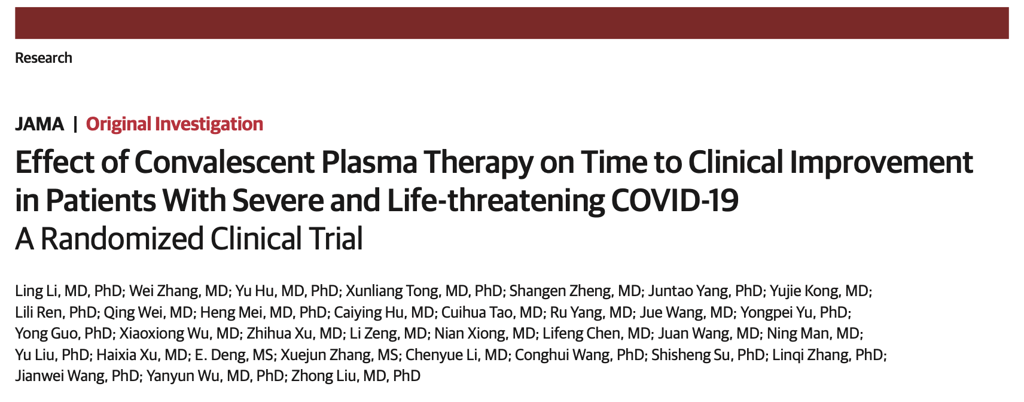
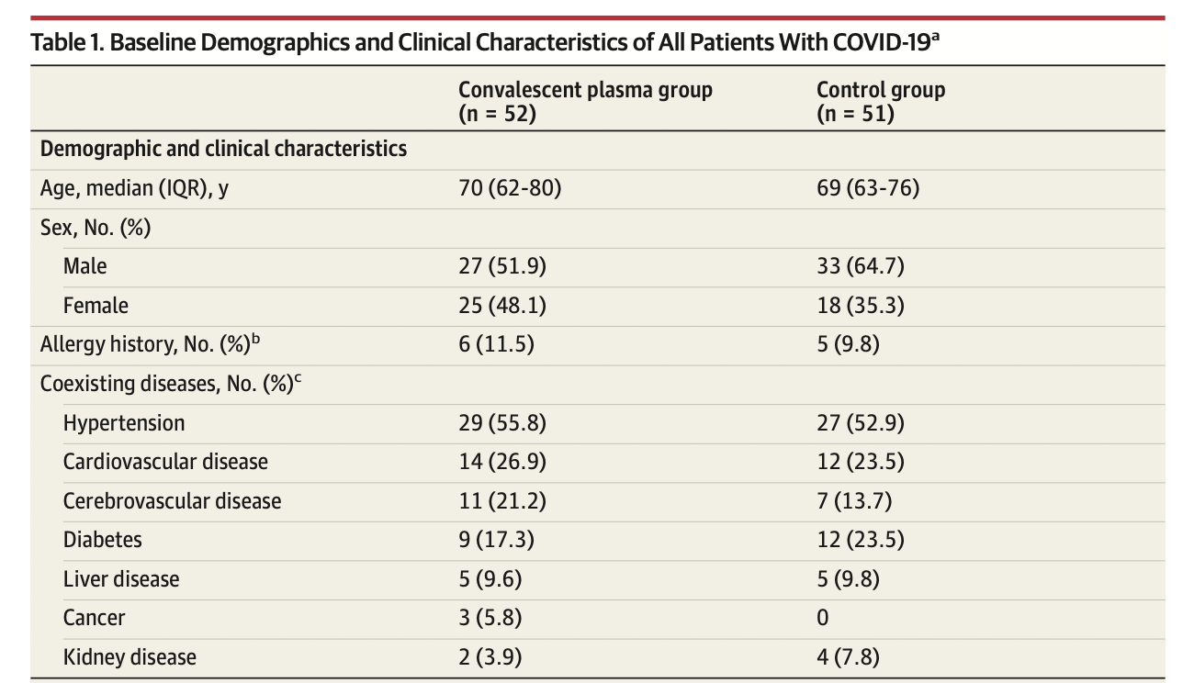
Transfusion dose of COVID-19 convalescent plasma was approximately 4 to 13 mL/kg of recipient body weight
June 3, 2020
103 Subjects Randomized
52 Convalescent Plasma
23 severe COVID-19
29 life-threatening
51 Control
22 severe COVID-19
29 life-threatening
Stopped Early because epidemic subsided
Median (IQR) days from symptom onset 27 (22-39) 30 (19-38)

Slide 12
 | Convalescent Plasma | Control
Time to Clinical Improvement
All subjects | HR 1.40 [95%CI 0.79-2.49]
Severe COVID-19 | HR 2.15 [95%CI 1.07-4.32]
Life-threatening | HR 0.88 [95% CI 0.30-2.63]
Clinical improvement
At day 7 | 5/52 (9.6%) | 5/51 (9.8%)
At day 14 | 17/52 (32.7%) | 9/51 (17.6%)
At day 28 | 27/52 (51.9%) | 22/51 (43.1%)
Discharged by day 28 | 26/51 (51%) | 18/50 (36%)
Mortality at day 28 | 8/51 (15.7%) | 12/50 (24%)
Viral Test Negative
At 24 hrs | 21/47 (44.7%) | 6/40 (15.0%)
At 48 hrs | 32/47 (68.1%) | 13/40 (32.5%)
At 72 hrs | 41/47 (87.2%) | 15/40 (37.5%)
Li et al. JAMA 3 June 2020

Slide 13
Does passive immunization with convalescent plasma (CP) prevent progression of early/mild COVID-19 illness to moderate/severe illness?

Slide 14
Does passive immunization with convalescent plasma (CP) prevent progression of early/mild COVID-19 illness to moderate/severe illness?
Convalescent Plasma
Mild illness < 7 days
Control

Slide 15
Does passive immunization with convalescent plasma (CP) prevent progression of early/mild COVID-19 illness to moderate/severe illness?
Convalescent Plasma
Develop moderate or severe COVID-19
Mild illness < 7 days
15 days
Recover
Control

Slide 16
Does passive immunization with convalescent plasma (CP) prevent progression of early/mild COVID-19 illness to moderate/severe illness?
Convalescent Plasma
Develop moderate or severe COVID-19
Mild illness < 7 days
15 days
Recover
Control
Preventing progression to moderate/severe illness is preferred: rescue is much more difficult (Right Patients)
Antibody levels increase from 0 to 14 days (Right Timing)
CP is available and could be administered in all regions worldwide (Impact)
CP is available prior to a specific vaccine in any emerging infection where there are survivors (Impact)
Demonstration that CP / passive immunization is effective opens path for hyper-immune globulins (Impact)

Slide 17
Study Population
Adults with mild symptomatic laboratory-confirmed COVID-19 illness in the Emergency Department, who are at high risk for progression to severe illness, but who are clinically stable for outpatient management at randomization.
Inclusion Criteria
One or more symptoms of COVID-19 illness and laboratory-confirmed SARS-CoV-2 infection
At least one study defined risk factor for severe COVID-19 illness:
  Age≥50 years; hypertension; diabetes; coronary artery disease; chronic lung disease; chronic kidney disease; immunocompromised state
Clinical team plans outpatient management without oxygen
CP available at the site at the time of enrollment
Duration of symptoms ≤ 7 days
Signed informed consent

Slide 18
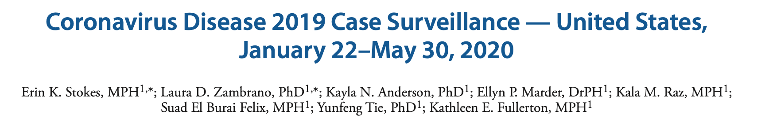
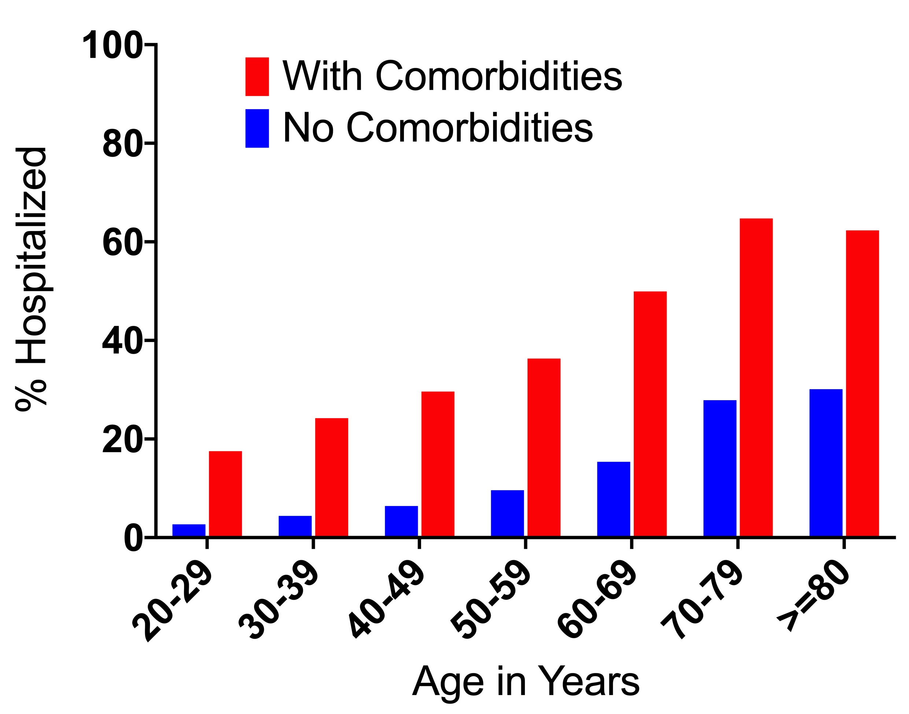
diabetes mellitus
cardiovascular disease including hypertension
severe obesity body mass index ≥40 kg/m²
chronic renal disease, chronic liver disease
chronic lung disease
any immunocompromising condition
any autoimmune condition
any neurologic condition including neurodevelopmental, intellectual, physical, visual, or hearing impairment, any psychologic/psychiatric condition
any other underlying medical condition not otherwise specified
MMWR Morb Mortal Wkly Rep. ePub: 15 June 2020

Slide 19
Study Population
Adults with mild symptomatic laboratory-confirmed COVID-19 illness in the Emergency Department, who are at high risk for progression to severe illness, but who are clinically stable for outpatient management at randomization.
Inclusion Criteria
One or more symptoms of COVID-19 illness and laboratory-confirmed SARS-CoV-2 infection
At least one study defined risk factor for severe COVID-19 illness:
  Age≥50 years; hypertension; diabetes; coronary artery disease; chronic lung disease; chronic kidney disease; immunocompromised state
Clinical team plans outpatient management without oxygen
CP available at the site at the time of enrollment
Duration of symptoms ≤ 7 days
Signed informed consent

Slide 20
Study Population
Adults with mild symptomatic laboratory-confirmed COVID-19 illness in the Emergency Department, who are at high risk for progression to severe illness, but who are clinically stable for outpatient management at randomization.
Inclusion Criteria
One or more symptoms of COVID-19 illness and laboratory-confirmed SARS-CoV-2 infection
At least one study defined risk factor for severe COVID-19 illness:
  Age≥50 years; hypertension; diabetes; coronary artery disease; chronic lung disease; chronic kidney disease; immunocompromised state
Clinical team plans outpatient management without oxygen
CP available at the site at the time of enrollment
Duration of symptoms ≤ 7 days
Signed informed consent
Exclusion Criteria
Age < 18 years
Prisoner or ward of the state
Unable to complete follow-up at 15 days
Prior adverse reaction(s) from blood product transfusion
Receipt of any blood product within the past 120 days
Enrollment in another interventional trial for COVID-19 illness
Clinical team unwilling to administer 250 ml intervention

Slide 21
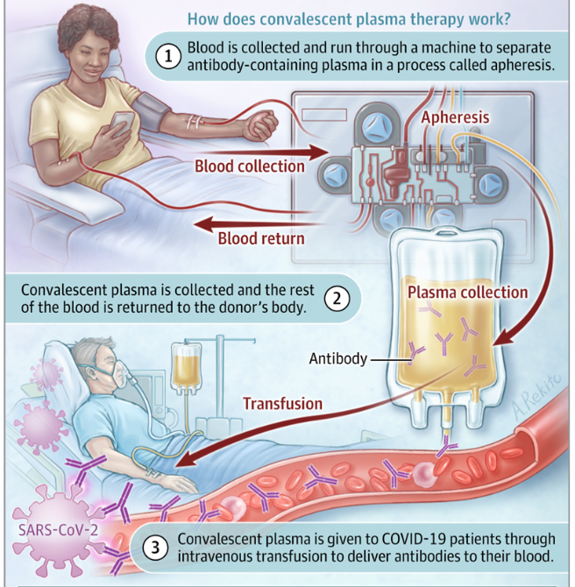
Intervention
Study Intervention: Randomized to receive in the emergency department either
  One unit (~200 ml) dose of pathogen-reduced ABO group compatible SARS-CoV-2 convalescent plasma
Donors:
  Positive SARS-CoV-2 test
  Symptoms resolved 14 days
  Males, never-pregnant females, or females with negative anti-HLA antibodies
Testing by Creative Testing Solutions:
  Ortho VITROS SARS-CoV-2 Total positive (corresponds to 1:100 titer)
  Vitalant Research Institute SARS-CoV2 Reporter Viral Particle Neutralization (RVPN) test (at least 1:160 titer)
Malani AN, Sherbeck JP, Malani PN. Convalescent Plasma and COVID-19. JAMA. Published online June 12, 2020. doi:10.1001/jama.2020.10699

Slide 22
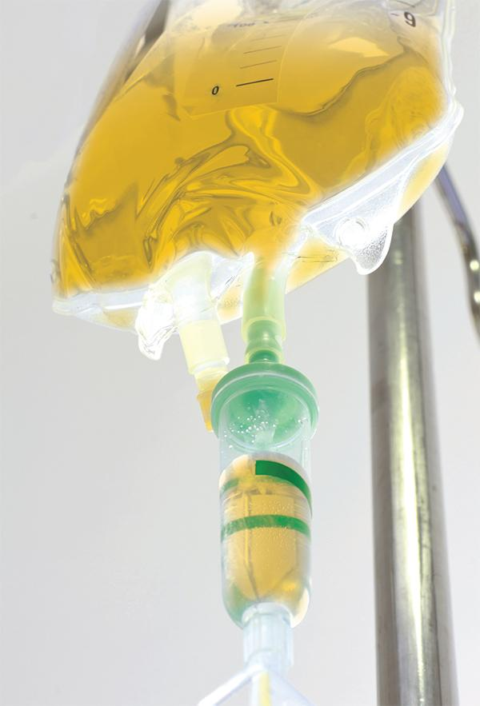
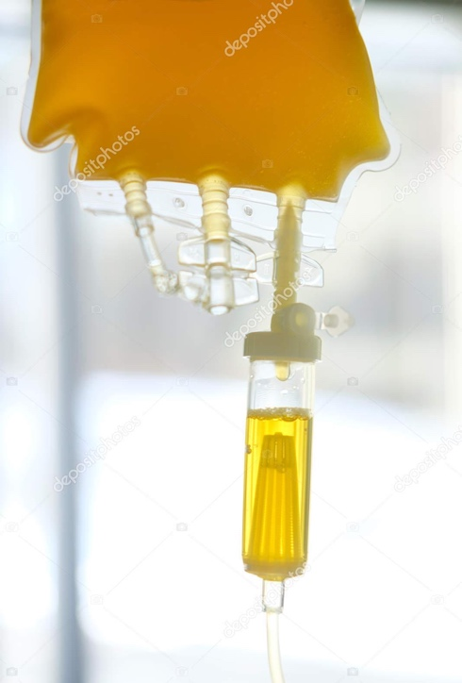
Intervention
Study Intervention: Randomized to receive in the emergency department either
  One unit (~200 ml) dose of pathogen-reduced ABO group compatible SARS-CoV-2 convalescent plasma (CP, titer > 1:160 neutralizing antibodies), OR
  250 ml of normal saline with MVI (for color)
Control: FFP may have non-specific effects (e.g. cross-reacting antibodies to other coronaviruses) that will reduce ability to detect CP effect. Subjects may not want to receive non-immune blood product.
Single-Blind with blinded outcome assessment: Subjects will be blinded by covering the bag and infusion line. Providers will not be blinded. Outcome assessors will be blinded.

Slide 23
Primary Outcome
Objective | Endpoint
To establish the efficacy of a single dose of convalescent plasma (CP) for preventing the progression from mild to severe COVID-19 illness. | Disease progression defined as death or hospital admission or seeking emergency or urgent care within 15 days of randomization
Hospital admission alone is a highly relevant outcome
Symptom worsening is important to patients
Symptom worsening that prompts re-visit for medical care is important and serious
Home

Slide 24
Secondary and Exploratory Outcomes
Time to disease progression
  COVID Outpatient Ordinal Outcome Scale censored at 15 days after randomization
Worst severity
  COVID WHO Ordinal Outcome Scale during the 30 days following randomization
Hospital-free days
  During the 30 days following randomization
All-cause mortality
  at 30 days
Symptom inventory
  CDC list of COVID-19 symptoms on days 2, 4, 6, 8, 10, 14, 15, 30 days
Biospecimens
  4 blood samples: Pre-infusion, Post-infusion, 15 days, 30 days

Slide 25
Statistical Plan (Brief)
Primary Analysis is a Bayesian framework: non-informative prior and posterior probability of success
Intent-to-treat population: all randomized subjects
Randomization: After sample 1 (type and screen), web-based central randomization system will assign treatment using a fixed 1:1 allocation ratio. The randomization algorithm will prevent accidental treatment imbalances in age and site.
3 planned interim efficacy and futility looks:
  Efficacy: posterior probability of success (CP event rate < Control) > 99.9% at any given look (every 150 consecutive randomizations)
  Futility: predictive probability of success <20% at 33%, 50% and 75% consecutive randomizations.
Final primary analysis: posterior probability of success > 97.5%
Type I error: desire is to maintain a one-sided type I error rate of 0.025

Slide 26
Sample Size – 600 (300 saline; 300 CP)
Designed to detect a 10% risk reduction with one-sided type I error of 0.025
Figure illustrates power with different primary outcome rates from 15% to 35%
Plan sample size re-estimation prior to the first interim analysis, based on the overall rate of events
“If control group event rate is 20%, we have ~90% power to detect a 10% risk difference; ~80% power to detect a 8.5% risk reduction”

Slide 27
Review of 477 consecutive subjects at University of Michigan ED
ED Revisits within 15 days
 | ED Revisit | No Revisit
Admitted during index ED visit | 15 (4.8%) | 294 (95.2%)
Discharged from ED | 40 (23.8%) | 128 (76.2%)
 | 55 (11.5%) | 422 (88.5%)
35% of patients are discharged from ED on first visit, and among those discharged from ED:
Hospital admits within 15 days
24% return to ED within 15 days
 | Hospital admit | No Hospital admit
Admitted during index ED visit | 14 (4.5%) | 295 (95.2%)
Discharged from ED | 24 (14.3%) | 144 (85.7%)
 | 38 (8.0%) | 439 (92.0%)
14% are admitted to hospital within 15 days
ED Revisits within 28 days
 | ED Revisit | No Revisit
Admitted during index ED visit | 29 (9.4%) | 280 (90.6%)
Discharged from ED | 42 (25.0%) | 126 (75.0%)
 | 71 (14.9%) | 406 (85.1%)
Most events are during first 15 days
Hospital admits within 28 days
 | Hospital admit | No Hospital admit
Admitted during index ED visit | 25 (8.1%) | 284 (91.9%)
Discharged from ED | 24 (14.3%) | 144 (85.7%)
 | 49 (10.3%) | 428 (89.7%)
Korley 2020

Slide 28
Estimated Event Rate (April-May data)
Site | COVID-19 + and discharged from ED | Admitted within 15 days | Percent
University of Michigan | 167 | 24 | 14.3%
University of Cincinnati | 179 | 24 | 13.4%
Baystate Medical Center | 123 | 18 | 14.6%
Harbor UCLA | 87 | 28 | 32.2%
Henry Ford | 1,467 | 235 | 16.0%
University of Florida | 75 | 20 | 26.7%
University of Colorado / Denver Health | 312 | 34 | 10.9%
Regions Hospital | 89 | 11 | 12.3%
Total | 2400 | 394 | 16.4%

Slide 29
ED Encounter Activities
Screen for COVID+ Patient; Confirm I/E
Michigan REDCap
Obtain Written Informed Consent
WebDCU
Complete Medical History, Enrollment, Get Subject ID
Send Blood Type* and Collect First Blood Sample
Lab
*Follow institutional protocol for checking type: may need two samples
Confirm Compatible Unit Available*
Blood Bank
WebDCU
Randomize
Order Saline
Order Plasma

Slide 30
ED Encounter Activities
Screen for COVID+ Patient; Confirm I/E
Michigan REDCap
Obtain Written Informed Consent
WebDCU
Complete Medical History, Enrollment, Get Subject ID
Send Blood Type* and Collect First Blood Sample
Lab
*Follow institutional protocol for checking type: may need two samples
Confirm Compatible Unit Available*
Blood Bank
WebDCU
Randomize
Order Saline
Order Plasma
Pharmacy
Blood Bank
Check at Bedside
Give Infusion over 30-60 minutes

Slide 31
ED Encounter Activities
Screen for COVID+ Patient; Confirm I/E
Michigan REDCap
Obtain Written Informed Consent
WebDCU
Complete Medical History, Enrollment, Get Subject ID
Send Blood Type* and Collect First Blood Sample
Lab
*Follow institutional protocol for checking type: may need two samples
Confirm Compatible Unit Available*
Blood Bank
WebDCU
Randomize
Order Saline
Order Plasma
Pharmacy
Blood Bank
Check at Bedside
Give Infusion over 30-60 minutes
Stanford REDCap
Collect Detailed Contact Information
Observe for 60 minutes after Infusion
Collect Final Blood Sample
Provide Discharge and Follow-up Information

Slide 32
Design, Procedures
~2 hours
Day 2-14 assessments will be conducted by centralized follow-up core (Stanford University). The core will email, text, call the subjects. The core is blinded.
If the follow-up core cannot reach a subject, or the subject has a problem, they will call the local study team to check on status, complete an AE form, etc.

Slide 33
Monitoring for Adverse Events
~2 hours
All Adverse Events
Serious Adverse Events
or Medical Visits
Observed in ED
Records from ED
“Has anything happened?”
Coordinator follow-up if “yes”
Chart Review at 30 days
IMSM will review within 48 hours

Slide 34
Enrolling Site Activities
ED Encounter
Enrollment
Intervention
hand off contact information
Check for Death, ED/Urgent Care Visits, Hospitalization
missed follow-up
Stanford Follow-Up Core
Call subject to answer any questions or help with access to information
has concern

Slide 35
Enrolling Site Activities
ED Encounter
Enrollment
Intervention
hand off contact information
Check for Death, ED/Urgent Care Visits, Hospitalization
missed follow-up
Stanford Follow-Up Core
Call subject to answer any questions or help with access to information
has concern
Arrange 15 Day Blood Sample
Collect Information at 15 Days*
*Can collect information in person or remotely
Arrange 30 Day Blood Sample
Collect Information at 30 Days*
Review Records for Adverse Events, Worst Illness, and Any Medical Visits
Send four blood samples
Pittsburgh Biorepository

Slide 37
Biospecimen Collection, Processing, Storage, & Shipment

Slide 38
Blood Sample Collection, Processing, Storage and Shipment
25 June 2020

Slide 39
Blood Sample Collection
Universal precautions
Blood sample kit
Cryovials, tubes for plasma and serum, transfer pipettes, labels
Timing
        Before the administration of study intervention
        1 hour post-administration of study intervention
        Day 15
        Day 30
Amount: 15 ml/draw

Slide 40
Requirements
Staff to do blood draws especially at follow-up
-70 degree freezer or colder
Centrifuge
Can process and store samples within 2 hours of blood draw
Team member with certification in shipping dangerous goods and substances

Slide 41
Avoiding hemolysis
Steps to avoid hemolysis
Avoid butterfly needles, use 20-22 guage
Avoid “milking” the site
Don’t leave tourniquet on for longer than 1 minute
If using a syringe, don’t pull back forcefully
Centrifuge within 1 hour
Fill tubes to correct volume

Slide 42
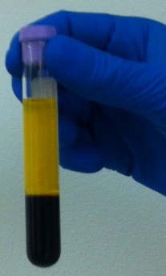
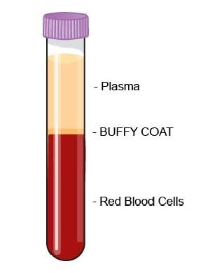
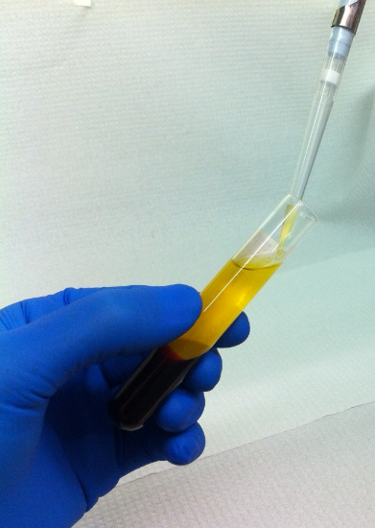
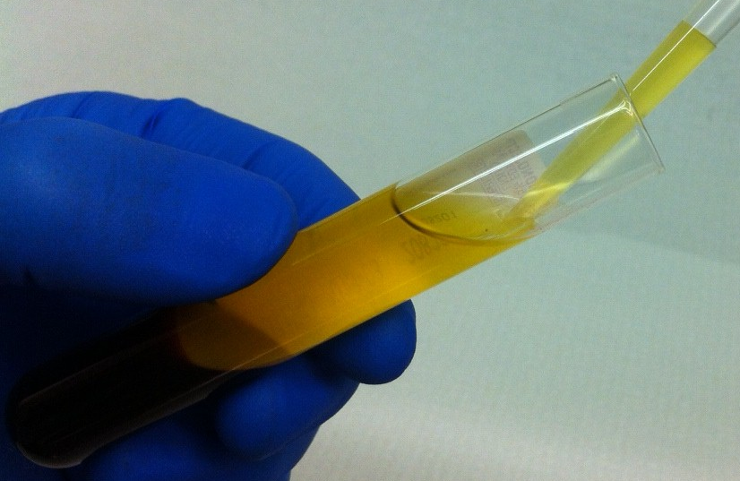
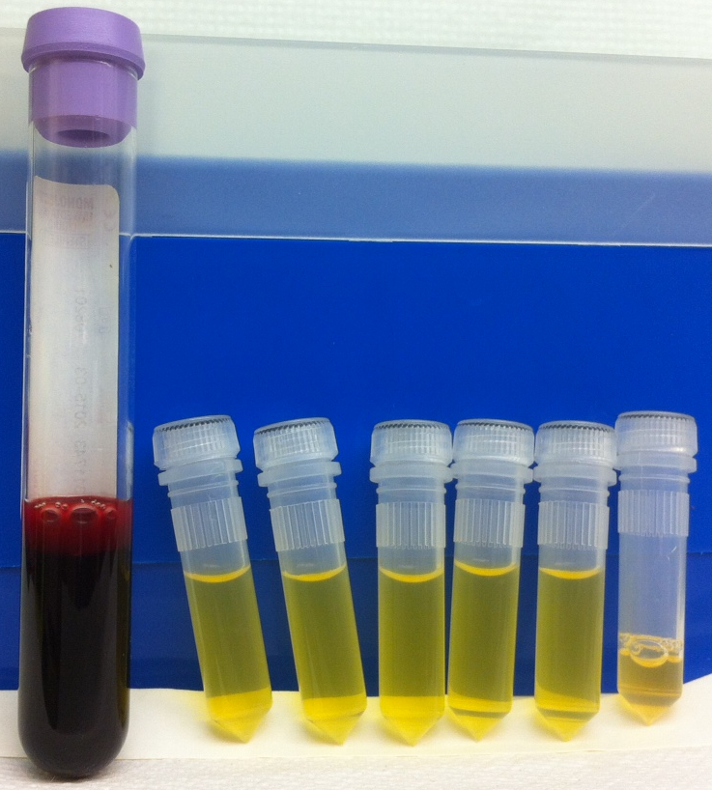
Plasma Aliquots
Blood Sample Processing
Process samples into serum and plasma and pipette into aliquots

Slide 43
Blood Sample Storage and Shipment
Store in -70 degrees or colder
Training in shipping dangerous goods and substances
Pre-paid shipping account will be provided
Ship samples only on Mondays – Wednesday
Ship in batches once every 3-4 months (twice during study)

Slide 44
Outcome Assessment

Slide 45
C3PO Secondary Outcomes

Slide 46
CDC Symptom Assessments
(Days 2, 4, 6, 8, 10, 14, 15, 30)
Fever Or Chills
Cough
Shortness Of Breath Or Difficulty Breathing
Fatigue
Muscle Or Body Aches
Headache
New Loss Of Taste Or Smell
Sore Throat
Congestion Or Runny Nose
Nausea Or Vomiting
Diarrhea
Abdominal Pain
https://www.cdc.gov/coronavirus/2019-ncov/symptoms-testing/symptoms.html

Slide 47
COVID Outpatient Ordinal Outcome Scale
Time to disease progression on the COVID Outpatient Ordinal Outcome Scale censored at 15 days after randomization
1. Patient requires care in the hospital
2. Patient requires care in the ED or urgent care
3. Patient at home with symptoms rated as moderate (defined as fever, shortness of breath, abdominal pain)
4. Patient at home with symptoms rated as mild (defined as afebrile, constitutional symptoms (flu-like illness) without shortness of breath)
5. Patient in their usual state of health
(adapted for outpatient use from Harrell 2020 )

Slide 48
C3PO Exploratory Outcomes
Hospital-free days during the 30 days following randomization
WHO's COVID Ordinal Scale for Clinical Improvement during the 30 days (8 ranks, 6 inpatient focused assessments)

Slide 49
Stanford Call Center
Day 2-14 assessments will be conducted by centralized follow-up core (Stanford University). The core will email, text, call the subjects. The core is blinded.
If the follow-up core cannot reach a subject, or the subject has a problem, they will call the local study team to check on status, complete an AE form, etc.

Slide 50
Protocol Violations/Deviations, AE Reporting

Slide 51
Adverse Events and Protocol Deviation Reporting
25 June 2020

Slide 52
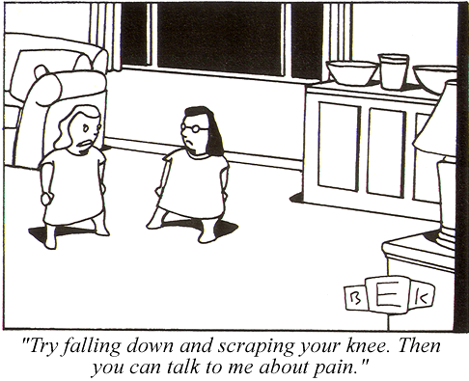
Notes:
Adverse events – seriousness is all relative

Slide 53
Adverse Events
Any untoward medical occurrence in a subject that was not previously identified
regardless of whether or not it is serious
whether or not related to the intervention
generally anything that requires treatment
Serious Adverse Events are
fatal or life-threatening
cause or require intervention to prevent permanent disability or damage
cause or prolong hospitalization

Slide 54
Reporting AEs in C3PO
All AE (serious and non-serious) are collected on the day of infusion
Only SAE and visits to an ED or Urgent Care are collected on all other days
Primary outcome events are captured as AE in C3PO

Slide 55
Reporting AEs in C3PO
Do not report events EXISTING PRIOR to randomization
(unless there is a change in severity, e.g. progression of disease requiring hospitalization)
Report the DIAGNOSIS, not the symptoms:
Fever, cough, chest pain, crackles = pneumonia
Report the PATHOLOGY, not the outcome or treatment
Not ‘death’ but the event that caused death. Intubation, hemodialysis, etc. are treatments

Slide 56
Reporting AEs in C3PO
All AE’s reported on Adverse Event Case Report Form (CRF)
Name events using MedDRA
SAE’s require:
  Narrative description
  Relevant tests and laboratory data
  Relevant history and pre-existing conditions
  Concomitant medications

Slide 57
Relatedness
Not Related
The timing is wrong and there was clearly another cause
Unlikely
Timing may be suggestive
Another cause is possible
Not something the intervention is known to cause
Reasonable Possibly (2 of 3)
Timing is suggestive
Not readily caused by something else
Is known to be caused by the intervention
Definitely (must have all 3)
Timing is suggestive
No other possible cause
Is known to be caused by the intervention

Slide 58
Write good SAE narratives
Be concise but complete (not comprehensive)
Include only the pertinent PMH and HPI
Describe the event
Describe the response
Describe the outcome
And say when each of those happened
Look for and respond to queries promptly
Notes:
It is important for us here at the CCC and for all your site co-investigators.

Slide 59
SAE review process
Internal Quality Review - completeness, brevity, consistency
Independent Medical Safety Monitor Review – serious, related, expected
Data Safety Monitoring Board – aggregate safety and risk-benefit
Federal Expedited Reporting - MedWatch

Slide 60
Protocol Deviation Reporting
PD and unanticipated problems are reported in WebDCU
When and what to report
  Risk to participants or others
  Eligibility deviations
  Altered exposure to the intervention
Corrective and Preventative Actions (CAPA)

Slide 61
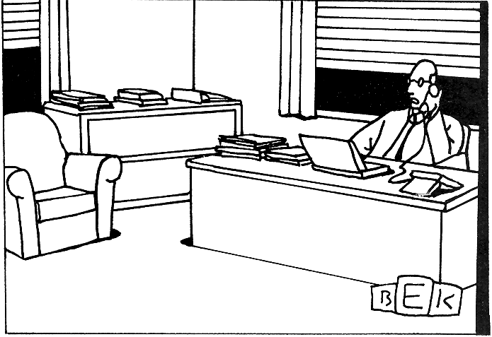
“I just have to create a few loose ends for other people
to clear up, and then I can out of here.”
Notes:
Why you have to turn in SAE’s early. A lot of other people need to look at them and the clock is running

Slide 62
Questions?

Slide 63
Site Regulatory Readiness

Slide 64

C3PO
Clinical Trial of COVID-19 Convalescent Plasma in Outpatients
Site Regulatory Readiness
Carol Van Huysen
C3PO Site Manager/Monitor
SIREN CCC, University of Michigan
Notes:
64

Slide 65
Objectives
Websites and links
Documents & Tools
Being Released to Enroll

Slide 66
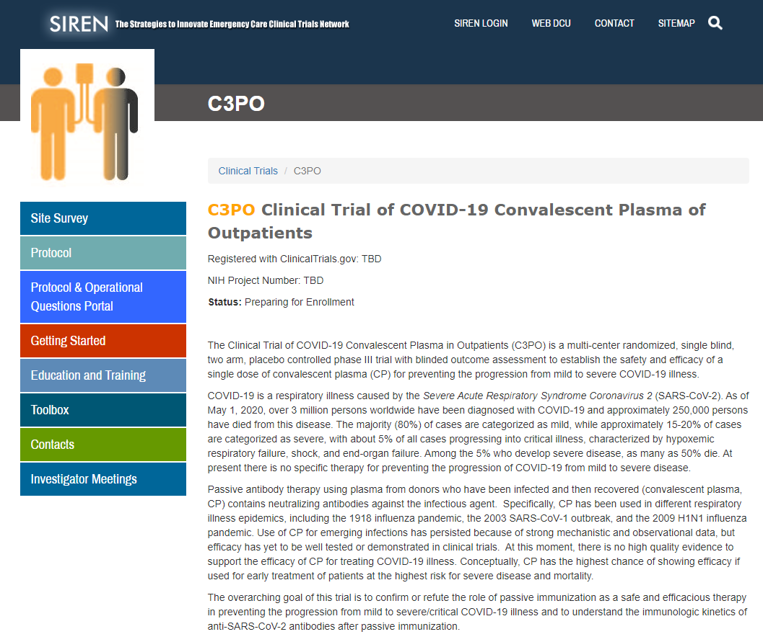
https://siren.network/clinical-trials/c3po
  Locate study materials: protocol, cIRB approved ICF, Milestone and Regulatory Parameters documents, MOP
  Access training materials and FAQs
  Important information and materials for preparing for C3PO
  Useful links to trial resources
Notes:
66

Slide 67
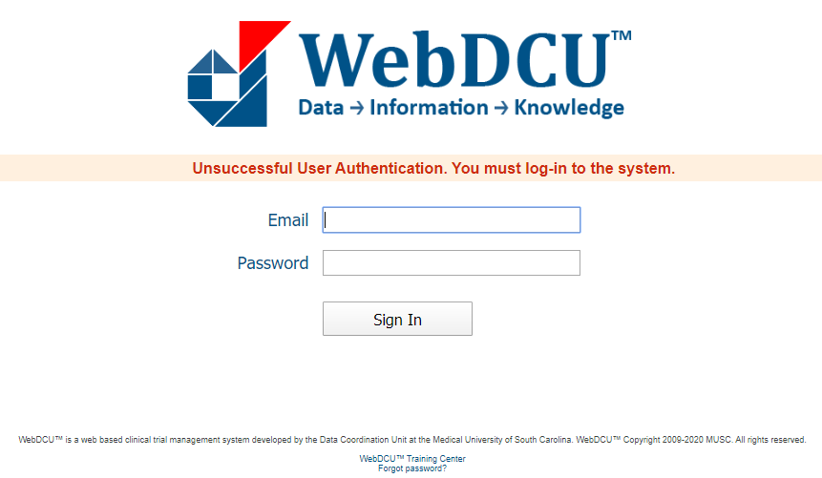
C3PO Regulatory Database: WebDCUTM
  C3PO regulatory database will serve as the central repository for all regulatory documents
  IRB Approvals and other essential documents will be available via the database
  Automated emails will be sent for expired, expiring, and missing documents
Notes:
67

Slide 68
Step 1 – Regulatory Readiness
Inform your local IRB of the C3PO study and request that they cede oversight of the trial to the study’s central IRB, Advarra.
Approved Protocol and ICF are on the C3PO website
Notes:
68

Slide 69
Step 2 – Regulatory Readiness
eDOA Completion
Obtain a UM Friends Account – Getting Started on C3PO website
email C3PO-contact@umich.edu to request a WebDCU database login
Enter the research team in the eDOA in WebDCU using the Regulatory Parameters document as guidance
Regulatory Document Approval Parameters for WebDCU pg 2
Notes:
69

Slide 70
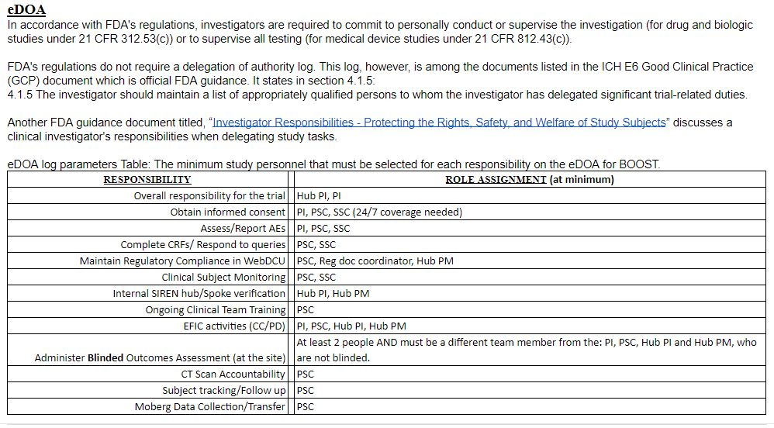
Electronic Delegation of Authority Log
A list of appropriately qualified persons to whom the investigator has delegated significant trial-related duties.
  .

Slide 71
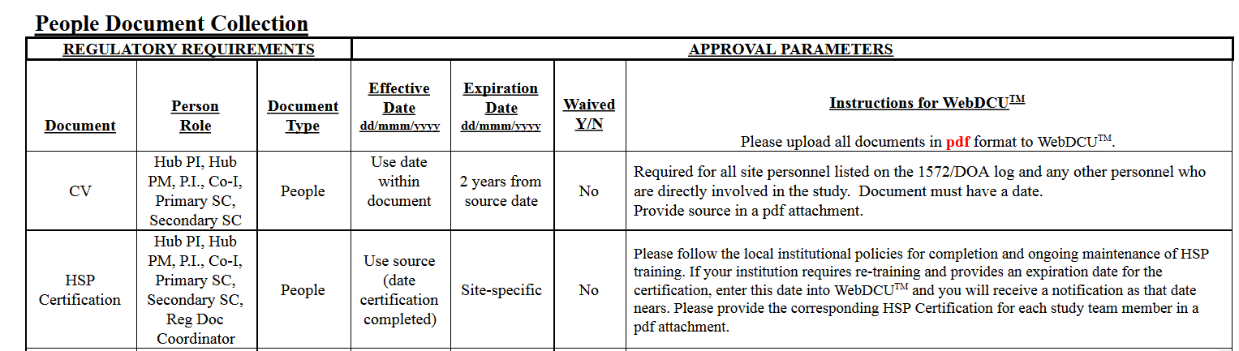
Step 3 - Regulatory Document Approval Parameters
  Outlines all regulatory and training requirements for People and Site documents
  People Document: Specific to an individual study team member
Regulatory Document Approval Parameters for WebDCU pgs 3-4

Slide 72
Regulatory People Documents Needed for Startup
  All Team Members
  HSP
  GCP
  Protocol Training
  Applicable Team Members
  CV
  Medical License
  Data Training
  Regulatory Document Training
  Sample Handling and Shipping
  **Reminder: Please upload all documents as PDFs in WebDCU

Slide 73
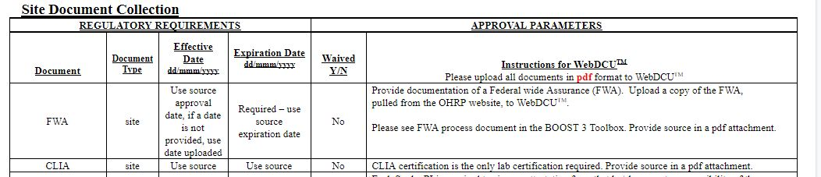
Regulatory Document Approval Parameters
  Site Document: Applies to a site/Spoke
Regulatory Document Approval Parameters for WebDCU pgs 5-6

Slide 74
Regulatory Site Documents Needed for Startup
  FWA for your Institution
  CLIA Certification
  FDA Form 1572
  HSP Requirements
  Attestation of Study Team Education and Training
  Conflict of Interest
  Ceding Request to Local IRB
  Ceding Acknowledgment from Local IRB
  IRB Approval (Advarra)
  IRB Approved Informed Consent (Advarra)
  **Reminder: Please upload all documents as PDFs in WebDCU

Slide 75
Step 4 – Regulatory Readiness
cIRB Tables completed in WebDCU
    Site Overview - Review and verify, or enter under SIREN, Central IRB .
    Site Inspection History - Review and verify, or enter under SIREN, Central IRB.
    Initial Site Submission - Enter in WebDCU under the C3PO.
Regulatory Document Approval Parameters pgs 7-25
Notes:
75

Slide 76
Step 5 – Complete all training
Complete all required training using the C3PO Regulatory Parameters Document as a guide.
  Protocol Training –Required for all study team members; IM Meeting
  Regulatory Document Management Training - Required for primary study coordinators, reg doc coordinators and Hub-PM
  Data training: Required for team members responsible for data entry. Available soon on the Education and Training Tab of the C3PO website.
  Sample Handling and Shipping Certification – For team members with this responsibility per institutional policy

Slide 77
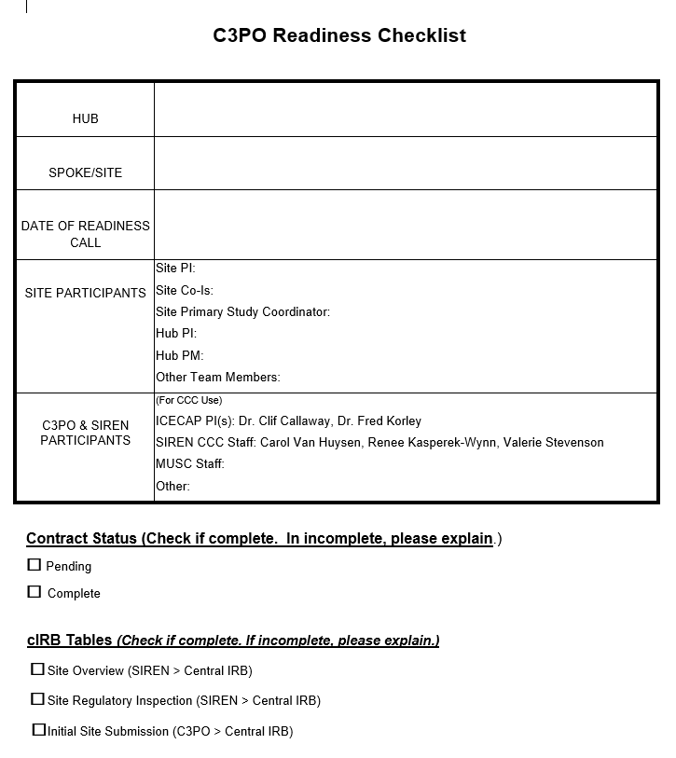
Step 6 - Readiness Checklist and Call
  Sites will complete checklist to confirm regulatory and logistical readiness
  List names of site participants who will be in attendance
  Respond to all questions in logistics section
  Email completed checklist prior to the call (C3PO-contact @umich.edu)
  Request CCC schedule a readiness call

Slide 78
Ongoing Site Management
  It is the responsibility of each Hub/Site to maintain regulatory compliance, inclusive of site documents and people documents, throughout the duration of the trial
  Documents approaching expiration should be reconciled prior to the expiration date
  Study team personnel who are out of regulatory compliance should not participate in any trial related activities

Slide 79
Study Team Changes
  Documented in C3PO Database
  Update eDOA
  Upload all team personnel documents, trainings and certifications (eg., CV, medical license)
  Study team members cannot begin research related activities until all of the above have been reconciled.

Slide 80
Who to Contact?
For immediate emergency assistance (enrollment, clinical, protocol, adverse events, etc.), please use the 24/7 C3PO Principal Investigator Hotline: 844-C3PO-PIs 844-237-6747 (inactive until 7-1-20)
For all other non-urgent questions: C3PO-contact@umich.edu
For non-urgent data entry/WebDCU questions call (843)792-1453
For all email communications, please include C3PO at the beginning of the subject line.

Slide 81
cIRB and Electronic Consent Training

Slide 82
Central IRB and e-Consent
25 June 2020

Slide 83
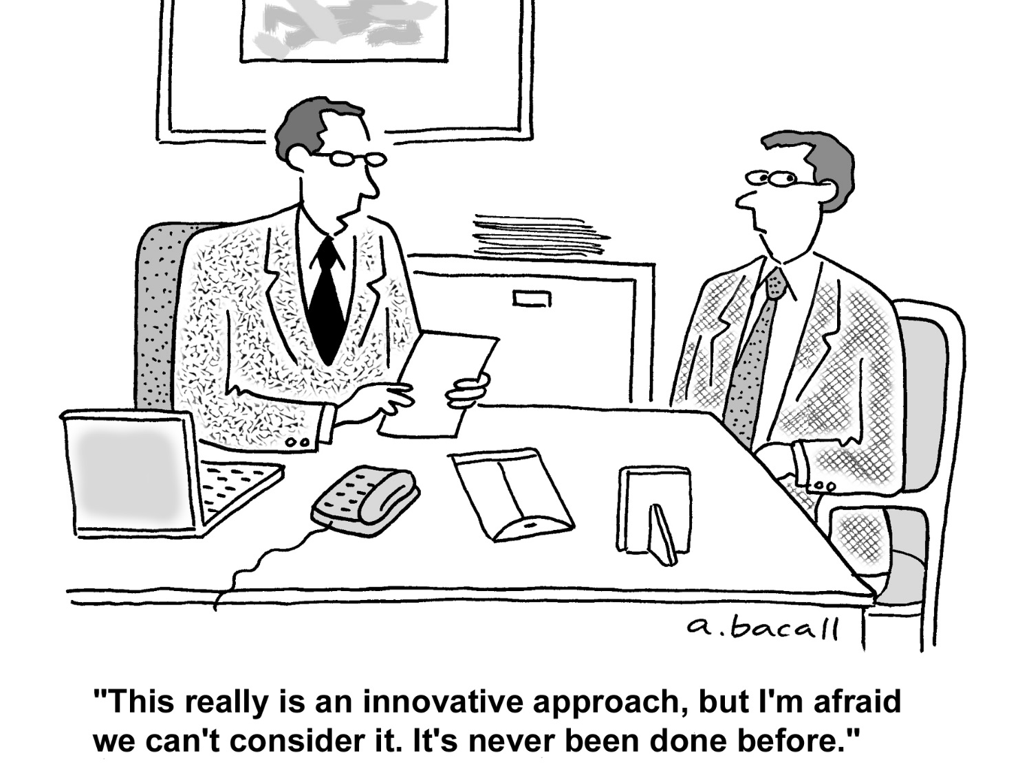
Notes:
Adverse events – seriousness is all relative

Slide 84
Objectives
Why a central IRB?
What a CIRB is and is not.
How it works.
The e-consent platform
CD
Notes:
84

Slide 85
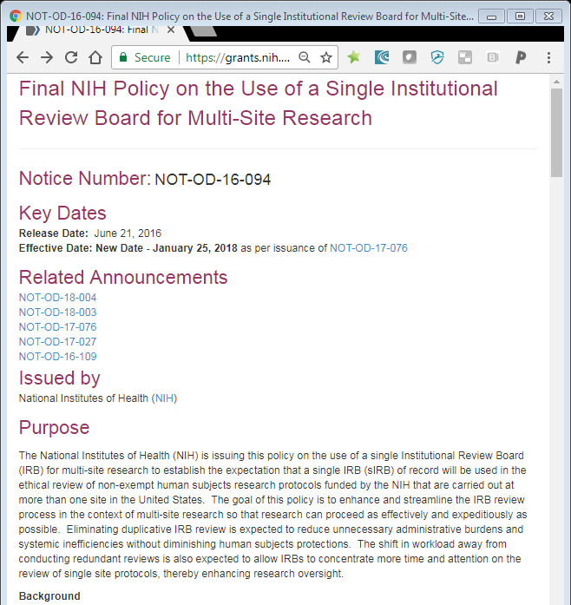
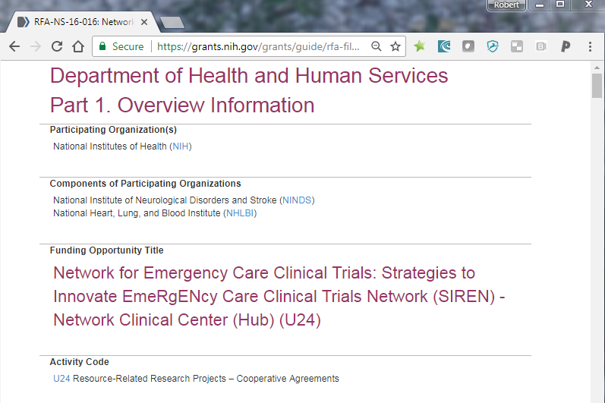
Why a central IRB?

Slide 86

Why a central IRB?
Empowerment
Equity
Efficiency
Expertise

Slide 87
What a CIRB is and is not
It IS a replacement for your local IRB panel
  Protocol review, consent review, site applications, AE’s, ORIO’s, SCR’s
It IS NOT a replacement for everything your local IRB office does
  Contracts, staff training, certification, billing, COI, radiation comm, etc.

Slide 88
How it works
Sponsor
Reliance agreements
Local processes
Ceding documents
Site applications
Approvals
AE and ORIO reporting
SCR

Slide 89
How it works
ER-CIRB
CIRB
Communication
Data flow
Avoid triplicative data entry
Avoid download/upload
CIRBI
WebDCU
CCC
Site
Site
Site
Site

Slide 90

E-consent document
Consent remains a human process
Adjustable text size
Error reduction
Compliant remote consent documentation
Completes the web based study binder
Facilitate remote monitoring

Slide 91
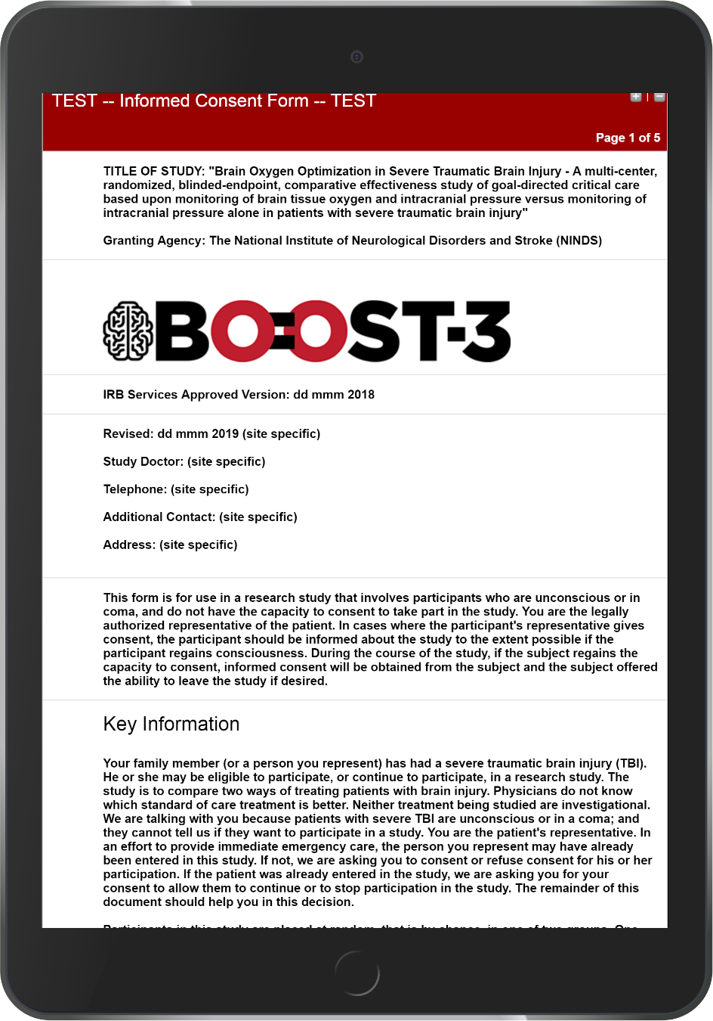
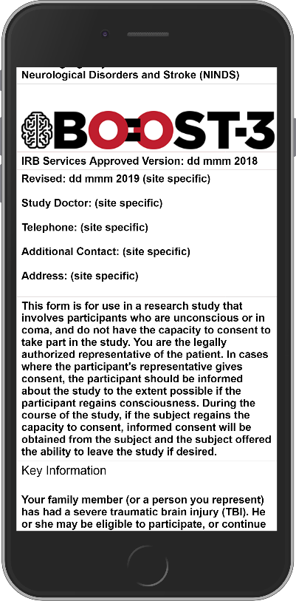
Link to test form
Link to simulator
RedCap
Compliant
Web based

Slide 92
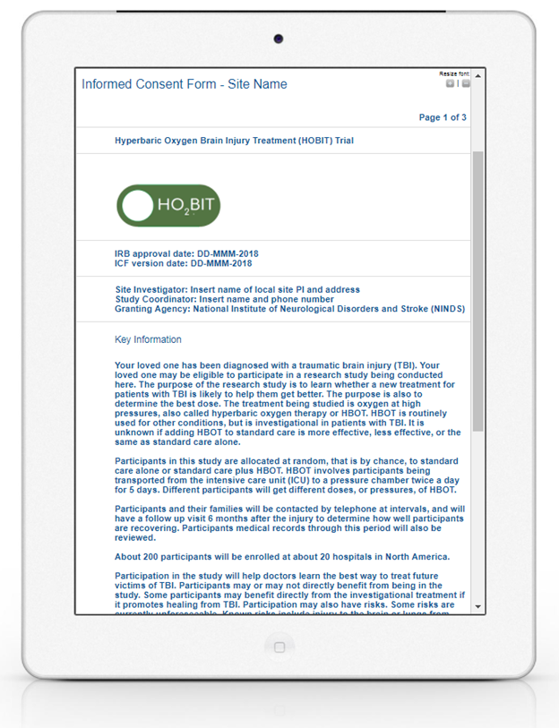
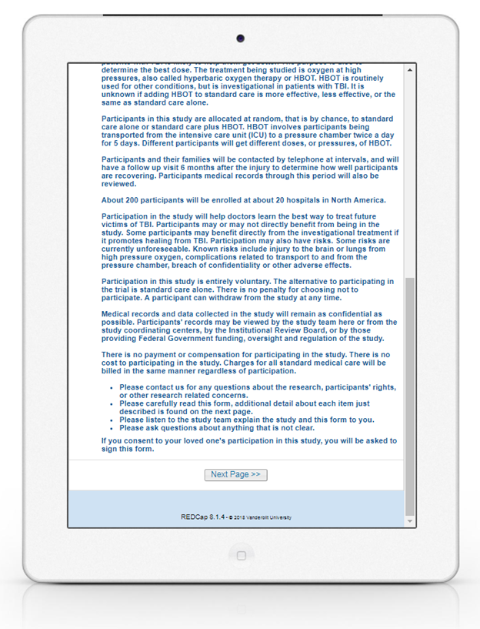


Slide 93
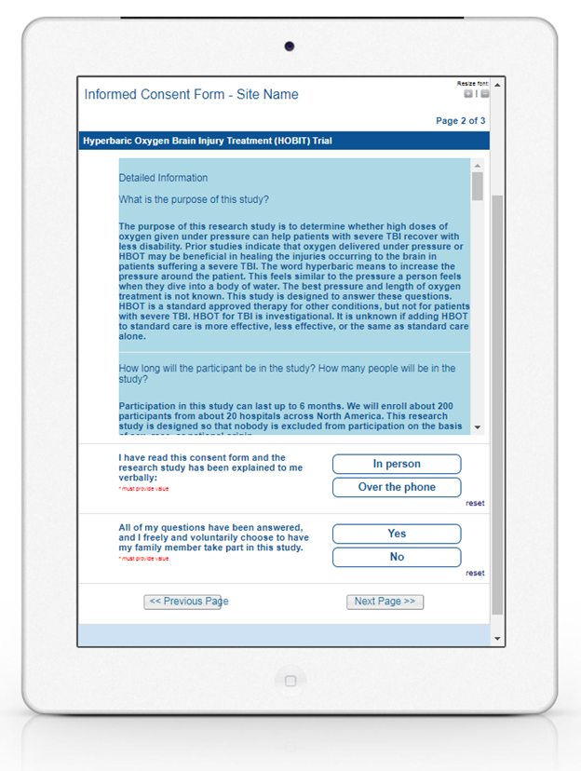
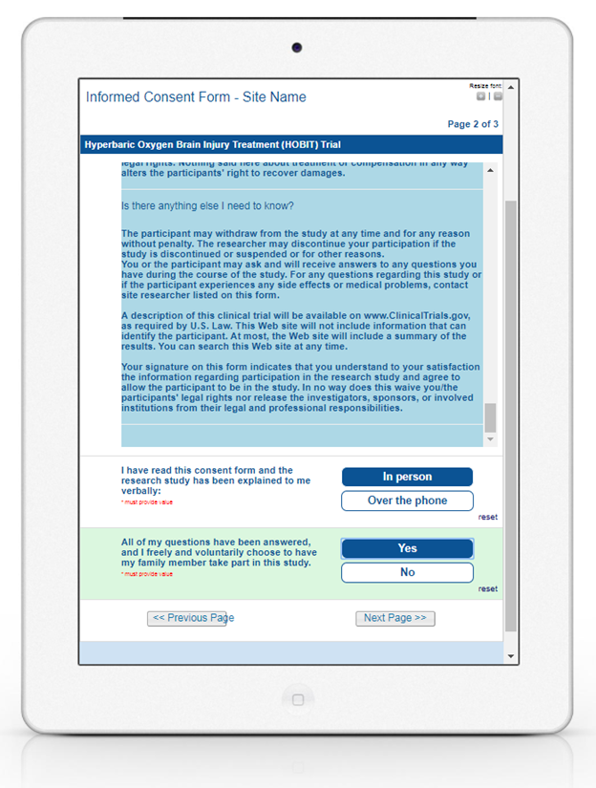

Slide 94
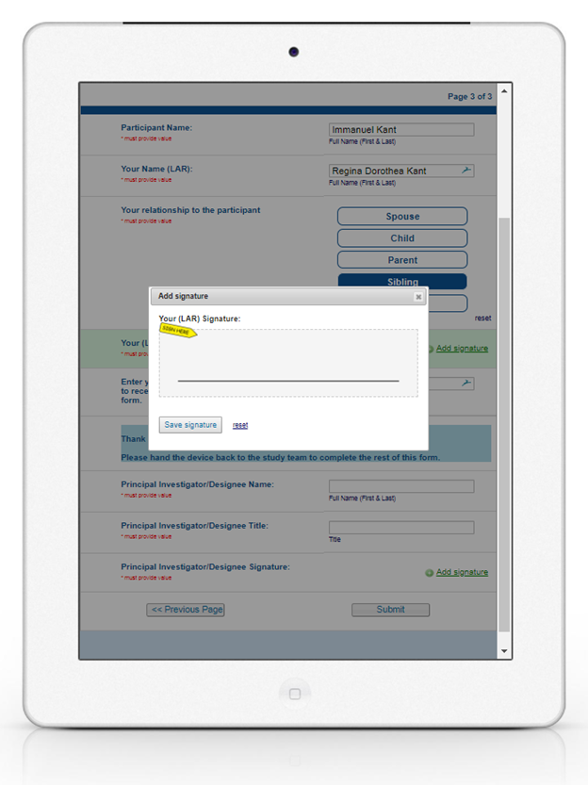


Slide 95
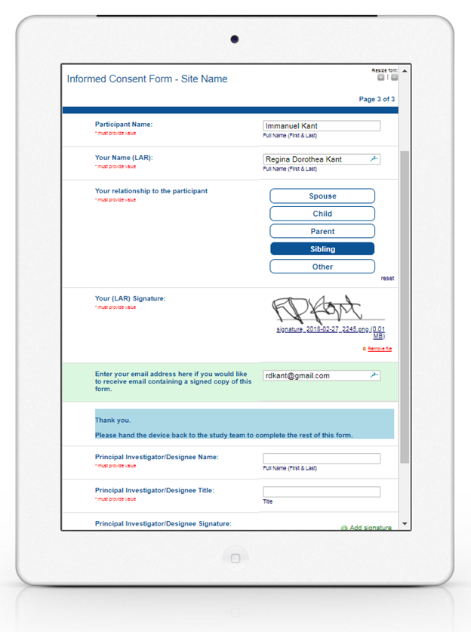

Slide 96
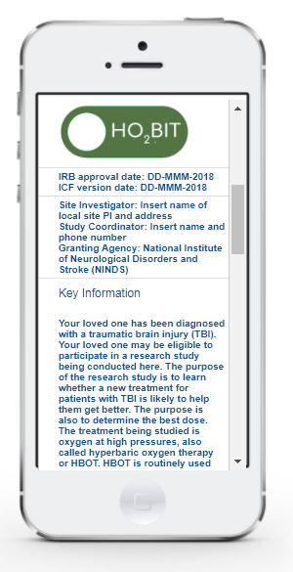
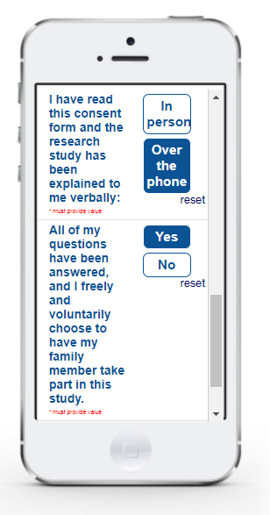
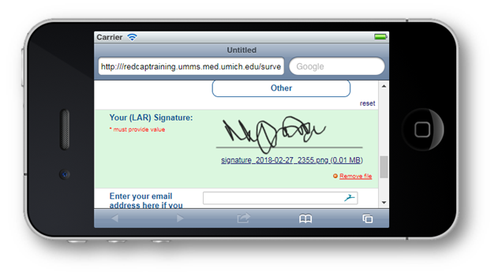

Slide 97
Contracts, Payments and Milestones

Slide 98
Contracts, Payments and Milestones
Valerie Stevenson
SIREN CCC

Slide 99
Contracts
Trial agreements are riders to the SIREN Master Trial agreement
  Subrecipient agreement form must be returned before rider can be sent
Sites designated as Spokes will receive agreements from their Hub
Deadline for returning riders is August 1, 2020

Slide 100
Milestones and Payments: Start-up
$7,500 (inclusive of F&A costs)
  Approved to participate
  Payment made when site is open to enrollment
  A list of tasks that must be completed to be considered open to enrollment can be found at: https://siren.network/clinical-trials/c3po
  Payment status will be visible in WebDCU
  Start up payment is limited to the first 50 sites that meet this milestone

Slide 101
Milestones and Payments: Per-subject payments
Payment 1 $1,900 (inclusive of F&A costs)
  Subject is enrolled and randomized, and all study CRFs required from baseline through hospital discharge are submitted and free of queries
  Reads ready in WebDCU
Payment 2 $1,900 (inclusive of F&A costs)
  End of Study (EOS) visit occurs within the specified timeline
  All study CRFs required for the EOS visit are submitted and free of queries or EOS=death
Blood sample collection, $500/each at 2 time points (inclusive of F&A costs)
  Samples must be received at the Biorepository to be considered for payment
  Paid semi-annually

Slide 102
vwillis@umich.edu

Slide 103
Data Monitoring RSDV

Slide 104
Complete the survey if not previously done
Steps to RSDV Document on the C3PO WebSite
Plan for Site Monitoring
Remote Source Document Verification (RSDV)
https://umich.qualtrics.com/jfe/form/SV_268g5qhViiIoNi5Link to Survey

Slide 105

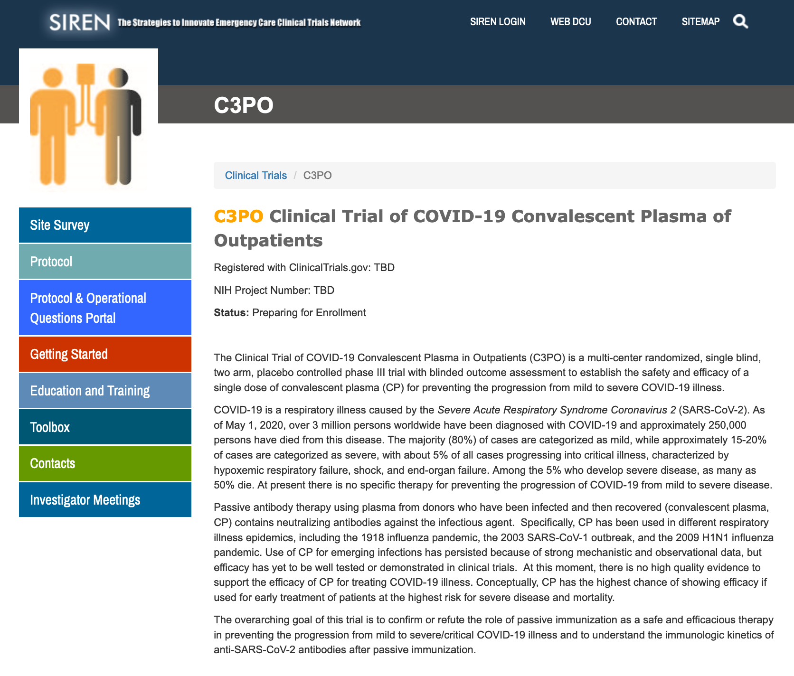
Investigator Hotline: 844-237-6747
(844-C3PO-PIS)
Email Questions: c3po-contact@umich.edu
https://siren.network

