Slide 1
C3PO Investigator Meeting
Advertise the trial
Impact of EUA for mAb
Boosting Enrollment
New payment scheme
PBMC substudy - Philip Norris
Other plasma trials
Miscellaneous, Q&A

Slide 2
1. Advertise the Study
https://siren.network/clinical-trials/c3po/toolbox#Resources

Slide 4
2. LY-3819253 / LY-CoV555 / Bamlanivimab
Chen et al. N Engl J Med. 2020 Oct 28. doi: 10.1056/NEJMoa2029849. PMID: 33113295

Slide 5
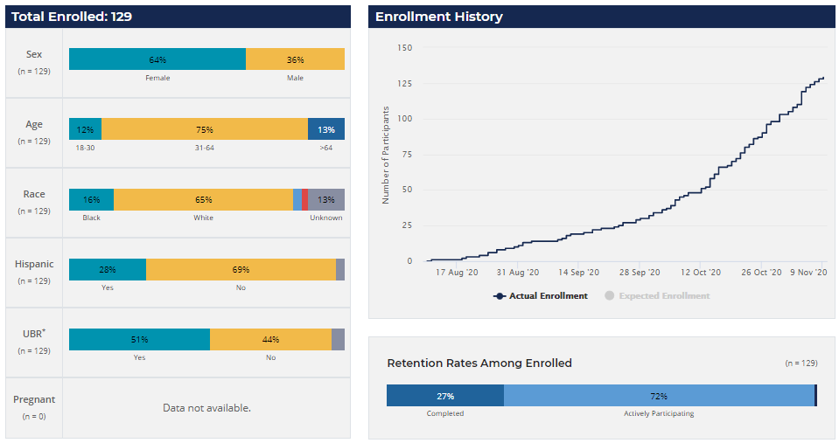
3. Boosting Enrollment
https://nhlbi-connects.org/secure/reports/enrollment

Slide 6
20 sites x 5 / month = 100 / month Finish in March/April
40 sites x 5 / month = 200 / month Finish in February
60 sites x 5 / month = 300 / month Finish in January
20 sites each enroll 30 subjects = 600 FINISHED
40 sites each enroll 15 subjects = 600 FINISHED
60 sites each enroll 10 subjects = 600 FINISHED
About 1 subject per week

Slide 7
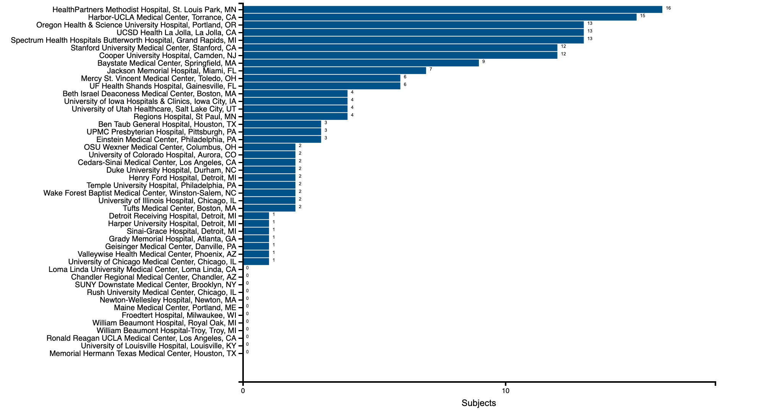
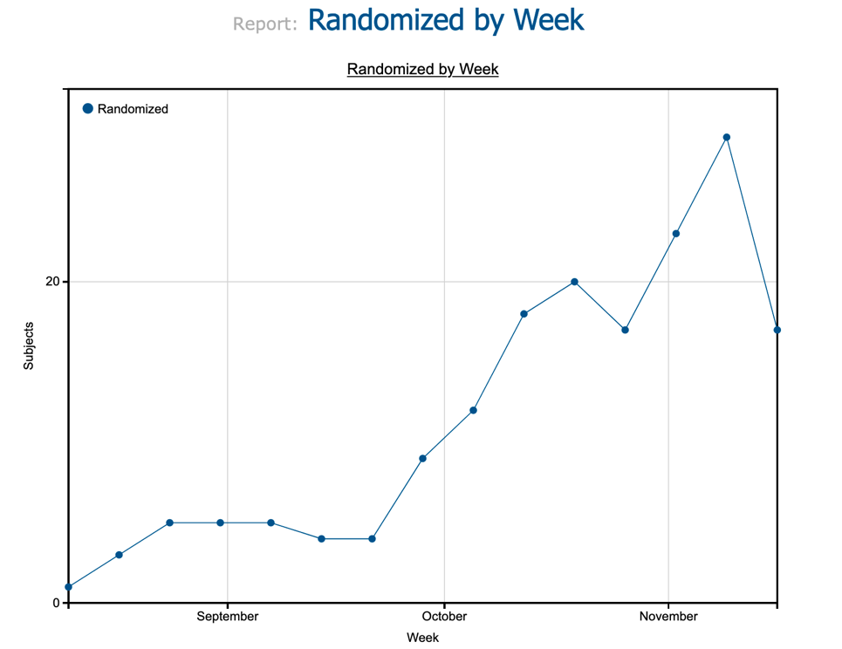
172

Slide 8
C3PO Screening Summary
COVID positive + Age>18 + Discharged from ED
n=1342
Inclusion or Exclusion Criteria Violation (not eligible) n=718
Potentially Eligible
n=624
Consent not offered
n= 297
n= 133 Study team unavailable
n= 84 Reason not stated
Miscellaneous others
Consent Offered
n=246
Declined to Participate
n=144
Consent Obtained
n=183
n=3 Chose to leave before test results and/or randomization
n=3 Became inpatient after consent before randomization
n=2 Pharmacy not available for placebo
n=1 AB blood type
n=3 Reason not stated
Enrolled
n=171
Updated 17-November-2020

Slide 9
Supplements
Enrolling more subjects per month requires more on-call time and more screening time. To compensate for these extra staff on call and screening, we will make supplemental monthly payments based on number of subjects enrolled per month.
Enrollments/month Supplement / month
0 No additional supplement
1 $500
2 $1000
3 $2000
4 $3000
5+ $5000

Slide 10
4. Ancillary Peripheral Blood Monocyte (PBMC) study

Slide 11
C3PO Mechanisms sub-study
New sub-study will enroll 100 subjects and collect whole blood for shipment to VRI-SF, samples will be processed to isolate peripheral blood mononuclear cells (PBMCs)
Plasma samples will be tested at four time points to measure pro-inflammatory cytokines as well as coagulation measures fibrinogen and D-dimer levels
Cells will be tested to measure evolution of B and T cell responses

Slide 12
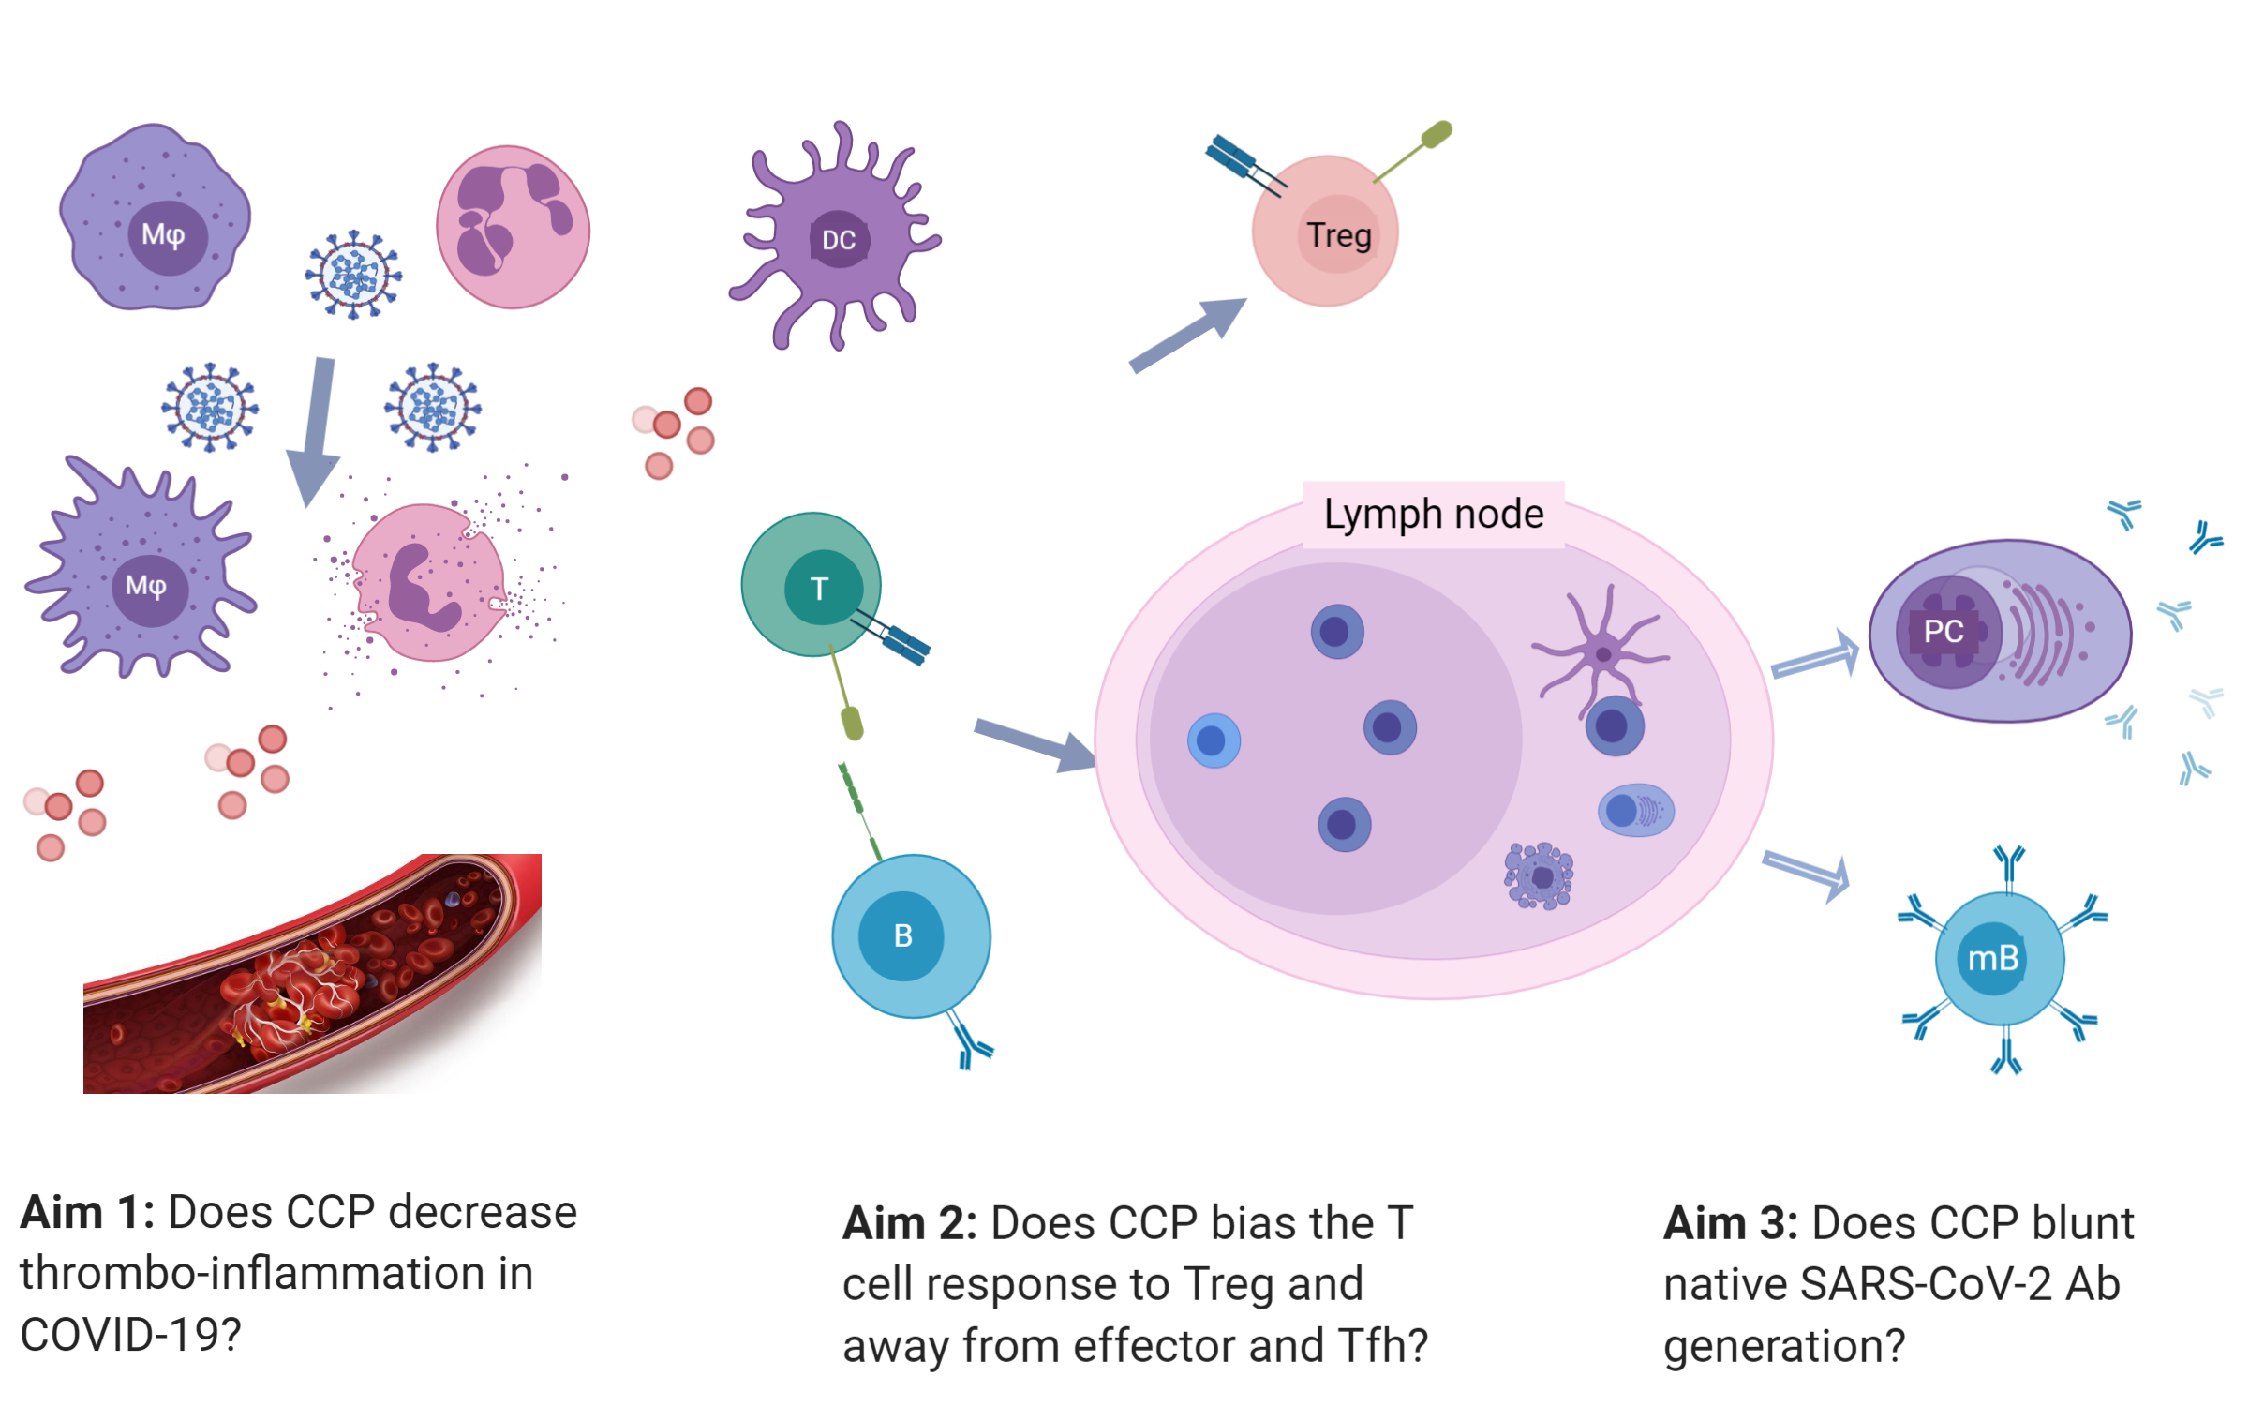
Pathophysiology of acute COVID
Innate immune response
Adaptive immune response

Slide 13
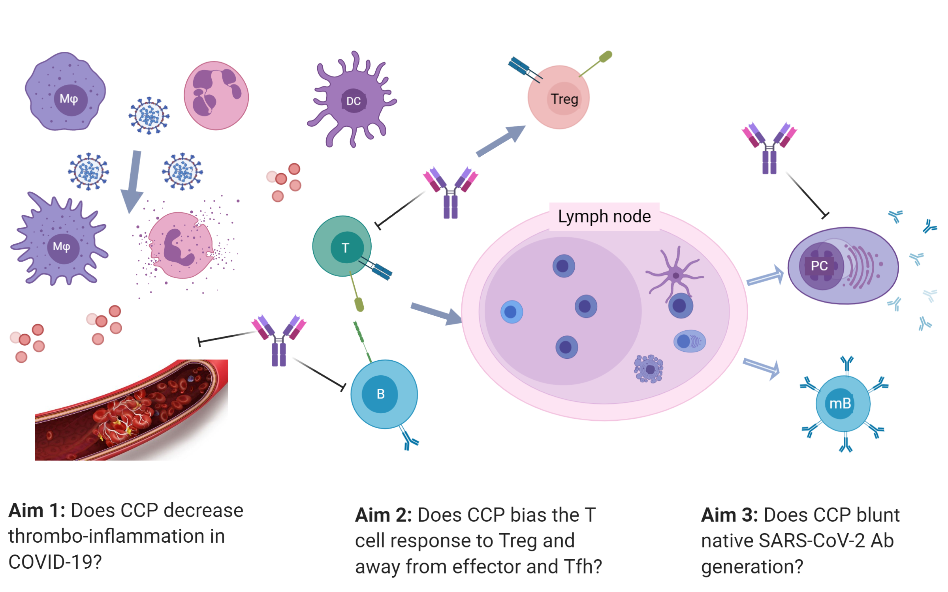
Pathophysiology of acute COVID
Innate immune response
Adaptive immune response

Slide 14
Ancillary Peripheral Blood Monocyte (PBMC) study
Sites will be reimbursed in the amount of $50 for the baseline blood collection, and $100 for each of the 15 day and 30 day collection time points in the study protocol.
Samples must be received at Vitalant Research Institute to be considered for payment.
Procedures for sample collection are included in the MOP for the trial at https://siren.network/clinical-trials/c3po
This ancillary study will collect blood from 100 subjects total, and we will only reimburse for the first 100 subjects completed.

Slide 15
Day | Sunday | Monday | Tuesday | Wednesday | Thursday | Friday | Saturday
OK to collect blood from Midnight until last FedEx Pickup (~6 pm) for next day delivery | Midnight - 6 pm* | Midnight - 6 pm | Midnight - 6 pm | Midnight – 6 pm | Midnight - 6 pm | Midnight - 6 pm | Do not collect sample on Saturday
Cannot get to lab in time from last pickup till Midnight | 6 pm-MN | 6 pm-MN | 6 pm-MN | 6 pm-MN | 6 pm-MN | 6 pm-MN
* Sunday evening pickup for FedEx delivery on Monday may not be available in all sites: check your local service at https://local.fedex.com/en-us/

Slide 16
5. C3PO and Convalescent Plasma Trials
C3PO
Stays out of hospital
15 and 30 day blood samples
Adapted from Akhmerov et al. Circulation Research. 2020;126:1443–1455

Slide 17
6. Miscellaneous
Biospecimen shipping for sites who have enrolled a lot
Short forms for non-English / non-Spanish consent
SAE Reporting
Include Date of Randomization
Included Medical Intervention for AE
For AEs, use names of “disease” (pneumonia, PE) not “consequences” (admission, intubation, death)

