Slide 1

Operational Resources for Hospital Transfusion Services to Initiate Clinical-trial of COVID-19 Convalescent Plasma in Outpatients (C3PO)
Webinar presenters:
Robert Davenport, MD University of Michigan (rddvnprt@med.umich.edu)
Alesia Kaplan, MD University of Pittsburgh (akaplan@itxm.org)
Hua Shan, MD Stanford University (hshan@stanford.edu)
Larry J. Dumont, MBA, PhD VP Research & Scientific Programs Vitalant Research Institute (LDumont@vitalant.org)
Amy Hutch VP, Inventory Management and hospital Services, Vitalant
(AHutch@vitalant.org)

Slide 2
Objectives
Study overview
CP supply and CP characteristics
Operational highlights for hospital transfusion services
Q&A session

Slide 3
Study overview
Objective: To establish the efficacy of a single dose of convalescent plasma (CP) for preventing the progression from mild to severe COVID-19 illness
Study Population: Adult patients with mild symptomatic COVID-19 illness and high risk for progression to severe COVID-19 illness, managed as outpatients
Randomized (in a 1:1 ratio) to receive either placebo (saline with vitamins) or CP
Single-Blind: Subjects will be blinded by covering the bag and infusion line. Providers will not be blinded. Outcome assessors will be blinded.
30+ SIREN Sites across the United States, 600 patients (300 placebo and 300 CP) over 9 months
Primary outcome: Disease progression defined as death or hospital admission or seeking emergency or urgent care within 15 days of randomization

Slide 4
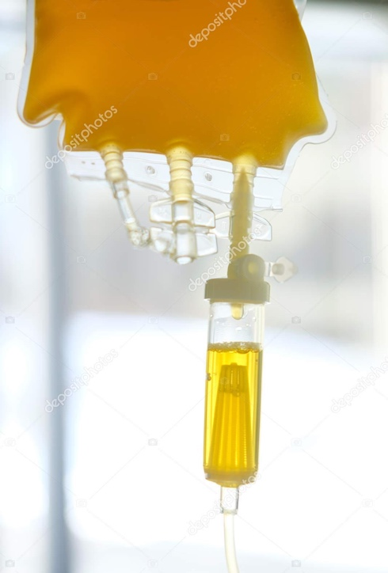
CP supply
BARDA contract with Vitalant through ABC
Donors:
  Positive SARS-CoV-2 test
  Symptoms resolved >14 days
  Males, never-pregnant females, or females with negative anti-HLA antibodies
3 O and 3 low-titer A units (Immucor, Inc., Galileo Neo <1:200) per site
Sites that don’t use low-titer A plasma as a standard of care can receive a set of O, A, and B
  (Vitalant needs authorized list of these few centers to support our ordering process. Note AB units are off the table because of inventory)
CP is collected by apheresis in ACD-A
Volume 200 ± 20 mL per unit
Pathogen inactivation is not performed

Slide 5
CP Selection
Step 1: Selection of higher titer units from Vitalant inventory –
  Ortho VITROS anti-SARS-CoV-2 total (IgG, IgA and IgM) to SARS CoV-2 S1 protein
Step 2: neutralizing Ab titers tested
  Vitalant Research Institute SARS-CoV2 Reporter Viral Particle Neutralization (RVPN) test (at least 1:160 titer)
Step 3: C3PO designated units sequestered in Vitalant inventory
Step 4: Clinical site places order

Slide 6
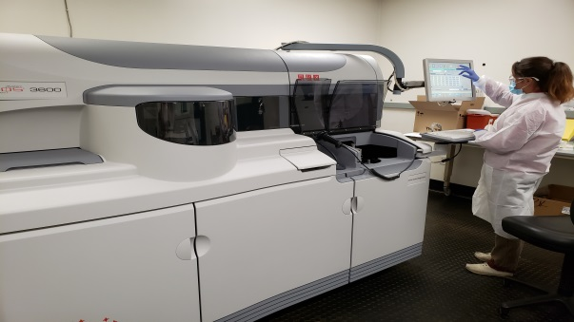
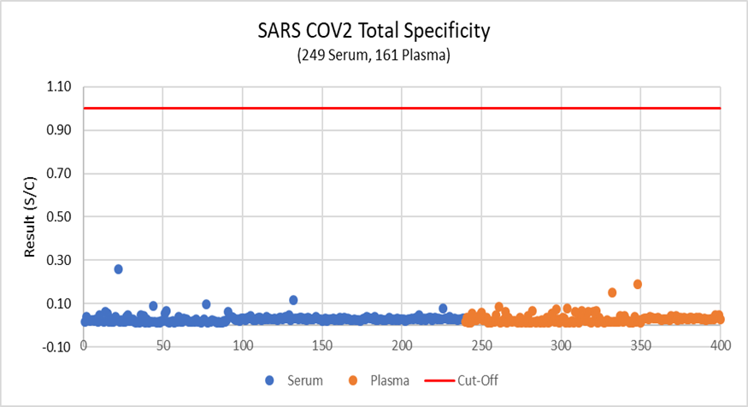
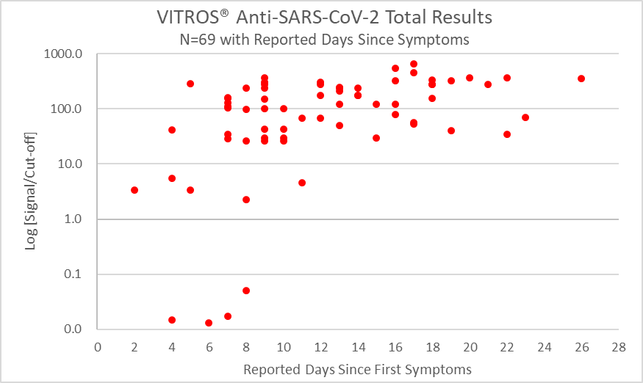
Ortho VITROS anti-SARS-CoV-2 Total Ig Assay
Detects IgM, IgA, IgG to S1 spike rAg
>1,600 of VITROS analyzers in over 1,000 labs in all 50 US states.
(2 at VRI-SF; 6 at CTS labs)
TAT: 130+ tests per hour
>360,000 COVID-19 antibody tests shipped to US customers in April
>5 million tests during May
Cutoff
Cutoff
Samples confirmed antibody negative by neutralizing antibody testing
Clinical Specificity 100% (95% CI: 99.1–100.0%)
Clinical Sensitivity = 100% >8 days from Symptoms Reported

Slide 7
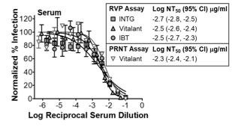
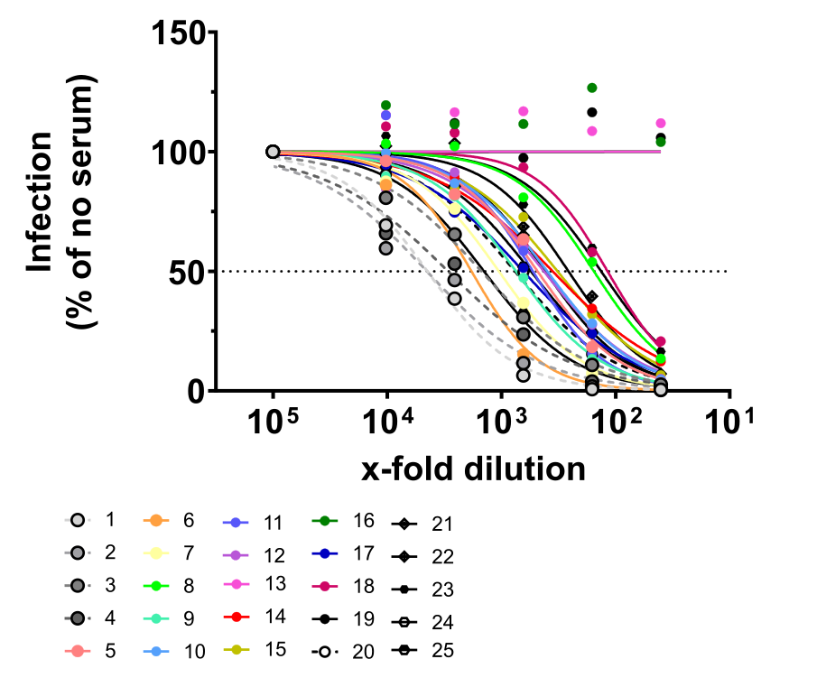
SARS-CoV-2 Spike Pseudovirus RVPNT Assay
Production of SARS-CoV-2 pseudoviruses
Correlation between single-round RVPT assay &
live virus PRNT assay (Zika RVPT vs PRNT)
Neutralization of SARS-CoV-2 S with convalescent serum from confirmed COVID-19 patients

Slide 8
Supplier and Facility identification number
Vitalant is a supplier of CP plasma
A list of individual FINs will be provided to all the sites in a separate document
  Vitalant, Scottsdale, AZ 85257, FDA Registration Number 2071464
  Lifesource dba Vitalant, Rosemont, IL 60018, FDA Registration Number 3008744215
  Lifefsource dba Vitalant, Pittsburgh, PA 15220 FDA Registration Number 2571073
  Bergen Community Regional Blood Center dba Vitalant, Montvale, NJ 07645, FDA Registration Number 2275064

Slide 9
CP product ISBT codes
Product Description | Product Codes
Apheresis CONVALESCENT PLASMA|ACD-A/XX/<=-18C|COVID-19 | E9747V00
Apheresis CONVALESCENT PLASMA|ACD-A/XX/<= -18C|Irradiated|COVID-19 | E9753V00
Thawed Apheresis CONVALESCENT PLASMA|ACD-A/XX/refg|COVID-19 | E9752V00
CLINICAL SITES: Update LIS & EMR or have manual process for receiving and issuing study CP

Slide 10
Ordering CCP from Vitalant
Orders will be accepted in one of two ways:
  Emailed to a Vitalant email address or
  Via an online via web form
Order detail must include:
  Facility Name
  Address
  Contact name/number
  Delivery instructions
  Order details
    Blood type
    Number of products

Slide 11
Ordering CCP from Vitalant
CCP ships via UPS
  Orders received by 2 PM EST will ship for next day - 10 AM delivery
Orders will be processed M-F for delivery T-Sa.
Start up orders per clinical site may have longer turn around time, based on the number of orders received daily
Start Up Order | O CCP | A CCP | B CCP
Low titer | 3 | 3
Non-low titer | 2 | 2 | 2

Slide 12
Shipments from Vitalant
The packing slip will include a note that reads: CCP for C3PO Study
No other frozen components will be comingled in the shippers.
Each shipper will include a prepaid UPS label to return the empty shipper.
  Please remove dry ice prior to returning the empty shipper

Slide 13
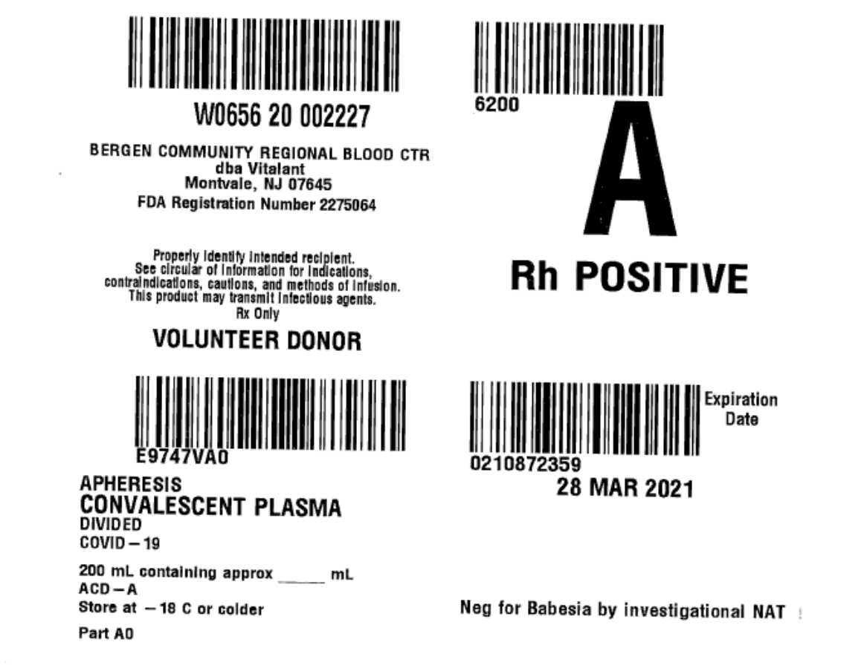
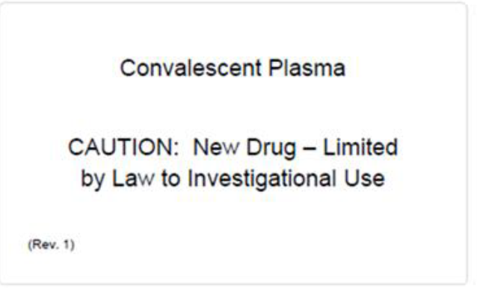
Labeling
Each unit will have 2 labels: a standard label and a tie tag
NB: IND# not on the Vitalant label. If required, should be placed on the transfusion service thawed product label or added to tie tag

Slide 14
CP samples for additional studies
Vitalant will ship units directly to participating sites
CP plasma samples from these units will be shipped separately to University of Pittsburgh for additional CP characterization by different assays, e.g.:
  Quantitate Anti-spike (S1) protein IgG titers (e.g. EUROIMMUN ELISA)
  Neutralization of SARS CoV-2 Plaque Formation (gold standard))

Slide 15
Transfusion Service
Develop internal blood bank SOP for the study
Train blood bank staff on the study SOP
Set up FINs and ISBT codes to receive and maintain inventory
ISBT code and label for thawed product – IND #
Designate freezer space and thawed plasma refrigerator space

Slide 16
Workflow for transfusion service
When a subject is enrolled, a T&S order is placed and sample sent to lab (follow usual practice including confirmatory sample as needed)
Based on blood type, blood bank confirms that an ABO compatible unit of CP is available
A subject is randomized only if ABO compatible CP is available
Blood bank Co-PI will be involved in choosing ABO type of CP based on the available inventory
If a subject is randomized to CP arm, a plasma prepare and transfuse order is placed
CP is transfused according to hospital’s blood transfusion policy

Slide 17
Q&A session

