Slide 1


C3PO
4 September 2020

Slide 2
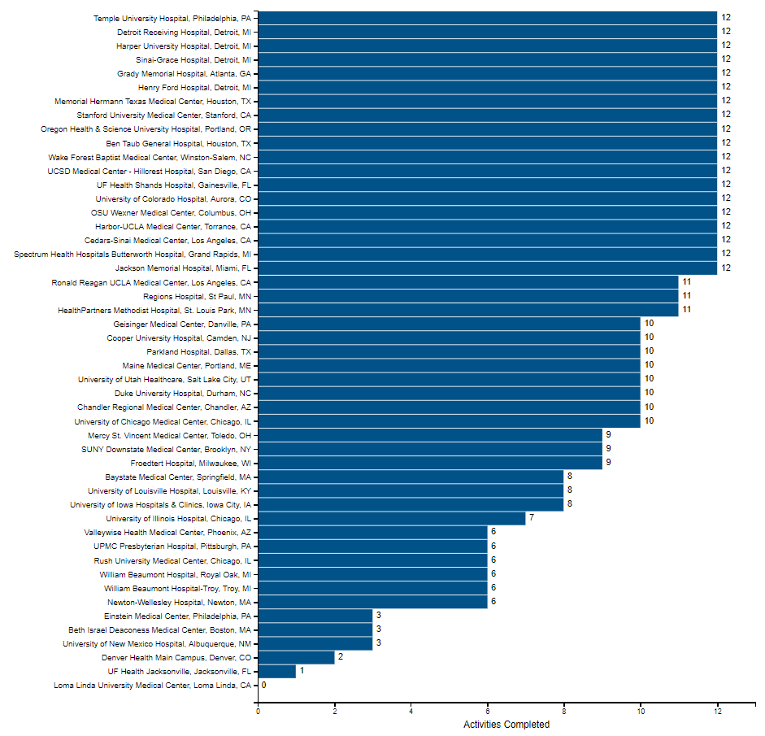
Site Progress
41 Sites have Advarra approval
36 Sites have completed their readiness call
29 executed contracts
22 Released to Enroll
14 sites Screening
14 Enrolled

Slide 3
29 Sites With Executed Contracts
Name | Status
Ben Taub General Hospital, Houston, TX | Released to enroll
Cedars-Sinai Medical Center, Los Angeles, CA | Released to enroll
Detroit Receiving Hospital, Detroit, MI | Released to enroll
Grady Memorial Hospital, Atlanta, GA | Released to enroll
Harbor-UCLA Medical Center, Torrance, CA | Released to enroll
Harper University Hospital, Detroit, MI | Released to enroll
HealthPartners Methodist Hospital, St. Louis Park, MN | Released to enroll
Henry Ford Hospital, Detroit, MI | Released to enroll
Jackson Memorial Hospital, Miami, FL | Released to enroll
Memorial Hermann Texas Medical Center, Houston, TX | Released to enroll
Oregon Health & Science University Hospital, Portland, OR | Released to enroll
OSU Wexner Medical Center, Columbus, OH | Released to enroll
Regions Hospital, St Paul, MN | Released to enroll
Sinai-Grace Hospital, Detroit, MI | Released to enroll
Spectrum Health Hospitals Butterworth Hospital, Grand Rapids, MI | Released to enroll
Stanford University Medical Center, Stanford, CA | Released to enroll
Temple University Hospital, Philadelphia, PA | Released to enroll
UCSD Medical Center - Hillcrest Hospital, San Diego, CA | Released to enroll
UF Health Shands Hospital, Gainesville, FL | Released to enroll
University of Colorado Hospital, Aurora, CO | Released to enroll
Wake Forest Baptist Medical Center, Winston-Salem, NC | Released to enroll
Duke University Hospital, Durham, NC | Ready to receive investigational product
Froedtert Hospital, Milwaukee, WI | Ready to receive investigational product
Maine Medical Center, Portland, ME | Ready to receive investigational product
Parkland Hospital, Dallas, TX | Ready to receive investigational product
Ronald Reagan UCLA Medical Center, Los Angeles, CA | Ready to receive investigational product
University of Utah Healthcare, Salt Lake City, UT | Ready to receive investigational product
UF Health Jacksonville, Jacksonville, FL | Preparing - High Priority
UPMC Presbyterian Hospital, Pittsburgh, PA | Preparing - High Priority

Slide 4
22 Sites Released To Enroll
Hub | Site | 1st Subject In
Ben Taub | Ben Taub General Hospital, Houston, TX
Cedars-Sinai | Cedars-Sinai Medical Center, Los Angeles, CA
Emory | Grady Memorial Hospital, Atlanta, GA
Florida | Jackson Memorial Hospital, Miami, FL | 26-Aug-20
Florida | UF Health Shands Hospital, Gainesville, FL | 11-Aug-20
HFHS | Henry Ford Hospital, Detroit, MI
OHSU | Oregon Health & Science University Hospital, Portland, OR
OSU | OSU Wexner Medical Center, Columbus, OH
Regions | HealthPartners Methodist Hospital, St. Louis Park, MN | 26-Aug-20
Regions | Regions Hospital, St Paul, MN
Stanford | Stanford University Medical Center, Stanford, CA | 22-Aug-20
Temple | Cooper University Hospital, Camden, NJ
Temple | Temple University Hospital, Philadelphia, PA
Texas | Memorial Hermann Texas Medical Center, Houston, TX
UCLA | Harbor-UCLA Medical Center, Torrance, CA | 19-Aug-20
UColorado | University of Colorado Hospital, Aurora, CO
UCSD | UCSD Medical Center - Hillcrest Hospital, San Diego, CA | 24-Aug-20
Wake | Wake Forest Baptist Medical Center, Winston-Salem, NC
Wayne | Detroit Receiving Hospital, Detroit, MI
Wayne | Harper University Hospital, Detroit, MI
Wayne | Sinai-Grace Hospital, Detroit, MI
Wayne | Spectrum Health Hospitals Butterworth Hospital, Grand Rapids, MI

Slide 5
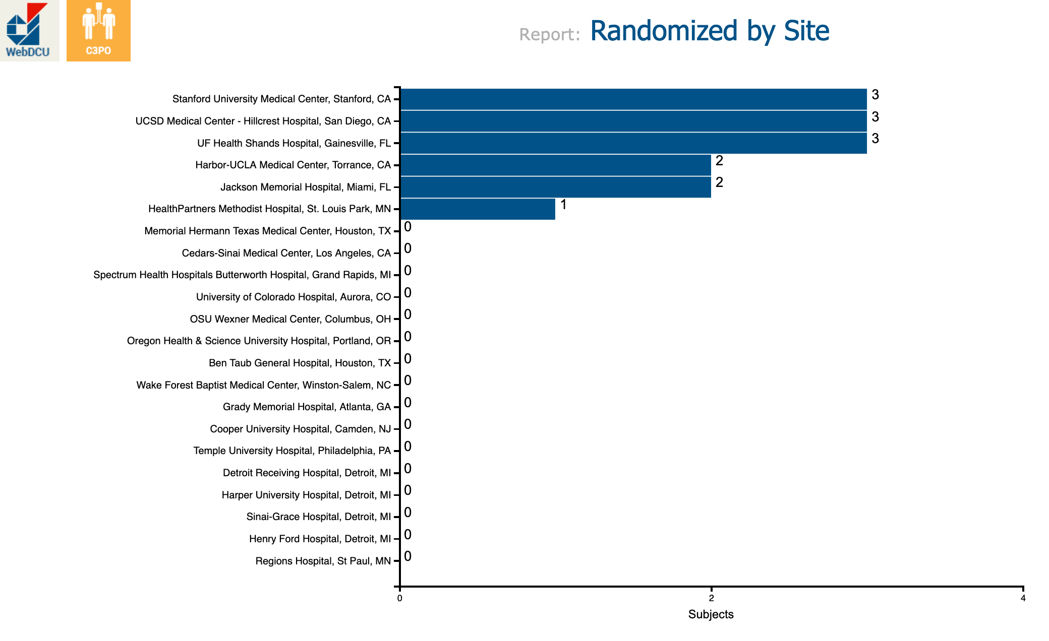

Slide 6
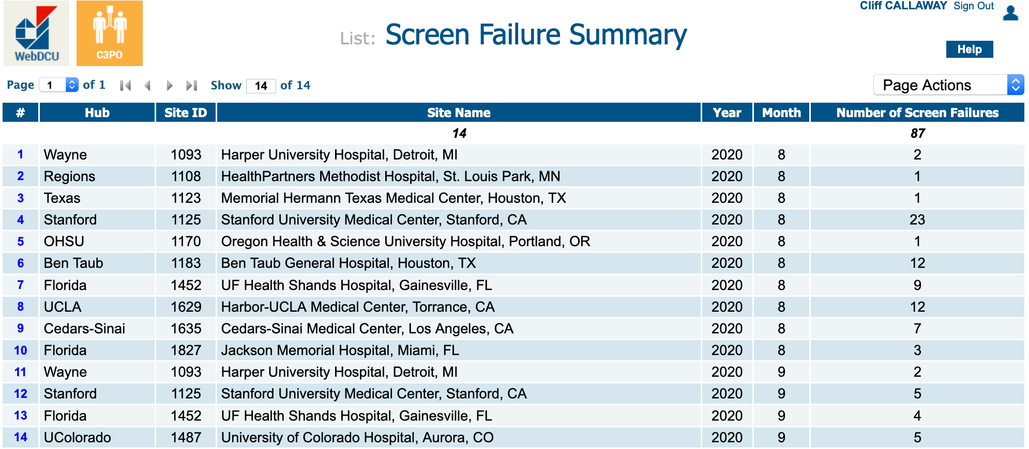

Slide 7
Screening Logs
14 Enrolled
86 Screen Failures
  6 had Consent Obtained, but not enrolled (2 got impatient before test results came back; 3 had exclusion criteria discovered)
  17 Declined Study
  52 Do not meet Inclusion
  13 with various (5 missing Spanish Consent form , 5 study team not available)
Fixed
Help!

Slide 8
2-3 enrollments / site / week

Slide 9
2-3 enrollments / site / week
x 50 sites = 100-150 / week

Slide 10
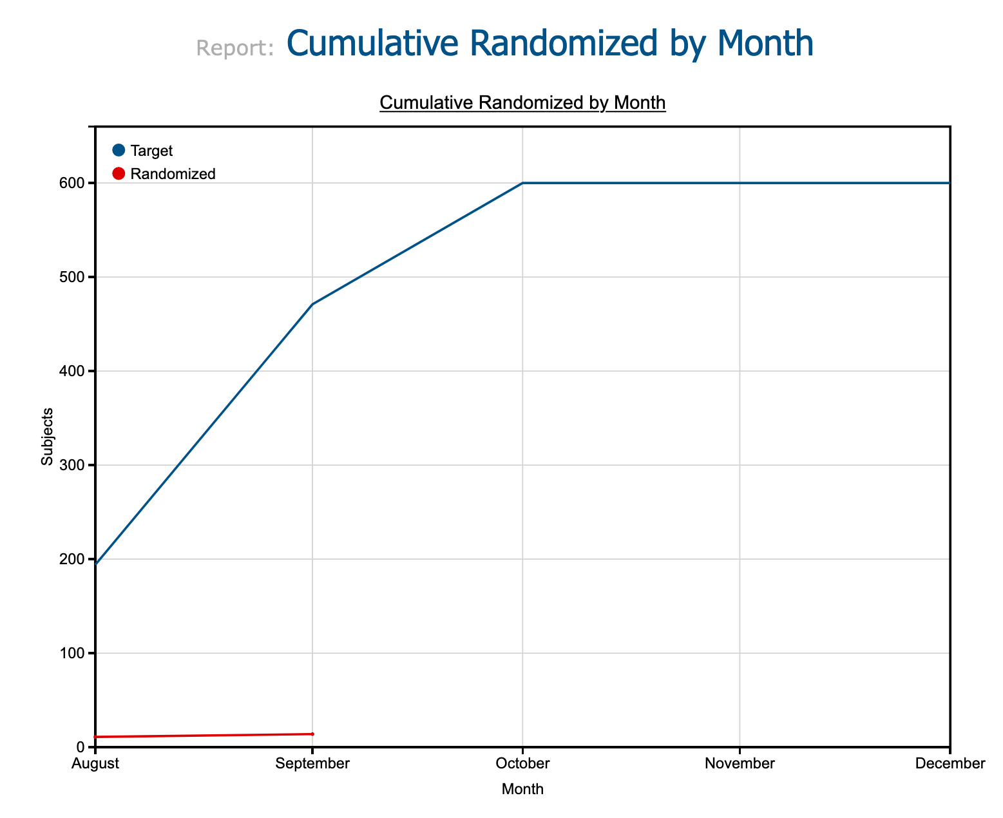

Slide 11
Wish we started July 1
Wish we had 50 sites active

Slide 12
Things to do right now
Clinical team training – Has to be done, but not hard
Any other people will be added to DOA? - Get their research / training certificates now
EPIC / CERNER / EMR builds - Pharmacy approval for placebo
Blood Bank programming and SOPs – Talk to them now
Committees – “one more approval” – Use Francis Collins’ letter
Any special IRB language? - Put it in WebDCU Now.
Readiness call – Schedule it Now

Slide 13
You cannot change the IRB – Approved Consent Form!
Your institution and local IRB can add “special things” in a box after the form (but this has to be approved by the central IRB). “Special things” go into WebDCU – find out if any and put them in NOW!
https://siren.network/clinical-trials/c3po/getting-started
Consent Form (Updated 7-10-20)
C3PO e.consent
Use this training link for your practice and training needs. If you provide your email address at the end of the consent you will receive an email like the one a study participant would receive. The email to the participant reflects the email local study team members (on the e.DOA with consenting permissions) will receive when a real participant is enrolled.
A site specific participant link, unique to your site and mirroring the cIRB-approved paper version of the site consent will be provided nearer to the time that your site is released to enroll.
To learn more: SIREN e.consent SOP

