Slide 1
Brain Oxygen Optimization in Severe TBI-Phase 3 (BOOST-3)
Ramon Diaz-Arrastia, MD, PhD, Scientific PI
Lori Shutter, MD, Clinical PI
William Barsan, MD, Contact PI, CCC SIREN
Sharon Yeatts, PhD, Statistical PI, DCC SIREN

Slide 2
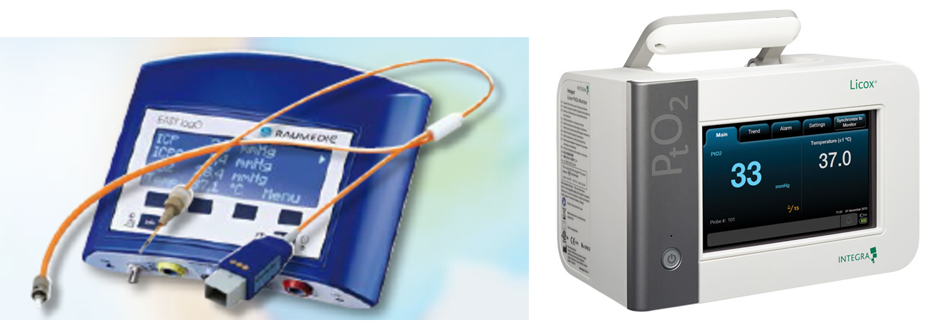
Brain Tissue Oxygen Monitors
FDA-approval:
Integra Licox® in 2000; Raumedic Neurovent PTO in 2007
Measures PbtO₂ in mm³ region around tip of catheter
No Class I data that it improves outcome
Variable penetrance of utilization in NICU
Notes:
The ability to measure brain tissue oxygen has been around for many years, and the initial device allowing continuous monitoring of brain tissue oxygen was FDA-approved 18 years ago.
For devices, FDA-approval is confirmation that the device works as advertised—that it accurately measures the brain tissue oxygen pressure in the few cubic millimeters around the tip of the catheter. FDA approval of devices does not require evidence that it improves outcome.
Because of the lack of Class I data that monitoring brain tissue oxygen improves clinical outcome, there has been variable penetration into neurological intensive care units, and this technology is primarily used in a handful of academic medical centers.

Slide 3
Rationale for PbtO₂ monitoring
Episodes of low PbtO₂ are common after TBI
Van den Brink et al¹ (2000)
101 patients monitored average 86 hours
57% had values < 15 mm Hg
42% had values < 10 mm Hg
22% had values < 5 mm Hg
Longhi et al² (2007)
Episodes PbtO2 10 - 19 mm Hg in 23% of time
Median duration 50 minutes
Episodes PbtO2 < 10 mm Hg 11% of the time
Median duration 39 minutes
van den Brink WA, et al, Neurosurgery 2000; 46:868-878.
Longhi L, et al, Intensive Care Med 2007; 33(12):2136-2142.

Slide 4
Rationale for PbtO₂ monitoring
Low PbtO₂ is associated with poor neurological outcome
Study (First Author, # of patients evaluable) | Hypoxia |  | No Hypoxia |  | Odds Ratio (95% C.I.)
 | Unfavorable Outcome (n) | Favorable Outcome (n) | Unfavorable Outcome (n) | Favorable Outcome (n)
Van den Brink 2000 (n = 99) | 29 | 14 | 24 | 32 | 3.8 (1.6 – 8.4)
Bardt et al 1998 (n = 35) | 18 | 5 | 3 | 9 | 10.8 (2.1 – 55.7)
Chang et al 2009 (n = 25) | 6 | 1 | 7 | 11 | 9.43 (1.1 – 95.9)
van den Brink WA, etr al Neurosurgery 2000; 46:868-878
Bardt TF, et al, Acta Neurochir 1998; Suppl. 71:153-156
Chang J, et al, Crit Care Med 2009;37:283-290

Slide 5
Rationale for PbtO₂ monitoring
Interventions can rectify low PbtO₂
Normobaric hyperoxia
Tolias et al (2004)
Increases PbtO₂ and decreases microdialysate glutamate and lactate levels
Nortje et al (2008)
Increases PbtO₂ and decreases microdialysate L/P ratio, increases CMRO₂ in physiologic region of interest
Tolias, CM, et al, J Neurosurgery 2004; 101:435-444.
Nortje J, et al, Crit Care Med 2008; 36(1):273-280.

Slide 6
Rationale for PbtO₂ monitoring
Interventions can rectify low PbtO₂
CPP Augmentation
Johnston et al (2004)
Norepinepherine increases PbtO₂ and decreases A-V ΔO₂
Johnston et al (2005)
Norepinepherine increases PbtO₂ and decreases OEF in ¹⁵O-PET studies
Linear relationship between PbtO₂ and OEF
RBC Transfusion
Zygun et al (2009)
Increased PbtO2 in 57% of patients
No change in microdialysate lactate/pyruvate ratio
Johnston AJ, et al, Int. Care Med. 2004; 30:791-797.
Johnston AJ, et al, Crit Care Med 2005; 33(1):189-195.
Zygun DA et al, Crit Care Med 2009;37(3):1074-1078

Slide 7
Published Clinical Trials
No randomized clinical trials available
Four studies have been published
All used historical or concurrent (physician choice) controls
Study | ICP + PbtO2 |  | ICP/CPP |  | Odds Ratio
 | Poor Outcome (n) | Good Outcome (n) | Poor Outcome (n) | Good Outcome (n) | (95% CI)
McCarthy 2009 | 34 | 29 | 32 | 16 | 1.7
Meixenberger 2003 | 18 | 34 | 18 | 21 | 1.6
Narotam 2009 | 44 | 83 | 22 | 17 | 2.4
Spiotta 2010 | 25 | 45 | 32 | 21 | 2.7
Pooled Odds Ratio |  |  |  |  | 2.1 (1.4 – 3.1)
Nangunoori et al NeuroCrit Care 2012 17:131-138

Slide 8
Clinical Equipoise
No Class I data that PbtO₂ monitoring improves clinical outcome
Utilization is expensive and labor-intensive
Adoption in management of critically ill brain injured patients is highly variable
Center to Center differences
Physician to Physician differences within Centers
Patient to Patient differences by same physician

Slide 9
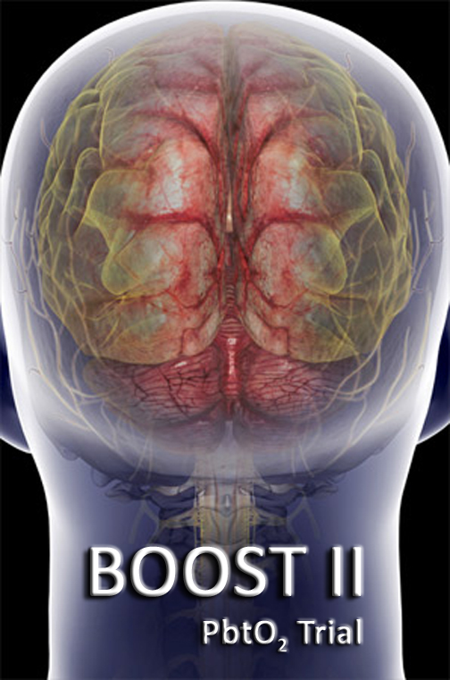
BRAIN OXYGEN AND OUTCOME IN SEVERE TRAUMATIC BRAIN INJURY: PHASE 2
BOOST 2

Slide 10
BOOST2 Primary and Secondary Objectives
Primary Objective: Treatment protocol informed by PbtO₂ monitoring results in reduction of brain tissue hypoxia
Secondary Objectives:
Safety hypotheses: Adverse events associated with PbtO₂ monitoring are rare.
Feasibility hypotheses: Episodes of decreased PbtO₂ can be identified and treatment protocol instituted comparably across clinical sites, and protocol violations will be low and uniform across different clinical sites.
Non-futility hypothesis: Relative Risk of good outcome measured by the GOS-E 6 months after injury of 2.0 is consistent with the results of this phase II study.

Slide 11
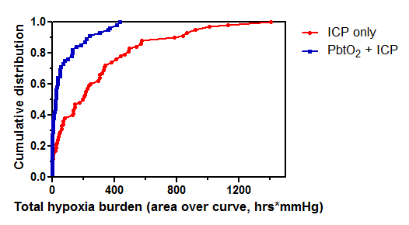
BOOST-2 Primary Outcome
Okonkwo et al, Crit. Care Med 2017 Nov;45(11):1907-1914
Notes:
This graph shows the cumulative distribution of brain tissue hypoxia, again showing the clear difference between the two treatment groups.
In the control group, less than 20% experienced no or trivial amounts of hypoxia, and over half experienced a hypoxia burden of over 200 (hours * mmHg)
For group treated with a protocol informed by PbtO2, 40% experienced only trivial duration of hypoxia, and less than 10% experienced a hypoxia burden of over 200.

Slide 12
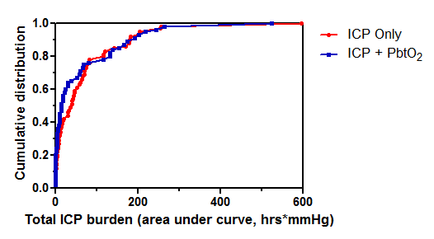
BOOST-2 Primary Outcome
Okonkwo et al, Crit. Care Med 2017 Nov;45(11):1907-1914
Notes:
And similarly, there was no difference in the cumulative distribution if ICP burden between both groups

Slide 13
BOOST-2 Secondary Outcome
--Safety
Serious Adverse Events by Treatment Groups | Overall | ICP Only | PbtO₂ + ICP | p
Subjects | 119 | 62 | 57
A - Cardio-Vascular | 14 (12%) | 5 (8%) | 9 (16%) | .257
B - Genito-Urinary | 0 (0%) | 0 (0%) | 0 (0%) | ---
C - Gastro-intestinal | 2 (2%) | 1 (2%) | 1 (2%) | 1.000
D - Laboratory abnormalities | 0 (0%) | 0 (0%) | 0 (0%) | ---
E - Metabolic Disorders | 0 (0%) | 0 (0%) | 0 (0%) | ---
F - Musculo-skeletal | 0 (0%) | 0 (0%) | 0 (0%) | ---
G - Neurological | 15 (13%) | 10 (16%) | 5 (9%) | .276
H - Ophthalmologic | 0 (0%) | 0 (0%) | 0 (0%) | ---
I - Respiratory | 5 (4%) | 1 (2%) | 4 (7%) | .192
J - Skin | 0 (0%) | 0 (0%) | 0 (0%) | ---
K - Other | 25 (21%) | 17 (27%) | 8 (14%) | .114
Death following w/d of medical care | 22 (18%) | 14 (23%) | 8 (14%) | .248
Other* | 3 (3%) | 3 (5%) | 0 (0%) | .245
Okonkwo et al, Crit. Care Med 2017 Nov;45(11):1907-1914
Notes:
There was no difference in Adverse Events and Serious Adverse Events between the two groups. We were particularly concerned about pulmonary SAEs, since many of the interventions aimed at correcting brain tissue hypoxia involve ventilator adjustments and may be risky to the lungs. There may have been a slight trend towards higher pulmonary SAEs in the PbtO2 treated group, but the numbers are low

Slide 14
BOOST-2 Secondary Outcome
--Feasibility
 | Overall | ICP Only | PbtO₂ + ICP
Total | 166 | 71 | 95
Deviation: ICP 20-25 for >30 min. | 104 | 57 | 47
Deviation: pBtO2 15-19 for >30 min. | 24 | 0 | 24
Violation: ICP >25 for >30 min. | 21 | 14 | 7
Violation: pBtO2 <15 for >30 min. | 17 | 0 | 17
Okonkwo et al, Crit. Care Med 2017 Nov;45(11):1907-1914
Notes:
The protocol was also feasible, although this is an area where additional training will be needed. The number of protocol deviations and violations were not significantly different for the two groups, and given the complexity of the NeuroICU environment they were relatively low, although we anticipate that with additional training we will do better.

Slide 15
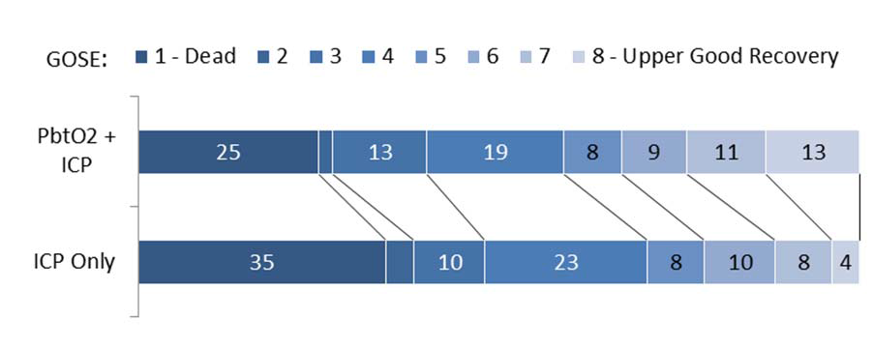
Secondary Outcome: Non-futility
Glasgow Outcome Score-Extended distribution between ICP only and PbtO2 + ICP groups.
Okonkwo DO, et al. Crit Care Med 2017;45(11):1907-1914.

Slide 17
BOOST-Phase 3 (BOOST3)
Approved by NINDS Council 9/2017
Target enrollment 1094
Sufficient to detect a 10% absolute improvement in good outcome
GOS-E Sliding Dichotomy
Planned 45 sites
Funded in August 2018

Slide 18
Primary Objective
To determine whether the prescribed treatment protocol, informed by PbtO₂ monitoring, results in improved neurologic outcome measured by the Glasgow Outcome Scale-Extended (GOS-E) 6 months after injury compared to treatment based on intracranial pressure (ICP) monitoring only.

Slide 19
Secondary Objectives
To determine whether treatment informed by PbtO2 monitoring improves functional, cognitive, and behavioral outcome at 6 months
Safety objective: To determine whether adverse events and serious adverse events associated with PbtO2 and ICP directed therapy are different from adverse events and serious adverse events for therapy directed only at ICP
To determine whether treatment informed by PbtO2 monitoring reduces total brain hypoxia exposure, measured by the area under the PbtO2 curve below 20 mmHg
To determine whether total brain hypoxia exposure is correlated with worse neurological outcome as measured with the GOS-E
To determine whether total brain hypoxia time is independently correlated with worse neurological outcome as measured by the GOS-E, mortality, and quantified by a composite outcome measure based on functional, cognitive, and behavioral assessments.

Slide 20
Inclusion Criteria
1. Non-penetrating traumatic brain injury (TBI)
2. Requirement for intracranial pressure monitoring, based on BTF / ACS TQIP Guidelines for the Management of Severe TBI, as operationalized below:
GCS 3-8 (measured off paralytics) (In intubated patients, GCS Motor score < 6)
Evidence of intracranial trauma on CT scan (Marshall Score > 1)
If patient has a witnessed seizure, wait 30 min to evaluate GCS
3. Able to place intracranial monitors and randomize within 6 hours of arrival at enrolling hospital, but no later than 12 hours from injury
4. Males and females ages >14

Slide 21
Exclusion Criteria
1. Bilaterally absent pupillary response in the absence of paralytic medication
2. Contraindication to the placement of parenchymal monitors, such as uncorrectable coagulopathy
3. Refractory hypotension (SBP < 90 mmHg for two consecutive readings at least 5 minutes apart any time prior to randomization)
4. Refractory systemic hypoxia (SaO₂ < 90% or F_{i}O₂ > 0.5 for two consecutive readings at least 5 minutes apart any time prior to randomization)
5. PaO₂/FiO₂ ratio < 200
6. Pre-existing neurologic disease (e.g. TBI, stroke, or neurodegenerative disorder) with confounding residual neurologic deficits
7. Inability to perform activities of daily living (ADL) without assistance prior to injury
8. Known active drug or alcohol dependence that, in the opinion of site investigator, would interfere with physiological response to PbtO₂ treatments
9. Non-survivable injury (e.g. withdrawal of care prior to randomization, no intention for aggressive intervention, on hospice or DNR order etc.)
10. Pregnancy
11. Prisoner or ward of the state

Slide 22
Types of events |  | ICP < 22 | ICP > 22
PbtO₂ > 20 |  | Type A No interventions directed at PbtO₂ or ICP needed | Type B Interventions directed at lowering ICP
PbtO₂ < 20 |  | Type C Interventions directed at increasing pBtO₂ | Type D Interventions directed at lowering ICP and increasing pBtO₂

Slide 23
Isolated ICP increase | Isolated PbtO₂ drop | ICP increase + PbtO₂ drop
TIER 1 Adjust head of the bed to lower ICP Ensure Temperature < 38 oC. Adjust pharmacologic analgesia and sedation: Titrate to effect. CSF drainage (if EVD available) Titrate to effect. Standard dose Mannitol (0.25 – 1.0 g/kg), to be administered as bolus infusion. Hypertonic saline. Titrate to ICP control and maintain serum Na+ 155-160). | TIER 1 Adjust head of the bed to improve brain oxygen level Ensure Temperature < 38 oC. Increase CPP to 70 mm Hg with fluid bolus. Optimize hemodynamics. Increase PaO2 by increasing FiO2 to 60%. Increase PaO2 by adjusting PEEP Add EEG monitoring Consider adding AED’s, either Dilantin or Keppra, for 1 week only. | TIER 1 Adjust head of the bed to lower ICP Ensure Temperature < 38 oC. Pharmacologic analgesia and sedation CSF drainage (if EVD available). Increase CPP up to a maximum >70 mm Hg with fluid bolus. Standard dose Mannitol, to be administered as bolus infusion. (0.25 – 0.5 mg/kg). Hypertonic saline Adjust ventilator parameters to increase paO2 by increasing FiO2 to 60%. Increase FiO2 by increasing PEEP. Consider EEG monitoring Consider AED’s, either Dilantin or Keppra, for 1 week only.
TIER 2 Adjust ventilatory rate to lower paCO2 to 32 – 35 mm Hg. High dose Mannitol > 1 g/kg. Repeat CT to determine if increased size of intracranial mass lesions. Treat surgically remediable lesions with craniotomy according to guidelines. Adjust temperature to 35 – 37o C, using active cooling measures. | TIER 2 Adjust ventilator parameters to increase paO2. by increasing FiO2 to 100%. Increase paO2 by adjusting PEEP Increase CPP up to a maximum of 70 mmHg with vasopressors. Adjust ventilatory rate to increase paCO2 to 45 – 50 mm Hg. Transfuse pRBCs to reach Hgb > 10 g/dL. Decrease ICP to < 10 mm Hg. CSF drainage. Increased sedation. | TIER 2. High dose Mannitol 1 g/kg, or frequent boluses standard dose Mannitol Increase CPP up to maximum of 70 mm Hg with vasopressors. Adjust ventilator parameters to increase paO2 by increasing FiO2 to 100%. Increase FiO2 by increasing PEEP Transfuse to Hgb > 10 g/dL. Repeat CT to determine if increased size of intracranial mass lesions. Treat surgically remediable lesions with craniotomy according to guidelines Induced hypothermia to 35 - 37o C, using active cooling measures.
TIER 3 (Tier 3 therapies are optional). Pentobarbital coma, according to local protocol. Decompressive craniectomy. Adjust temperature to 32 – 34.5o C, using active cooling measures. Neuromuscular paralysis |  | TIER 3. (Tier 3 therapies are optional). Pentobarbital coma: Decompressive craniectomy. Induced hypothermia. hypothermia to 32 – 34.5o C. Neuromuscular paralysis
Notes:
This is too busy a slide which I do not expect you to read, but it illustrates that the treatment protocol used was a distillation of evidence-based but PRIMARILY expert opinion representing what neurointensivists do on a daily basis when managing severley ill patients with TBI.
The protocol targets the abnormality detected at any epoch in the ICU—isolated intracranial hypertension, isolated brain tissue hypoxia, or the combination of both, since each require different (and in some cases opposite) interventions.
The protocol is pragmatic, and recognizes that the practice in the Neuro ICU is complex, and the study protocol should not seek to replicate a textbook of Neurocritical Care Medicine. The protocol was arranged in hierarchical tiers, with less intense and less dangerous interventions in Tier 1, with more intense and risky interventions in Tiers 2 and 3. Within each tier there were several options, and it was up to the staff in each ICU to choose which options to apply, baed on the clinical details of each patient.
What was tested was the protocol informed by PbtO2 and ICP data, compared to the protocol informed by only ICP data. PbtO2 was recorded in both groups, but in the ICP only group the number was masked and treating physicians were blinded to it.

Slide 24
Clinical Standardization Guidelines
Pragmatic guidelines aimed at minimizing treatment variability across study centers
Recognize the complexity and heterogeneity of TBI, and need to rely on expertise of clinician at the bedside to analyze large amount of complex data
Facilitate monitoring of adherence and assessment of efficacy of interventions

Slide 25
Exception from Informed Consent (EFIC) for Emergency Research
Regulatory Authority
Secretarial Waiver 45CFR46.101(i)
Requirements still at 21CFR50.24
Prior Experience
Community Consultation
Public Disclosure
Central IRB
Hybrid approach to enrollment
Prospective LAR consent
EFIC with LAR consent to continue
Implementation
Training
Tracking and accountability
Notes:
45CFR46.101(i) and the HHS Secretarial Waiver at FR Doc. 96–24968 versus 21CFR50.24

Slide 26
QUESTIONS?

