Slide 1
Helpful Hints for Interpreting and Entering Tier Interventions
Anita Fetzick
Ava Puccio
Carol Moore
boost-trainers@umich.edu

Slide 2
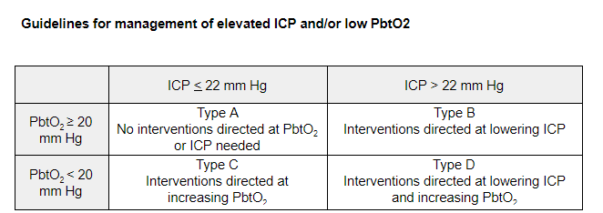
Definition of an Episode
Episode start:
ICP elevation (>22mmHg) that is sustained for > 5minutes
PbtO2 decline (<20 mmHg) that is sustained for > 5 minutes
End of Episode:
When an abnormality is treated and has resolved with normal values for at least 30 minutes
Participants in the treatment (PbtO2 + ICP) arm may start in one type of episode and move to another. This will appear as an annotation in CarePath.
Notes:
Treatment is tier based and triggered by abnormalities in either ICP (> 22 mmHg) or PbtO2 (< 20 mmHg). Elevations in ICP above 22 mm Hg, or a decline in PbtO2 below 20 mm Hg, which are sustained for more than 5 minutes will trigger intervention. Although 5 minutes of abnormal values are required to confirm a sustained abnormality requiring a treatment intervention, the actual start of an Episode is defined as the time when the value first exceeded the target value. Treatments must be initiated within 15 minutes of the start of the episode, as detected by the continuous ICP and PbtO2 recordings. The Moberg monitor will be programmed to signal the treating team in real time, when an intervention is recommended. It is expected that a treatment intervention will be initiated as soon as possible after the start of the episode.
An Episode ends when an abnormality is treated and has resolved with normal values occurring for a duration of 30 minutes.
If another abnormality begins after 30 minutes of normality, a new Episode begins and the treatment team should again begin in Tier 1.
Participants may start in one type of episode and move to another. Therapy will depend on which type of episode they are in at any given time. For the participants randomized to ICP treatment alone, only Type A and Type B episodes are relevant. Participants randomized to ICP + PbtO2 treatment may fall into any of the 4 scenarios (A, B, C, or D).

Slide 3
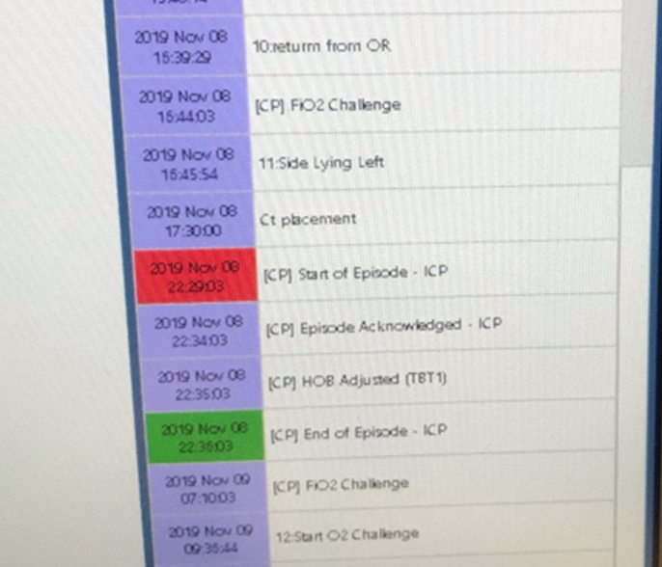
Example: Type B Event
ICP > 22 mmHg
Episode Start: 22:29
22.5 mmHg
Tier 1 Intervention: 22:35
HOB adjustment
End of Episode: 22:36
Value remained normal for at least 30 minutes
Notes:
This is an example of a simple event—the ICP elevates, an intervention is performed, and the ICP normalizes within 60 minutes, therefore there is not a requirement to escalate interventions to Tier 2. The ICP also remains normal for at least 30 minutes. This is clearly annotated in CarePath. Capturing this information as a source document is relatively simple—you can take a photo with your smartphone and email the picture to yourself; keep in mind to avoid capturing any photos with protected health information or of the patient.

Slide 4
Creating a Source Document
From Moberg:
Email photo of Moberg Screen Snapshot to your work email and save to your work computer
Copy and paste photo into a Word Document
Make sure that ICP and PbtO2 (if applicable) values are visible along with annotation/timestamp of episode start and finish.
From your electronic medical record:
Print documented values from EMR as source or provide access to EMR for study monitors.
Notes:
Capturing this information as a source document is relatively simple—you can take a photo with your smartphone and email the picture to yourself; keep in mind to avoid capturing any photos with protected health information or of the patient.
In the event where the information is not available on the Moberg device, you will need to rely on nursing documentation on the paper tool (available in the Toolbox) or the electronic medical record. Nurses will need to be careful to document any ICP or PbtO2 abnormality, along with the Tier intervention that was performed to treat it, and continue to monitor the subject’s response to the tier interventions.
Additional data that is collected on the Tier Interventions CRF include ventilator settings—these can be found in the EMR, although the location will vary among different sites. Ideally if nurses are documenting any Tier interventions that require a ventilator adjustment, it may appear as a comment in the nurse’s notes.

Slide 5
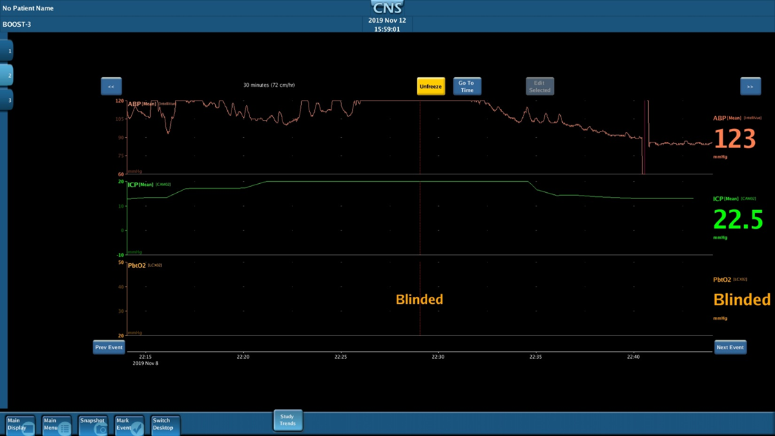
Using Moberg CNS Monitor or CarePath as a Source
2 options: CarePath or CNS Monitor Snapshot feature
Notes:
ICP > 22 mmHg
Episode Start: 22:29
22.5 mmHg
Tier 1 Intervention: 22:35
HOB adjustment
End of Episode: 22:36
Value remained normal for at least 30 minutes
The simplest way to capture this information is within CarePath—we will be sharing a video of how to visualize the ICP/PbtO2 data at a specific timepoint using the Trends screen in CarePath.
In the event that a value does not appear in CarePath, you may be able to capture it within the CNS monitor by switching the Desktop to CNS, “Freeze” the screen, and use the “Go To Time” button to visualize data at that specific timepoint. There is a Snapshot feature that will allow you to take a screenshot of the Moberg screen to save as a source document.

Slide 6
Snaps/Screenshots can be placed in a Word Document for Monitor Review:
Notes:
Study monitors can easily view the data that is entered on the Tier Intervention CRFs with a word document that incorporates your snapshots from Moberg as well as screenshots from the subject’s medical record. This is simply an example.

Slide 8
Using Your Electronic Medical Record as a Source
Notes:
In cases where data is not available on Moberg, the EMR can be used to capture abnormal ICP/PbtO2 values. This is an example of a recent subject who had a Type B event; the start and stop times were highlighted for review. Tier Interventions were documented in the comments. PbtO2 values were also available and remained within normal limits.

Slide 9
Entry Into WebDCU:
Notes:
Finally, data can be entered into WebDCU. Make sure that your source documents correspond with the data that is entered.

Slide 11
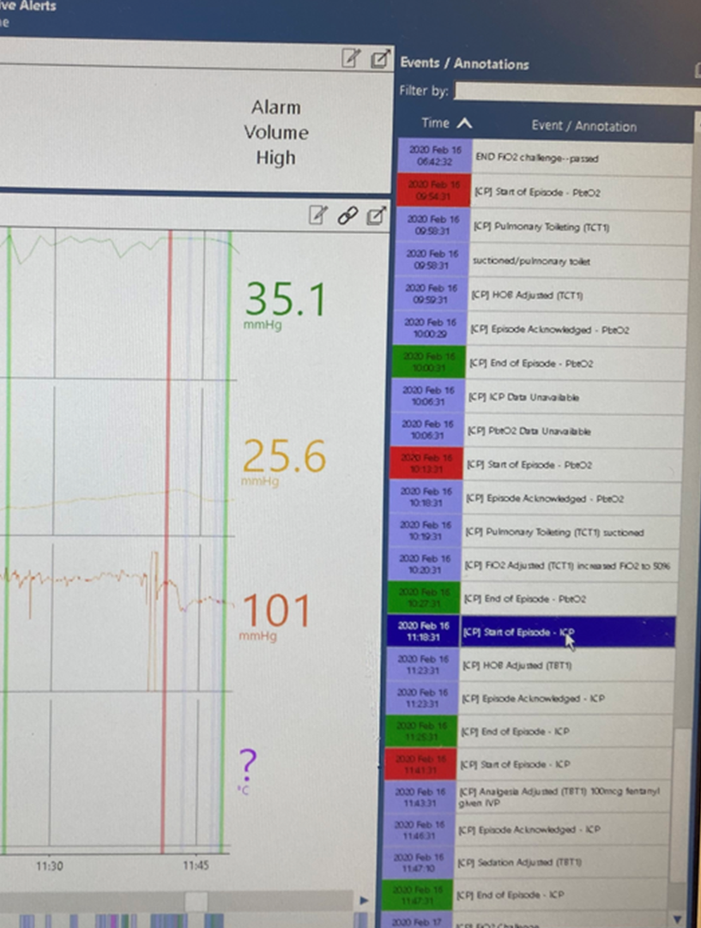
Type B Event (with recurrent abnormalities)
Episode Start:
11:18—ICP 35.1 mmHg, PbtO2 25.6 mmHg
Intervention:
11:23—HOB adjustment
ICP value is normal:
11:25
ICP elevates (<30minutes from normalization):
11:41
Intervention:
11:43—Analgesia adjustment
11:47—Sedation adjustment
End of Episode:
11:47—ICP 20.9, PbtO2 27.4
*ICP remained normal for at least 30 minutes after*
Notes:
According to the MOP, the episode ends when either the ICP and/or PbtO2 values normalize and remain normal for at least 30 minutes. This can be challenging for both the research and clinical teams to interpret, especially if they are looking at trends on CarePath, because there is an immediate annotation of “End of Episode” each time that the ICP or PbtO2 values return to normal. Study coordinators will need to remind the clinical team that these values will need to remain normal for at least 30 mintues. We are hoping that reviewing some recent examples will provide some clarity on interpreting the start and end of an episode that has recurrent abnormalities.

Slide 12
Notes:
Finally, you can see how data is entered in WebDCU. Notice that there is a separate line item for the specific times that a tier intervention was performed.

Slide 14
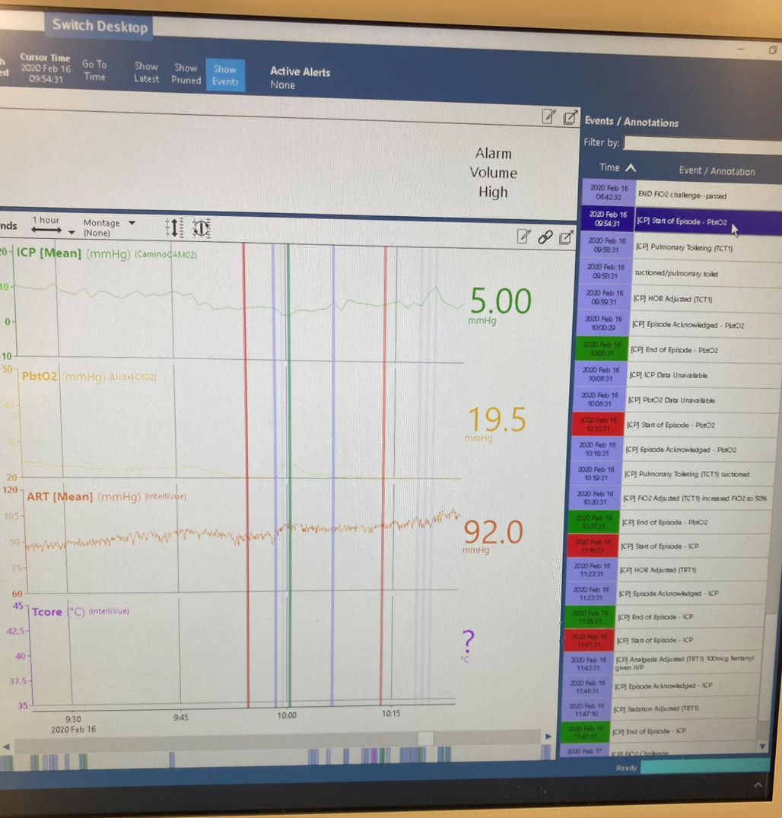
Example: Type C Event
PbtO2 < 20 mmHg
Episode Start: 09:54
19.5 mmHg
Tier 1 Interventions: 09:58
9:58—Pulmonary Toilet (Suctioned)
9:59—HOB adjustment
PbtO2 value is normal: 10:00
PbtO2 decreases (<30minutes from normalization):
10:13
Tier 1 Interventions:
10:19—Pulmonary Toilet (suctioned)
10:20—FIO2 Adjusted to 50%
End of Episode: 10:27
Value remained normal for at least 30 minutes
Notes:
This is another example of a Type C event in which there is an isolated decrease in brain oxygen, but ICP remains within normal limits at 5mmHg.

Slide 15
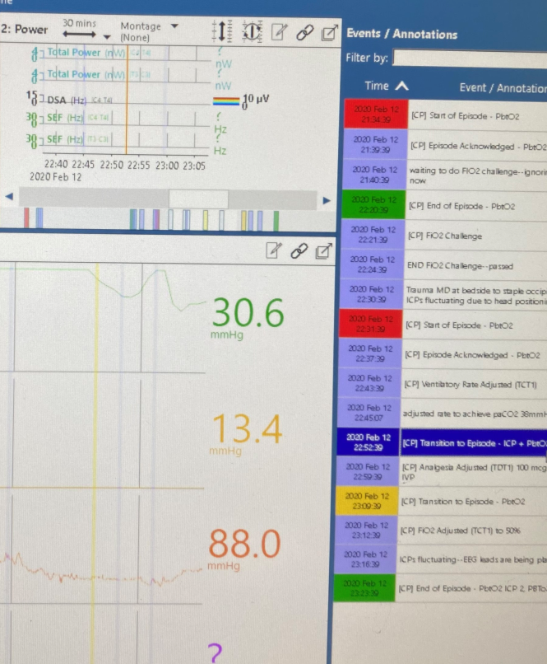
Example: Type D Event
ICP > 22 mmHg, PbtO2 < 20mmHg
Episode Start: 22:52
ICP—30.6
PbtO2—13.4
Tier 1 Intervention: 22:59
Analgesia adjusted
ICP normalized, but PbtO2 remains <20: 23:09 *Move to Type C Episode*
End of Episode: 23:09
PbtO2 normalized at 23:23
PbtO2 and ICP values remained normal for at least 30 minutes
Notes:
Participants in the treatment (PbtO2 + ICP) arm may start in one type of episode and move to another. This will appear as an annotation in CarePath as “Transition to Episode—ICP + PbtO2)”.
In this example, the Type D event started when brain oxygen was already decreased, and then the subject’s ICP elevated. The ICP normalized before the PbtO2 returned to normal range, so at that point, the Type D event ended and a new Episode began as a Type C event.
In WebDCU, there will be separate entries to indicate the transition between Events/Episodes (Type C to Type D to Type C).

Slide 16
Notes:
Putting this together: This is an example of how an episode transitioning into a different episode is captured in the CRFs. This patient started out with an isolated decrease in brain oxygen (Type C episode), then transitioned to a Type D Episode with ICP elevated and brain oxygen remained abnormal.
(Note: at the time of the start of this episode (22:31), the ICP happened to be > 22mmHg; however it was a transient elevation that was not sustained for 5 minutes. I had to write a note to file indicating this.)

Slide 17
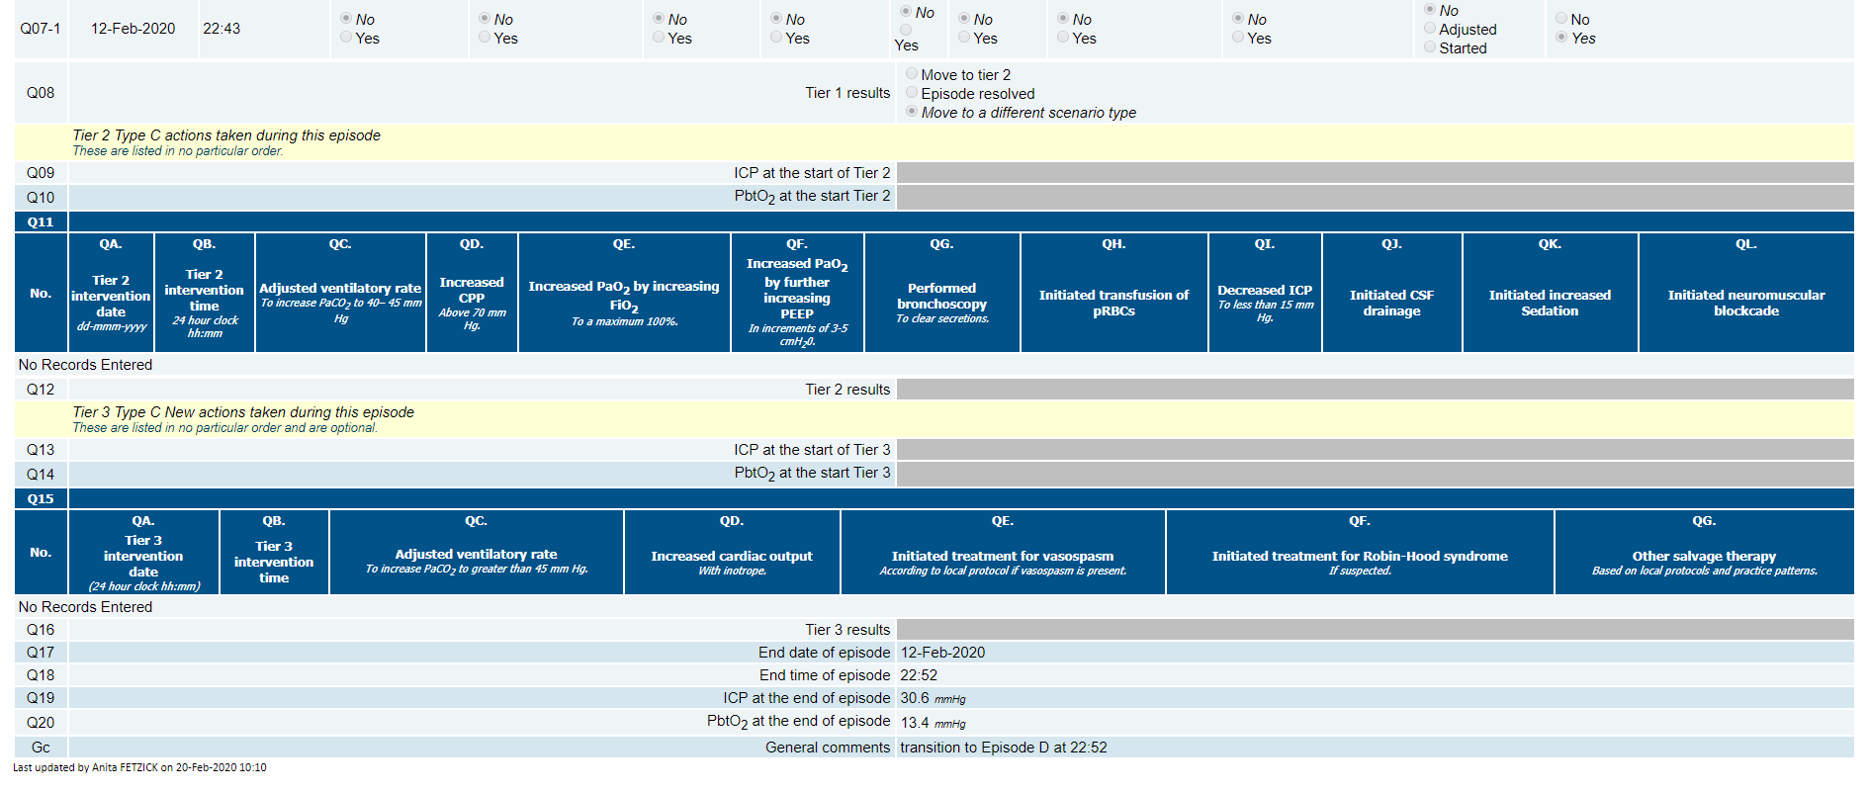
Notes:
At 22:52, ICP spiked and remained elevated for at least 5 minutes, triggering the transition to a Type D event; for data entry, we indicated that the subject moved to a different scenario type at 22:52.

Slide 18
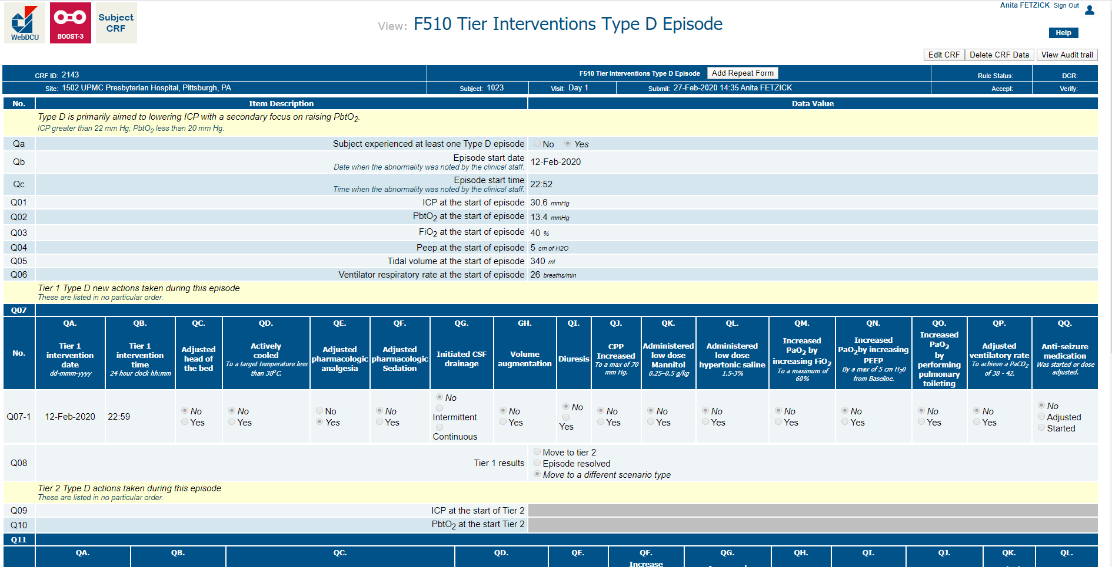
Notes:
Now we are in Type D, starting at 22:52.

Slide 19
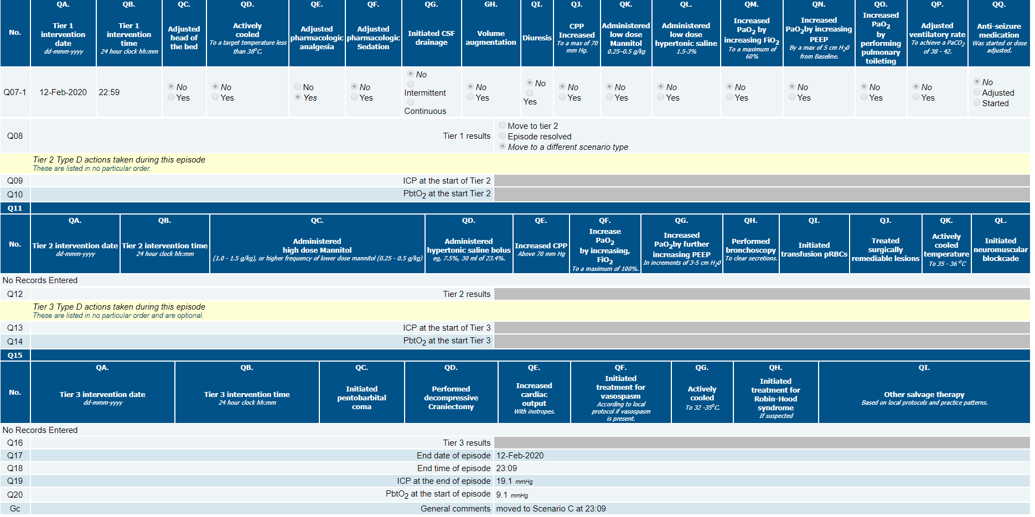
Notes:
In this case, ICP returned to normal (and remained normal for >30minutes), so the subject switched back to a Type C event, as brain oxygen remained abnormal. Since ICP returned to normal at 23:09, this event ends at 23:09. A new (Type C event) starts at this time as well.

Slide 20
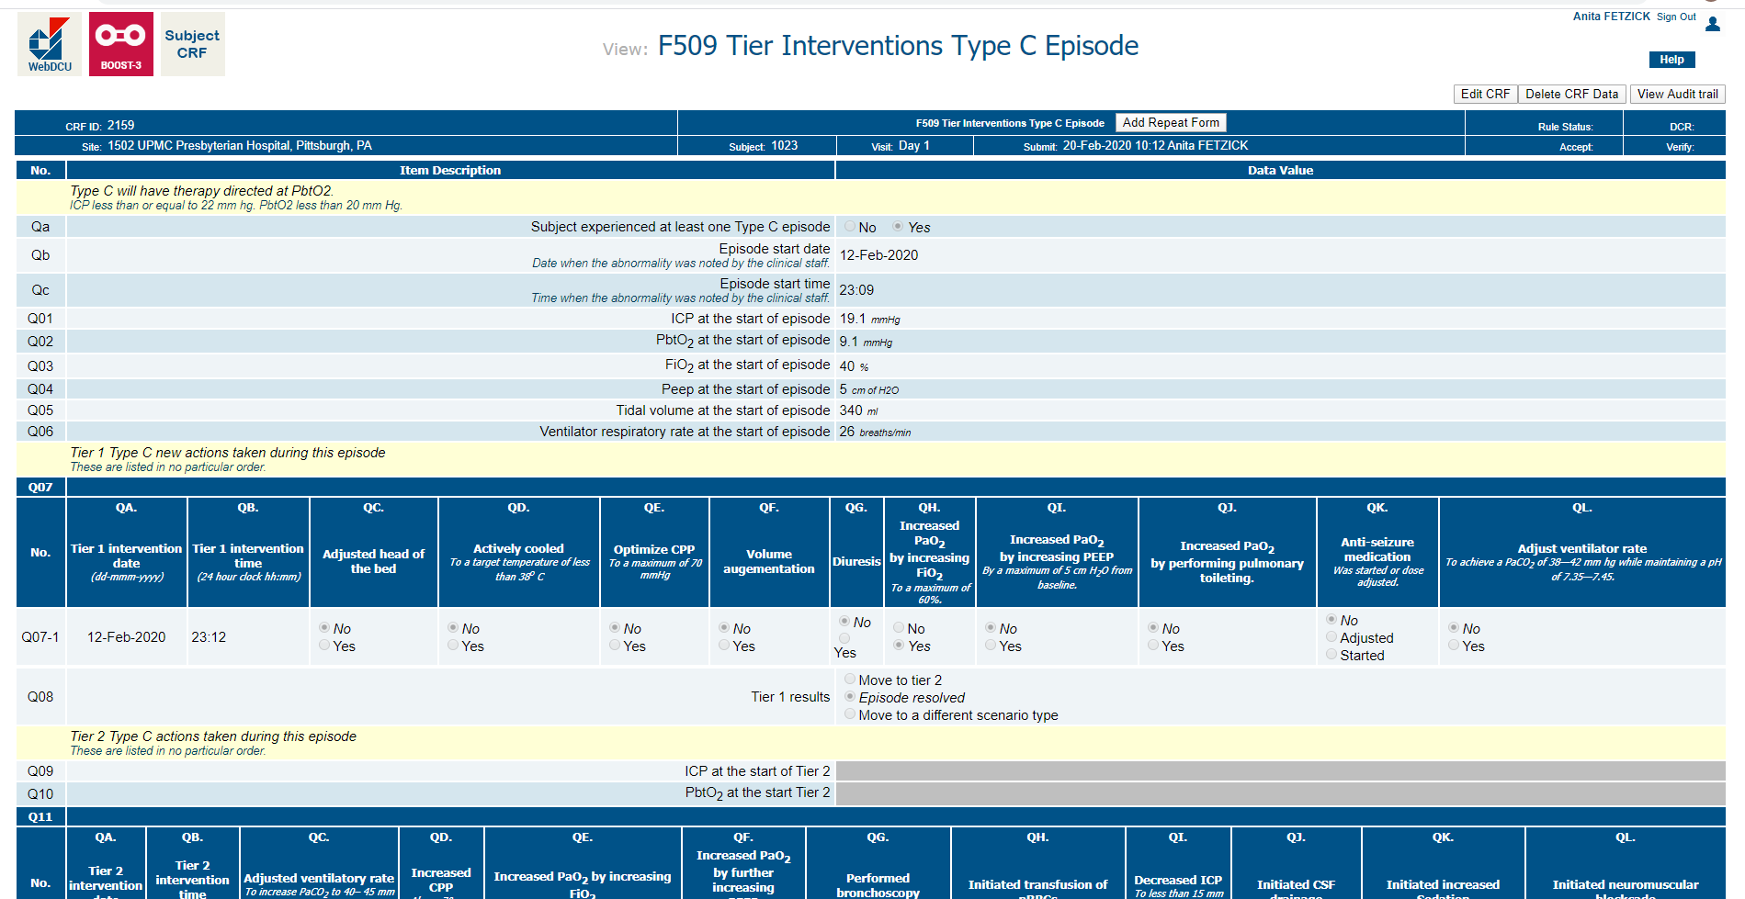
Notes:
Notice that this events starts at 23:09, when ICP returned to normal. Ultimately the episode resolved at 23:23 and was documented on the next slide.

Slide 21
