Slide 1
Adverse Event Reporting
Dr. Robert Silbergleit

Slide 2
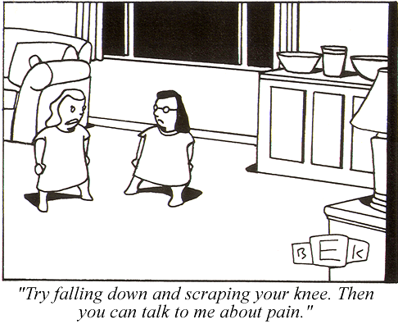
Notes:
Adverse events – seriousness is all relative

Slide 3
Adverse Event Reporting in P-ICECAP
Adverse
Serious
Severity
Relatedness
Reporting - timelines
Naming
Event type - Expectedness
Narratives

Slide 4
What is adverse?
Adverse Events (AEs) are “. . . any untoward medical occurrence in a subject that was not previously identified which does not necessarily have a causal relationship to the study drug…”
Abnormal lab values are only AE when they are deemed clinically significant by the site investigator.

Slide 5
What is serious?
Adverse events that…
Are Fatal
Are Life-threatening
Cause or prolong hospitalization
Result in disability/congenital anomaly
Require intervention to prevent permanent impairment
Report all SAE.
Report only non-serious occurring in the first 120 hours (5 days)

Slide 6
What is severity?
Is a grade of “how bad” - from 1 to 5
Use the CTCAE dictionary for event-specific severity when possible
Use the CTCAE general scheme for events not in the dictionary
Do NOT use the CTCAE dictionary for anything else.

Slide 7
What is severity?
Non-event specific severity

Slide 8
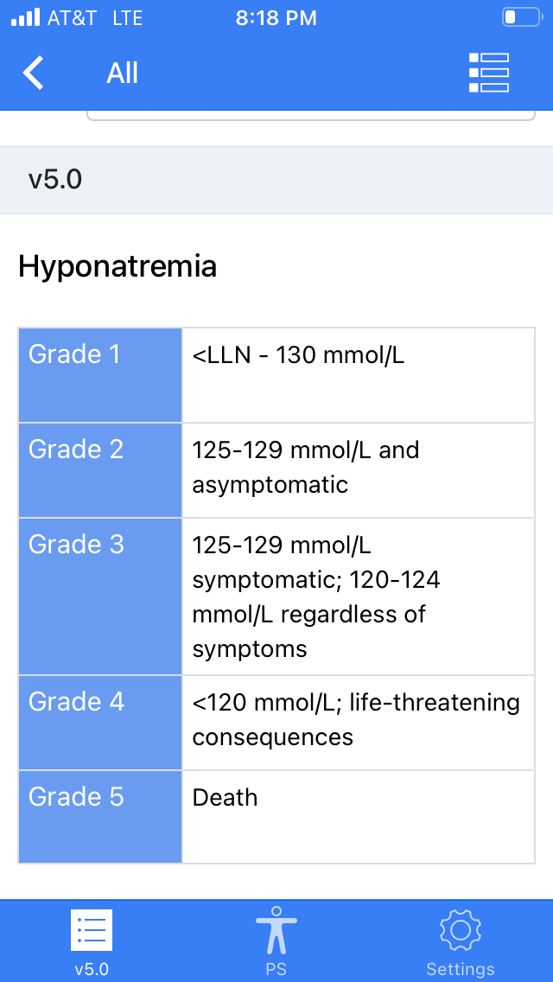
What is severity?
Event specific severity

Slide 9
What is relatedness?Relatedness algorithm
Not Related
The timing is wrong and there was clearly another cause
Unlikely (both of the following, but timing doesn’t matter)
Another cause is possible
Not something the intervention is known to cause
Reasonable Possibly (2 of 3)
Timing is suggestive.
Not readily caused by something else
This is something the intervention is known to cause.
Definitely (must have all 3)
Timing suggests intervention caused the problem.
No other possible cause.
This is something the intervention is known to cause.

Slide 10
What is relatedness? Relatedness algorithm
The intervention in P-ICECAP is duration of cooling
Not use of a temperature control device or TTM per se

Slide 11
What not to report…
Do not report events EXISTING PRIOR to randomization
(unless there is a change in severity)
Do not report “just in case”
Repeated occurrences that are really part of a single event
CD
Notes:
11

Slide 12
How to report
Form 104 – Adverse Event Case Report Form (CRF)
One AE per CRF

Slide 13
Data Entry Timelines
Non-serious AEs must be entered and submitted within 5 days of study team discovery.
SAEs must be entered and submitted within 24 hours of discovery by the study team.

Slide 14
Naming
Report the DIAGNOSIS, not the symptoms:
Fever, cough, chest pain, crackles = pneumonia
Report the PATHOLOGY, not the outcome or treatment
Not ‘death’ but the event that caused death
Not ‘intubation’ but the event that required it
The MedDRA dictionary

Slide 15
Naming
Like T.S. Eliot’s cats, the naming of events is a difficult matter,
and like his cats, events have three different names…
Event name
LLT - lowest level term
Preferred term

Slide 16
Naming

Slide 17
Naming when there is a procedure
Is getting cannulated and placed on ECMO an SAE?
Is getting renal replacement therapy an SAE?
Is placing a transthoracic cardiac pacemaker an SAE?

Slide 18
Naming fatal events
Is a death an SAE?
Provide the cause of death. Don’t use “synonyms” for death.
What if the cause of death is a pre-existing condition?
Is withdrawal-of-life-sustaining treatments ever an SAE?

Slide 19
AE of special interest (Q12 Event Type)
Pneumonia
Blood stream infection
Urinary tract infection
Cardiac arrhythmia requiring intervention
Neurological worsening
Hypokalemia
Neutropenia
Thrombocytopenia
Seizures
Repeated cardiac arrest
Other adverse event
Set apart by study-specific definitions - and are typically serious

Slide 20
Write good SAE narratives
Be concise but complete (not comprehensive) - think 1000 characters
Include only the pertinent PMH and HPI
Describe the event
Describe the response
Describe the outcome
And say when each of those happened
Look for and respond to queries promptly
Notes:
It is important for us here at the CCC and for all your site co-investigators.

Slide 21
How are SAE narratives used?
Medical safety monitor
DSMB
Study Leadership
Notes:
It is important for us here at the CCC and for all your site co-investigators.

Slide 22
Example narrative (637 characters)
A 41 yo woman was resuscitated from asystolic cardiac arrest on 7/31/21. Cooling with a definitive device started at 10:07. Head CT at 10:57 showed edema and subsequent over-read indicated impending uncal herniation. FOUR score remained at a 0 throughout hospital stay. Clinical exam was consistent with brain death though determination was confounded by methadone ingestion, which also precluded an apnea trial. Following the planned duration of cooling and rewarming, a radionuclide brain perfusion scan was conducted on 8/2/21 at 09:40 which was consistent with brain death. Brain death was confirmed and she died on 8/2/21 at 09:40.

Slide 23
Too much (2357 characters)
73-year-old male with no known past medical history who presented with an out-of-hospital witnessed cardiac arrest on September 8, 2020. He had bystander CPR, AED was placed and had a shockable rhythm defibrillated twice. EMS, patient was found to be in PEA and CPR was continued and was given ACLS until ROSC was achieved. Patient was intubated in the field and initial ECG reportedly showed ST elevations. However, the patient was evaluated by cardiology and was thought tdid not meet criteria for a STEMI. As result, targeted temperature management was started. Cooling duration of 12 hours and rewarming over 12 hours per ICECAP protocol. Rewarming was completed 9/9 @16:09 On September 10, purposeful movement was noted and His neurologic examination today was reported as being reassuring. Patient was being diuresed, however his urine output dropped. Also, lactate was noted to be elevated intermittently, highest of the day was 3. Creatinine was up to 1.19 from 0.8. LFTs were only minimally elevated. His distal extremities were somewhat cool, more proximally they were lukewarm. over the course of the day, the patient had a new norepinephrine requirement as well as dobutamine. Transthoracic echocardiogram was done on 9/9/2020 and showed an LVEF of 24%. RV was not well visualized but probably normal. No significant valvular lesions noted. There is mild concentric LVH. There is severe global hypokinesis. Troponins were noted to be 8.49 at their peak, downtrending 2.16. PA catheter was placed and the patient's RA pressure was measured at approximately 14, PA pressure was 70/54, PA saturation was 56, cardiac output was 3.27, cardiac index is 1.62, SVR was 905. PA pulsatility index was 0.67, cardiac power output is 0.44. Due to the patient's decreased urine output, increasing pressor and inotrope requirement, and decreased ejection fraction in the setting of a presumed VF arrest, the patient was taken for expedited coronary angiogram as well as placement of an intra-aortic balloon pump. The coronary angiogram was without evidence of significant obstructive lesions. . Update: 9/14. pt doing much better. hemodynamically stable, off pressors. balloon pump and PAC removed 9/13, urine output and CL improved. Pt extubated, following commands and interacting, although still somewhat confused. Continues on broad spectrum abx.

Slide 24
Too much - Just enough
73-year-old male was resuscitated following PEA arrest 9/8/20. Cooling with a definitive cooling device was initiated 9/8/20 at HH:MM and he completed the protocol 9/9/20 at 16:09. TTE 9/9/20 revealed LVEF 24% with severe global hypokinesis. On 9/10/20, the patient began to have decreased urine output, elevated lactate, increased creatinine and developed a vasopressor and inotrope requirement. The patient was taken for a coronary angiogram and intra-aortic balloon pump. The angiogram was without evidence of significant obstructive lesions. The IABP was removed 9/13, and the patient was taken off pressors 9/14/20. The patient’s clinical status continues to improve.

Slide 25
Too much - resolution
73-year-old male with no known past medical history who presented with an out-of-hospital witnessed cardiac arrest on September 8, 2020. He had bystander CPR, AED was placed and had a shockable rhythm defibrillated twice. EMS, patient was found to be in PEA and CPR was continued and was given ACLS until ROSC was achieved. Patient was intubated in the field and initial ECG reportedly showed ST elevations. However, the patient was evaluated by cardiology and was thought tdid not meet criteria for a STEMI. As result, targeted temperature management was started. Cooling duration of 12 hours and rewarming over 12 hours per ICECAP protocol. Rewarming was completed 9/9 @16:09 On September 10, purposeful movement was noted and His neurologic examination today was reported as being reassuring. Patient was being diuresed, however his urine output dropped. Also, lactate was noted to be elevated intermittently, highest of the day was 3. Creatinine was up to 1.19 from 0.8. LFTs were only minimally elevated. His distal extremities were somewhat cool, more proximally they were lukewarm. over the course of the day, the patient had a new norepinephrine requirement as well as dobutamine. Transthoracic echocardiogram was done on 9/9/2020 and showed an LVEF of 24%. RV was not well visualized but probably normal. No significant valvular lesions noted. There is mild concentric LVH. There is severe global hypokinesis. Troponins were noted to be 8.49 at their peak, downtrending 2.16. PA catheter was placed and the patient's RA pressure was measured at approximately 14, PA pressure was 70/54, PA saturation was 56, cardiac output was 3.27, cardiac index is 1.62, SVR was 905. PA pulsatility index was 0.67, cardiac power output is 0.44. Due to the patient's decreased urine output, increasing pressor and inotrope requirement, and decreased ejection fraction in the setting of a presumed VF arrest, the patient was taken for expedited coronary angiogram as well as placement of an intra-aortic balloon pump. The coronary angiogram was without evidence of significant obstructive lesions. . Update: 9/14. pt doing much better. hemodynamically stable, off pressors. balloon pump and PAC removed 9/13, urine output and CL improved. Pt extubated, following commands and interacting, although still somewhat confused. Continues on broad spectrum abx.
73-year-old male was resuscitated following PEA arrest 9/8/20. Cooling with a definitive cooling device was initiated 9/8/20 at HH:MM and he completed the protocol 9/9/20 at 16:09. TTE 9/9/20 revealed LVEF 24% with severe global hypokinesis. On 9/10/20, the patient began to have decreased urine output, elevated lactate, increased creatinine and developed a vasopressor and inotrope requirement. The patient was taken for a coronary angiogram and intra-aortic balloon pump. The angiogram was without evidence of significant obstructive lesions. The IABP was removed 9/13, and the patient was taken off pressors 9/14/20. The patient’s clinical status continues to improve.

Slide 26
Not enough
Blood culture positive for beta hemolytic strep, left peripheral line. Patient started Levaquin oral tablet qd x 10 days

Slide 27
Not enough
Blood culture positive for beta hemolytic strep, left peripheral line. Patient started Levaquin 750 mg oral tablet qd x 10 days
A 14 yo with epilepsy was enrolled on 3/15/17 at 9:02PM. On 3/17/17 she had fever, leukocytosis, and underwent a workup for an infectious source. Blood culture grew strep agalactiae sensitive to ceftriaxone and levofloxacin, but no other source was found. She was treated with ceftriaxone IV x 4 days, and levofloxacin PO x 10 days, and had no further fevers.

Slide 28
Style points
Use generic drug names
Use a spell checker
Have the site PI read critically

Slide 29
SAE review process
Site manager review
Internal quality reviewer
Independent medical safety monitor review
MedWatch

Slide 30
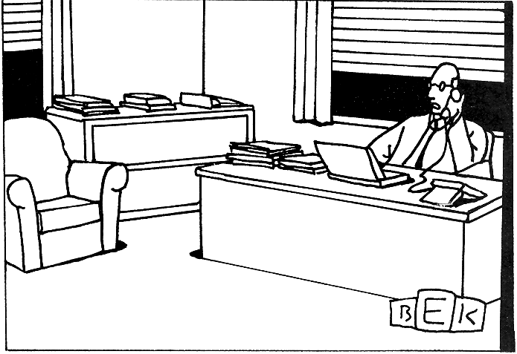
“I just have to create a few loose ends for other people to clear up, and then I can out of here.”
Notes:
Why you have to turn in SAE’s early. A lot of other people need to look at them and the clock is running

Slide 31
While being screened for enrollment in P-ICECAP, a 2 yo who had drowned has a prolonged seizure requiring treatment which resolves after several rounds of anticonvulsants. She is subsequently appropriately enrolled. Anticonvulsant medications are continued after enrollment as is continuous EEG monitoring.
Adverse event? Yes / No
Serious? Yes / No
Expected? Yes / No
Related? A. Not related
B. Unlikely
C. Reasonable Possibly
D. Definitely

Slide 32
While being screened for enrollment in P-ICECAP, a 2 yo who had drowned has a prolonged seizure requiring treatment which resolves after several rounds of anticonvulsants. She is subsequently appropriately enrolled. Anticonvulsant medications are continued after enrollment as is continuous EEG monitoring. Brief electrographic seizures are seen. No AED are added or changed.
Adverse event? Yes / No
Serious? Yes / No
Expected? Yes / No
Related? A. Not related
B. Unlikely
C. Reasonable Possibly
D. Definitely

Slide 33
While being screened for enrollment in P-ICECAP, a 2 yo who had drowned has a prolonged seizure requiring treatment which resolves after several rounds of anticonvulsants. She is subsequently appropriately enrolled. Despite continued anticonvulsants she develops more seizures in the ICU, and her propofol is titrated up from mild sedation to burst suppression.
Adverse event? Yes / No
Serious? Yes / No
Expected? Yes / No
Related? A. Not related
B. Unlikely
C. Reasonable Possibly
D. Definitely

Slide 34
An 8 yo with asthma arrests and aspirates while being endotracheally intubated. He is resuscitated and appropriately enrolled in P-ICECAP. On hospital day 3, he develops pneumonia and his PEEP is increased to improve recruitment. Three hours later he decompensates from a pneumothorax. A chest tube is placed without complications.
Adverse event? Yes / No
Serious? Yes / No
Expected? Yes / No
Related? A. Not related
B. Unlikely
C. Reasonable Possibly
D. Definitely

Slide 35
A 17 yo who arrested from an opioid overdose is resuscitated, appropriately enrolled in P-ICECAP, and randomized to 96 hours cooling duration. Temperature is monitored only with an esophageal probe. At 90 hours, his nurse notices that the esophageal probe has backed out into the pharynx. When advanced back into the esophagus, the temperature is noted to be 29 degrees, but then corrects to 33 over the next hour.
Adverse event? Yes / No
Serious? Yes / No
Expected? Yes / No
Related? A. Not related
B. Unlikely
C. Reasonable Possibly
D. Definitely

Slide 36
An 12 yo with myocarditis induced arrest and resuscitation is appropriately enrolled. On ICU day 3 her routine metabolic panel shows a potassium of 3.2 and an AST of 99 for which she receives no specific intervention.
Adverse event(s)? Yes / No
Serious? Yes / No
Expected? Yes / No
Related? A. Not related
B. Unlikely
C. Reasonable Possibly
D. Definitely

Slide 37
A 17 yo who arrested from an opioid overdose is resuscitated, and appropriately enrolled. After 7 days of diligent care, he remains unresponsive, head CT shows extensive cerebral edema with impending herniation. His parents opt for a transition to comfort care and he is terminally extubated and dies.
Adverse event(s)? Yes / No
Serious? Yes / No
Expected? Yes / No
Related? A. Not related
B. Unlikely
C. Reasonable Possibly
D. Definitely

